Slide 1
Should urinary catheter be used during routine primary knee or hip arthroplasty?
Atthakorn Jarusriwanna, MD
Postdoctoral Research Fellow; Rothman Orthopaedic Institute at Thomas Jefferson University, Philadelphia, PA, USA
Assistant Professor; Department of Orthopaedics, Faculty of Medicine, Naresuan University, Phitsanulok, Thailand

Slide 2







The Experts
Kerem Başarır,
MD
Ankara University
Türkiye
Daniele De Meo,
MD
Sapienza University of Rome
Italy
William Jiranek, MD, FACS
Duke University
USA
Koos Jordaan, MBChB, HDip,
FC Orth
Tygerberg Hospital
South Africa
Deiary Kader,
MBChB, FRCS, MFSEM
South West London Elective Orthopaedic Centre
UK
Gökhan Kaynak, MD
Cerrahpaşa School of Medicine
Türkiye
Gabriele Tucci, MD
Ospedale dei Castelli Ariccia
Italy

Slide 3
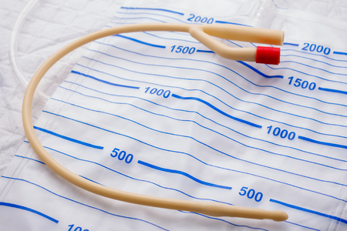
It is controversial whether the use of urinary catheters in routine primary knee or hip arthroplasty is necessary.
Pros
  May prevent urinary retention
  Volume monitor/management
Cons
  May reduce mobility; increase length of hospital stay and costs
  Increase risk of UTIs

Slide 4
Literature review/process
Inclusion criteria
  Primary total knee or total hip arthroplasty
  The use of urinary catheter/Foley catheter/bladder catheter
  Complications related to the bladder and infection (bladder dysfunction/incontinence/urinary retention/urinary tract infection/periprosthetic joint infection)
  English language
Exclusion criteria
  Revision total knee or total hip arthroplasty
  The patients with preoperative requirement of a urinary catheter (e.g. permanent catheter)
  Systematic reviews, case reports, review articles

Slide 5
Literature review/process
Keywords: 3 domains
  “total joint arthroplasty” OR “total knee arthroplasty” OR “total hip arthroplasty” AND
  “urinary catheter” OR “bladder catheter” OR “Foley catheter”
  AND
  “complication” OR “urinary retention” OR “urinary tract infection” OR “periprosthetic joint infection” OR “incontinence” OR “bladder function” OR “bladder dysfunction”

Slide 6
Literature review/process
Studies from databases/registers (n = 2,320)
PubMed (n = 1,204)
Scopus (n = 892)
CINAHL (n = 224)
Identification
References removed (n = 1,118)
Duplicates identified by Covidence (n = 1,118)
Studies screened (n = 1,202)
Screening
Studies excluded (n = 1,052)
Studies assessed for eligibility (n = 150)
Studies excluded (n = 95)
Included
Studies included in review (n = 55)

Slide 7
Findings of the literature
Of 55, 29 studies did not use perioperative urinary catheters.
Definition of postoperative urinary retention (POUR)
  The inability to voluntarily empty the bladder causing bladder overload
  The inability to void that requires the placement of an indwelling or straight catheter
  Specific cut-off values for bladder volumes as measured by bladder scanning
Magaldi RJ et al. J Bone Joint Surg Am. 2024;106(7):569-74.
Mathew M et al. J Arthroplasty. 2021;36(11):3681-5.

Slide 8
Findings of the literature
Using the urinary catheter vs POUR
  The overall rate of POUR: no catheter 15.94% vs catheter 5.64% (after removal)
  The perioperative use of catheter was associated with a reduced odds of POUR (OR 0.32; 95% CI 0.28-0.35).
Using the urinary catheter vs UTIs and PJIs
  Indwelling urinary catheter → a higher risk of UTIs (OR 1.19; 95% CI 1.02-1.40).
  The risk of PJIs was comparable (OR 1.21; 95% CI 0.38-3.81).

Slide 9
Findings of the literature
The risk factors of POUR, UTIs, and PJIs
  General anesthesia → decreased odds of POUR compared to regional anesthesia (OR 0.84; 95% CI 0.74-0.95)
  High-risk patients for POUR → Male patients > 65 years + spinal anesthesia with intrathecal morphine¹
  Symptomatic benign prostatic hyperplasia (BPH) patients
    Increased risk for developing POUR (OR 2.64; 95% CI 1.93-3.61), UTIs (OR 6.24; 95% CI 2.25-17.35), and PJIs (OR 6.85; 95% CI 1.87-25.08)
¹ Dana E et al. Singapore Med J. 2023.

Slide 10
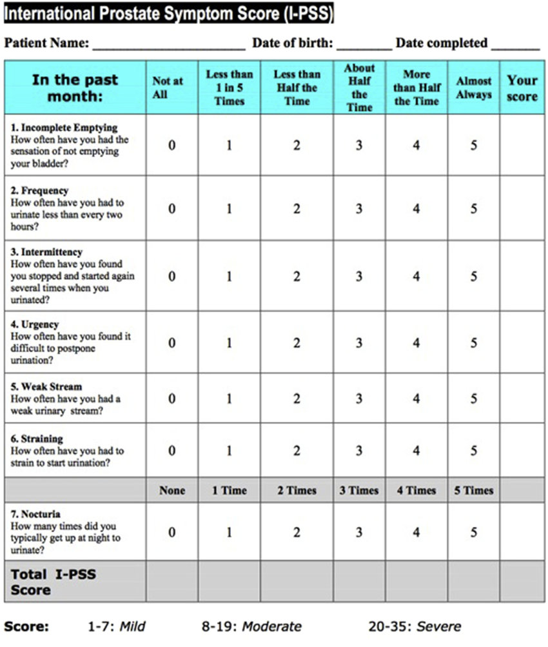
Findings of the literature
Urinary catheter suggestion
  Patients with BPH → using the International Prostate Symptom Score (IPSS) to evaluate the risk of POUR could be a useful tool to determine the necessity of prophylactic catheterization^{1,2}
  Patients who developed POUR → intermittent catheterization demonstrated a lower risk of UTIs compared to indwelling urinary catheter³
¹ Kieffer WK et al. Ann R Coll Surg Engl. 2012;94(5):356-8.
² Scholten R et al. J Arthroplasty. 2018;33(5):1546-51.
³ Garbarino LJ et al. J Arthroplasty. 2020;35(6s):S325-s9.

Slide 11
Question
Should urinary catheter be used during routine primary knee or hip arthroplasty?

Slide 12
Rationale
A comprehensive search was conducted on PubMed, Scopus, and the CINAHL database, resulting in 1,202 abstracts. After screening, fifty-five manuscripts were included in the final review. The majority of studies did not use perioperative urinary catheters (29 studies).
The overall rate of POUR in patients without the use of urinary catheters was 15.94%, while patients with perioperative placement of urinary catheters had an overall POUR rate of 5.64% after catheter removal.
The perioperative use of urinary catheters was associated with a reduced odds of POUR (OR 0.32; 95% CI 0.28-0.35).
However, indwelling urinary catheters revealed a higher risk of UTIs with an odds ratio of 1.19 (95% CI 1.02-1.40), while the risk of PJIs was comparable (OR 1.21; 95% CI 0.38-3.81).
Level of evidence: Moderate

Slide 13
Question
Should urinary catheter be used during routine primary knee or hip arthroplasty?
Response
Routine use of urinary catheters is not required in patients undergoing total joint arthroplasty.

