Slide 1
Q14: What are the absolute contraindications for elective total knee or hip arthroplasty?
Presenter: Hyonmin Choe
Yokohama City University Dept. Orthopaedic Surgery

Slide 2
Experts
Hyonmin Choe
Benjamin Ricciardi
Tae-Young Kim
Pier Francesco Indelli
Yasuhiro Homma
James Kigera
V Margarita Veloso Duran
Tahir Khan

Slide 3
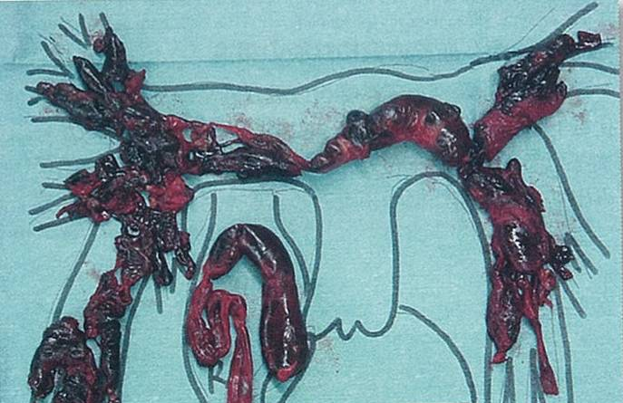
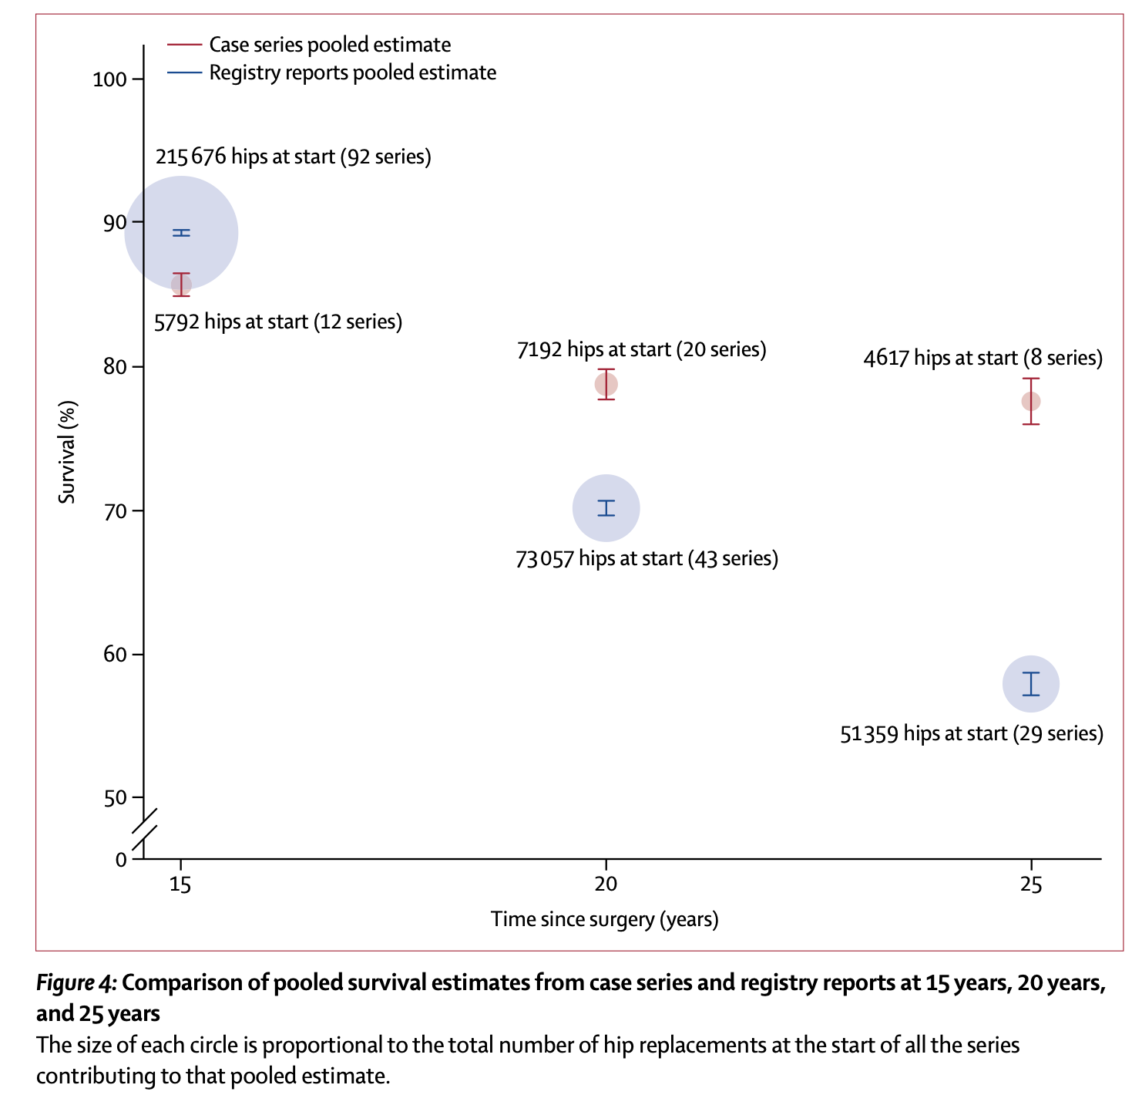
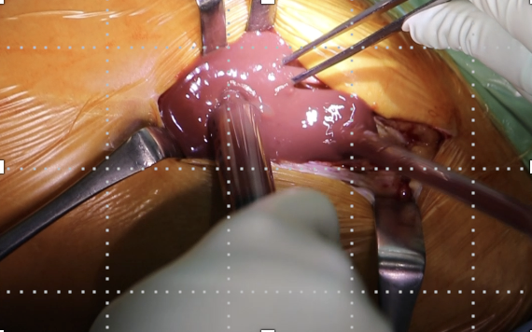
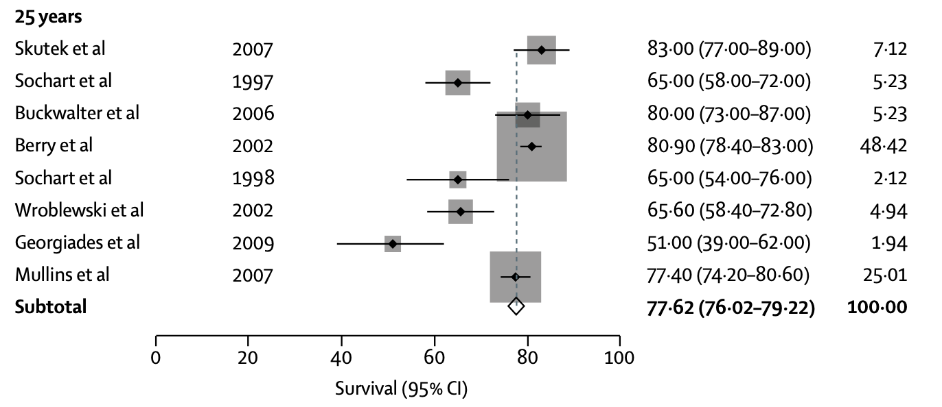
Total Knee or Hip Arthroplasty
Complications
PTE
Successful Surgery for
Degenerative Knee/Hip Diseases
Early
Mortality
Infection
Evans JT, 2019 Lancet

Slide 4
Literature Review/Process
428 articles
40 articles
Screening
Mesh Terms
("arthroplasty, replacement"[MeSH Terms] OR "Joint Prosthesis"[MeSH Terms] OR ((("arthroplast*"[Title/Abstract] OR "replacement*"[Title/Abstract] OR "Prosthesis"[Title/Abstract] OR "Prostheses"[Title/Abstract]) AND ("Knee"[Title/Abstract] OR "Hip"[Title/Abstract] OR "joint"[Title/Abstract])) OR ("Femoral Head"[Title/Abstract] AND ("Prosthesis"[Title/Abstract] OR "Prostheses"[Title/Abstract])))) AND ("absolute Contraindications"[Title/Abstract] OR "absolute Contraindication"[Title/Abstract] OR (("Contraindications"[MeSH Terms] OR "contraindication*"[Title/Abstract]) AND ("Infections"[MeSH Terms] OR "infection*"[Title/Abstract] OR ("Death"[MeSH Terms] OR ("Death"[Title/Abstract] OR "End Of Life"[Title/Abstract])) OR ("Venous Thrombosis"[MeSH Terms] OR "Thrombophlebitis"[MeSH Terms] OR ("Phlebothrombosis"[Title/Abstract] OR "Phlebothromboses"[Title/Abstract] OR (("Venous"[Title/Abstract] OR "Vein"[Title/Abstract]) AND ("Thrombosis"[Title/Abstract] OR "Thromboses"[Title/Abstract])) OR "VTE"[Title/Abstract] OR "thrombophlebiti*"[Title/Abstract])))))

Slide 5
Absolute contraindications for elective TKA/THA ・Modifiable risk: Preventable complication necessitating postponement of surgery until the risk is optimized. ・Non-modifiable risk: Precludes patient from surgery and alternative therapies for joint pain should be pursued.
Mortality, Infection, VTE

Slide 6
Question:
What are the absolute contraindications for elective total knee or hip arthroplasty?

Slide 7
Rationale: Modifiable Risk Factors
We did an systematic review on this question.
Infection | Symptomatic bacteremia, active joint infection, active local tissue infection Severe malnutrition -serum albumin<3 g/dL, transferrin levels<200 mg/dL Uncontrolled metabolic syndrome - Obesity; BMI>50, DM; HbA1c>8% Untreated immunodeficiency conditions of human immunodeficiency virus (HIV) Uncontrolled chronic diseases - end-stage renal disease, liver cirrhosis (Child-Pugh C), congestive heart failure, chronic obstructive pulmonary disease
Early Mortality | Active DVT involving the iliofemoral or popliteal veins

Slide 8
Question:
What are the absolute contraindications for elective total knee or hip arthroplasty?
Response/Recommendation:
Modifiable absolute contraindications to performing elective total joint arthroplasty are symptomatic bacteremia, active joint or local tissue infection, severe malnutrition, uncontrolled metabolic syndrome or chronic diseases, untreated immunodeficiency, and active deep venous thrombosis (DVT) or pulmonary embolism (PE)
Non-modifiable absolute contraindications are severe medical comorbidities precluding anesthesia.
Level of Evidence: limited

