Slide 1
Is there a difference between posterior stabilized, cruciate retaining, or medial pivot implants used during primary TKA?
Phillips M, Davis C, Civinini R, Ebied A, Plancher K, Carbo L, Mahapatra A, Ong M, Ekhtiari S

Slide 2
Charles Davis
Roberto Civinini
Ayman Ebied
Kevin Plancher
Lisandro Carbo
Anant Mahapatra
Michael Ong
Mark Phillips
Seper Ekhtiari

Slide 3
Why is this topic Important
Numerous adaptations and advancements have been developed to improve the outcomes of TKA, but the benefits or drawbacks of these various designs is not clearly understood.
The purpose of this review is to determine if there are any differences in key outcomes between posterior stabilized, cruciate retaining, or medial pivot TKA implants

Slide 4
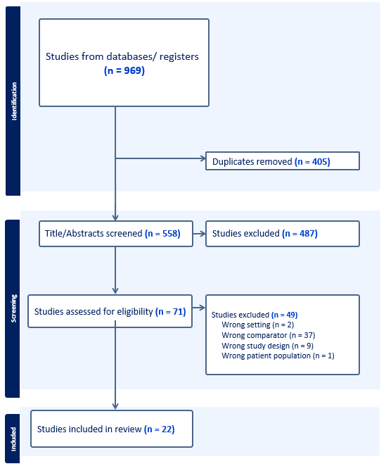
Literature Review/Process

Slide 5
There was no difference between the three implant designs regarding long-term function, which was reported in 21 out of 22 included RCTs (Figure 4).^{1-11,13-22} Posterior stabilized implants were ranked the best in terms of long-term function, although they were not significantly better than cruciate retaining (SMD: -0.13, 95% CI: -0.41 to 0.14, p=0.34, Moderate Certainty), or medial pivot (SMD: -0.14, 95% CI: -0.40 to 0.11, p=0.28, Moderate Certainty) implants.
There was no difference between the three implant designs regarding long-term function, which was reported in 21 out of 22 included RCTs (Figure 4).^{1-11,13-22} Posterior stabilized implants were ranked the best in terms of long-term function, although they were not significantly better than cruciate retaining (SMD: -0.13, 95% CI: -0.41 to 0.14, p=0.34, Moderate Certainty), or medial pivot (SMD: -0.14, 95% CI: -0.40 to 0.11, p=0.28, Moderate Certainty) implants.
Revisions
The overall revision rate across the included studies was 1.2%. The NMA comparison provided no statistically significant differences between the three TKA options.
Complications
There were no significant differences in complication rates between the three implant designs (Moderate Certainty).
NMA ranking suggests posterior stabilized implants had the best revision and complication rates, while medial pivot implants had the worst.

Slide 6
There was no difference between the three implant designs regarding long-term function, which was reported in 21 out of 22 included RCTs (Figure 4).^{1-11,13-22} Posterior stabilized implants were ranked the best in terms of long-term function, although they were not significantly better than cruciate retaining (SMD: -0.13, 95% CI: -0.41 to 0.14, p=0.34, Moderate Certainty), or medial pivot (SMD: -0.14, 95% CI: -0.40 to 0.11, p=0.28, Moderate Certainty) implants.
There was no difference between the three implant designs regarding long-term function, which was reported in 21 out of 22 included RCTs (Figure 4).^{1-11,13-22} Posterior stabilized implants were ranked the best in terms of long-term function, although they were not significantly better than cruciate retaining (SMD: -0.13, 95% CI: -0.41 to 0.14, p=0.34, Moderate Certainty), or medial pivot (SMD: -0.14, 95% CI: -0.40 to 0.11, p=0.28, Moderate Certainty) implants.
Short Term Function
Of the 22 RCTs identified, only 8 investigations reported on functional improvements between 3-6 months. There were no significant differences between these implants regarding short-term function. (Low Certainty)
Long Term Function
There was no difference between the three implant designs regarding long-term function, which was reported in 21 out of 22 included RCTs. (Moderate Certainty)
NMA ranking suggests posterior stabilized is best for longer term function, while cruciate retaining ranked best for short term function (not statistically significant)

Slide 7
Question:
Is there a difference between posterior stabilized, cruciate retaining, or medial pivot implants used during primary TKA?

Slide 8
Rationale:
We identified a total of 22 RCTs with 2528 patients enrolled across the included studies.
The pooled comparisons demonstrated similar revisions, complications, short term functional improvements, and long-term functional improvements between these three implant types.
Any differences are likely to be small in magnitude.
All three options had favorable safety profiles, as the total revision rate was 1.2% and the total complication rate was 6.9%.

Slide 9
Question:
Is there a difference between posterior stabilized, cruciate retaining, or medial pivot implants used during primary TKA?
Response:
Based on a network meta-analysis of randomized control trials, there is a lack of definitive evidence to suggest a meaningful difference in outcomes between posterior stabilized, cruciate retaining, or medial pivot total knee arthroplasty (TKA) implants.
While some minor trends in data suggested possible differences between these implants, results were not statistically significant and would likely not surpass clinically meaningful cutoffs. Due to this, surgeon preference and clinical decision making should be the determining factor behind implant choice when considering these three options.

