Slide 1
Q31 Are There any Difference in Short-Term to Mid-Term Functional Outcomes Among Different Total Knee Arthroplasty Approaches?
SMJ Mortazavi, MD,
Joint Reconstruction Research Center,
Tehran University of Medical Sciences, Tehran, Iran

Slide 2




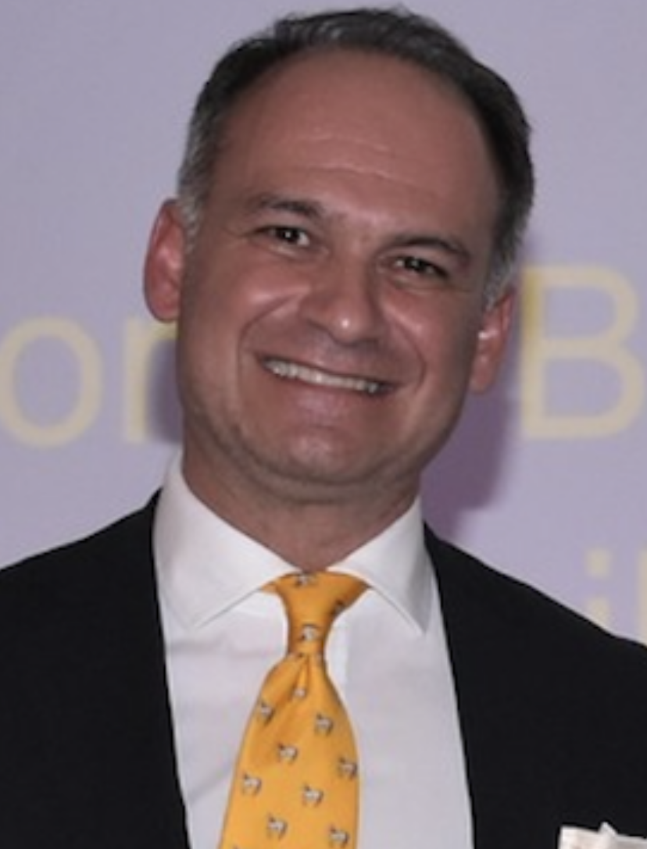



Mortazavi SMJ, Babis G, Barretto JM, Kalantar SH, Palacio JC, Razi M, Saeed M, Sancheti P, Soltani Farsani A, Tsiridis E, Vincent DM.

Slide 3
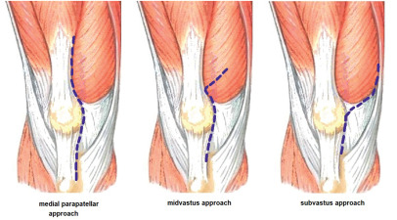
Total knee arthroplasty (TKA) approaches:
Medial parapatellar (MP),
Sub-vastus (SV),
Mid-vastus (MV),
Quadriceps-sparing (QS),
mini medial parapatellar (mini-MP)
1: Yoshida, T., Ebiko, J., Sasaki, K., Uchiyama, E., & Kura, H. (2022). Recovery process of the muscle activities during walking with efficient early quadriceps training and gait exercises after total knee arthroplasty. Journal of bodywork and movement therapies, 29, 49–53.

Slide 4
Previous studies
Yang 2023,
  at 6 months - KSS :MP = MV
  at one year - KSS: MV > MP
Bouché 2021,
  at 6 months - PROMs: all approaches comparable (except ROM that SV was superior)
  at midterm - PROMS: all approaches comparable (except KSS that mini-MP was superior)
3. Yang X, Cheng QH, Yang YZ, Zhang AR, Fan H, Guo HZ. Minimally invasive medial femoral approach to total knee arthroplasty improves short-term outcomes compared to the standard medial parapatellar approach: a systematic review and meta-analysis. J Orthop Surg Res. 2023;18(1):657.
4. Bouché PA, Corsia S, Nizard R, Resche-Rigon M. Comparative Efficacy of the Different Surgical Approaches in Total Knee Arthroplasty: A Systematic-Review and Network Meta-Analysis. J Arthroplasty. 2021;36(3):1187-94.e1.

Slide 5
Previous studies
Zhang 2021,
  at 6 months – KSS = all approached comparable
Yuan 2019,
  at midterm – KSS = QS > MP
Berstock 2018
  at 6 months – PROMs: MP = SV
3. Zhang L, Li X, Rüwald JM, Welle K, Schildberg FA, Kabir K. Comparison of minimally invasive approaches and standard median parapatellar approach for total knee arthroplasty: A systematic review and network meta-analysis of randomized controlled trials. Technol Health Care. 2021;29(3):557-74.
4. Yuan FZ, Zhang JY, Jiang D, Yu JK. Quadriceps-sparing versus traditional medial parapatellar approaches for total knee arthroplasty: a meta-analysis. BMC Musculoskelet Disord. 2019;20(1):117.
5. Berstock JR, Murray JR, Whitehouse MR, Blom AW, Beswick AD. Medial subvastus versus the medial parapatellar approach for total knee replacement: A systematic review and meta-analysis of randomized controlled trials. EFORT Open Rev. 2018;3(3):78-84.

Slide 6
Main limitation in previous studies:
  The comparison of endpoint scores without accounting for baseline variations
  Potentially masking treatment effects.
We addressed this limitation
  Comparing the improvement (delta) in functional outcomes
Notes:
The previous studies had limitations
The comparison of endpoint scores without accounting for baseline variations, potentially masking treatment effects.
We addressed this limitation
Comparing the improvement (delta) in functional outcomes between approaches at endpoint.
This method offers a more accurate evaluation of treatment effects.
This method offers a more accurate evaluation of treatment effects.

Slide 7
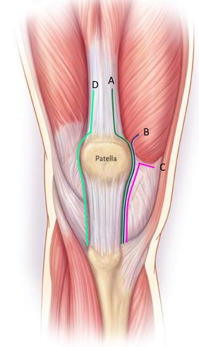
Grouping in our study:
MP (standard)
mini-MP
SV
MV and mini-MV
QS (often mini-SV)
Mini-MV
Mini-SV
2. https://www.orthobullets.com/recon/5031/tka-approaches

Slide 8
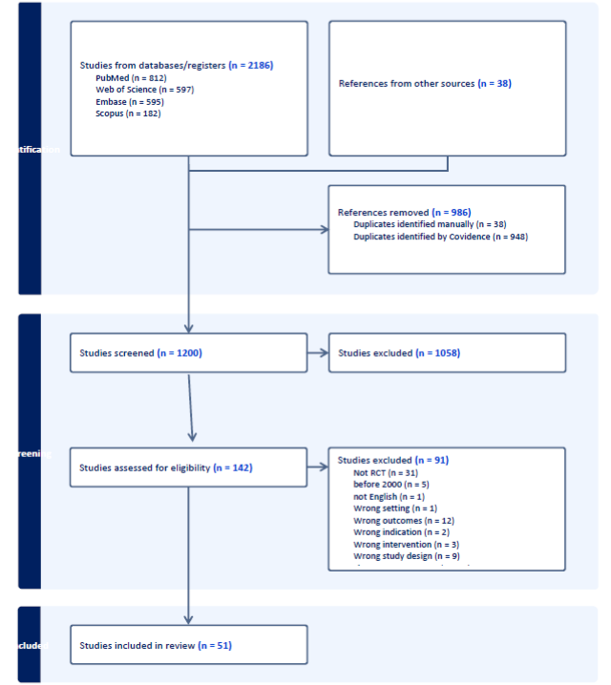
Study Selection
Searching for all RCTs after 2000
Mesh terms used: “Arthroplasty, Replacement, Knee” AND (midvastus OR subvastus OR parapatellar OR quadriceps-sparing)
51 articles were included in the final analysis

Slide 9
Outcomes
  KSS
    Clinical
    Functional
  WOMAC
  OKS
  Knee ROM
@ 6 months , 1 year and 1.5 years
Minimum Clinically Important Difference (MCID)
  KSS 5-6
  OKS 4-5
  ROM > 5 degrees

Slide 10
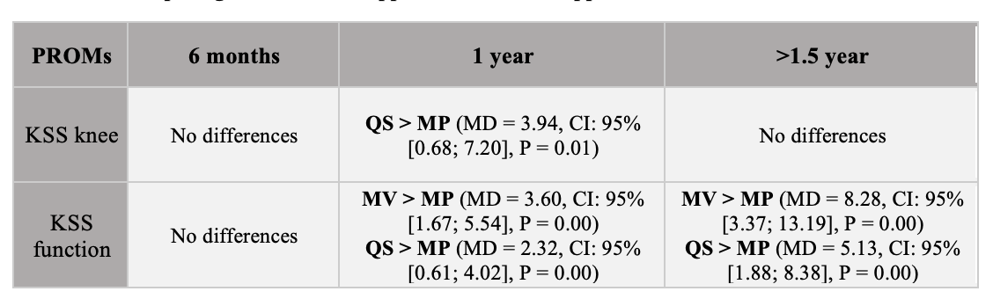
Results
KSS

Slide 11
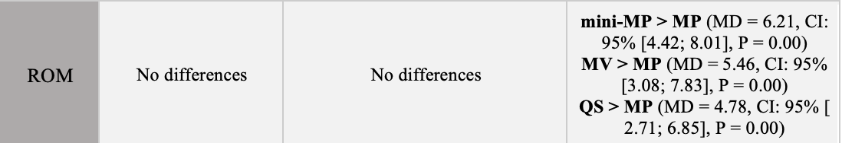
PROMS
ROM

Slide 12
Results
OKS

Slide 13

Results
WOMAC

Slide 14
Summary
At 6 months
  No significant differences in PROMs compared to MP
At 1 year
  KSS knee: QS > MP , not clinically
  KSS function: QS & MV > MP , not clinically

Slide 15
Summary
At more than 1.5 years:
  KSS function: MV & QS > MP (both clinically)
  ROM: mini-MP & MV & QS > MP (only mini-MP and MV clinically)

Slide 16
Question
Are There Differences in Short-Term to Mid-Term Functional Outcomes Among Different Total Knee Arthroplasty Approaches?

Slide 17
Question
Are There Differences in Short-Term to Mid-Term Functional Outcomes Among Different Total Knee Arthroplasty Approaches?
Recommendation
Current literature revealed no significant clinical or statistical differences in early functional outcomes (6-months post-surgery) among these approaches compared to the medial parapatellar (MP) approach.
However, extended follow-up (>1.5 years) indicated that both the quadriceps sparing (QS) and mid-vastus (MV) approaches resulted in clinically and statistically significant improvements in functional outcomes compared to the MP approach, with the MV approach demonstrating superior results in mid-term follow-up analyses.
Level of Evidence: high

