Slide 1
What are the contraindications for performing bilateral total knee arthroplasty under the same anesthesia?
Phillips M, Santori N, Gado I, Akinola B, Shahcheragi GH, Wadhwa M, Ekhtiari S.

Slide 2







Nicola Santori
Ibrahim Gado
Bola Akinola
Gholam Shahcheragi
Manuj Wadhwa
Mark Phillips
Seper Ekhtiari

Slide 3
Why is this topic important
It is important for surgeons to understand and identify the contraindications for patients to undergo simultaneous bilateral TKA to minimize patient risk and optimize recovery.

Slide 4
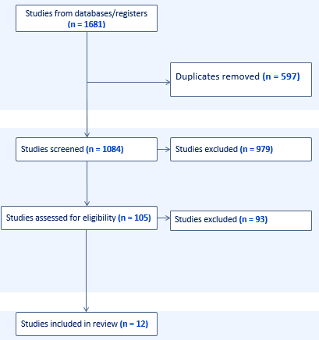
Literature Review/Process

Slide 5
There was no difference between the three implant designs regarding long-term function, which was reported in 21 out of 22 included RCTs (Figure 4).^{1-11,13-22} Posterior stabilized implants were ranked the best in terms of long-term function, although they were not significantly better than cruciate retaining (SMD: -0.13, 95% CI: -0.41 to 0.14, p=0.34, Moderate Certainty), or medial pivot (SMD: -0.14, 95% CI: -0.40 to 0.11, p=0.28, Moderate Certainty) implants.
There was no difference between the three implant designs regarding long-term function, which was reported in 21 out of 22 included RCTs (Figure 4).^{1-11,13-22} Posterior stabilized implants were ranked the best in terms of long-term function, although they were not significantly better than cruciate retaining (SMD: -0.13, 95% CI: -0.41 to 0.14, p=0.34, Moderate Certainty), or medial pivot (SMD: -0.14, 95% CI: -0.40 to 0.11, p=0.28, Moderate Certainty) implants.
Appropriate Selection Criteria
Wang et al used modeling to develop comprehensive selection criteria. This study developed a scoring system (The BTK Safety Score) to determine the suitability of simultaneous bilateral TKA
Patients were assigned points:
+1 for age ≥ 75
+2 for age ≥ 82
+1 for BMI ≥ 34
+2 for BMI ≥ 42
+1 for a patient using hypertension medication
+1 for pulmonary disease
+3 for end-stage renal disease
Patient scoring was highly correlated with the risk of complication
Contraindications
Pulmonary hypertension and congestive heart failure were most consistently determined to be risk factors for increased complication.
Advanced age >75 years old was also commonly reported as a significant predictor of complication.
BMI was evaluated in multiple studies, with conflicting results.
Appropriate Timing of Staggered TKA
For those patients who were not provided simultaneous bilateral TKA, it was recommended that staggered patients do not receive the second TKA any sooner than 3 months after the first procedure.

Slide 6
Question:
What are the contraindications for performing bilateral total knee arthroplasty under the same anesthesia?

Slide 7
Rationale:
Due to the lack of available RCT and prospective evidence, this review included any comparative study of simultaneous and staged total knee arthroplasty that specifically evaluated factors predictive of complications.
Qualitative synthesis of predictive modeling and regression results from non-randomized studies was used to summarize the contraindications found within the included studies, as meta-analysis was not possible for this data.

Slide 8
Question:
What are the contraindications for performing bilateral total knee arthroplasty under the same anesthesia?
Response:
Based on evidence primarily from retrospective cohort studies, the main contraindications for simultaneous bilateral total knee arthroplasty are advanced age, congestive heart failure, COPD, pulmonary hypertension, and renal disease.

