Slide 1
Does the Use of Ceramic Femoral Head Versus Metal Femoral Head Improve the Outcome of Primary Total Hip Arthroplasty?
Terry Clyburn, MD
Professor Orthopedic UT Houston (ret)
Total Joint Surgeon, Houston Methodist Hospital

Slide 2





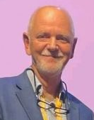


Experts
Liaisons
Terry Clyburn, MD
Jasmin Ciriviri, MD
Yihe Hu, MD PhD
Elizabeth Abe, BS
Dragan Radoicic, MD PhD
Graham Goh, MD
Koos Jordaan, MD
Eoin Sheehan, MD

Slide 3
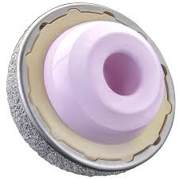
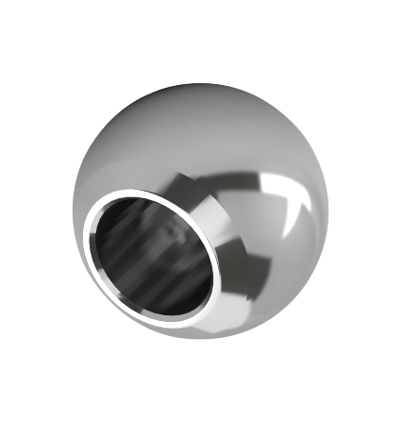
Why is this topic important?
Metal head on cross-linked polyethylene (M-on-XLP) has the longest follow-up and excellent outcomes, even in patients under 50 y/o.
Ceramic heads have improved wettability and surface smoothness and are thought to be more resistant to third body wear.
There is no current consensus on the best material for the femoral head.

Slide 4

Literature Review
Mesh Terms
Total hip arthroplasty
Hip prosthesis
Ceramic
Metal
Polyethylene
Arthroplasty, replacement hip
Prosthesis design
Prosthesis failure
Reoperation total hip
Risk Factors total hip
Follow-up studies total hip
55 original studies reviewed (2001-2022)
-Including 4,063 patients
3 Systemic Reviews With Meta-Analysis
2001-2022

Slide 5
Background
THA is highly successful, cost-effective for end-stage OA
Limitations to long-term implant survivorship¹⁻³
  Polyethylene wear
  Osteolysis
  Adverse local tissue reaction
Highly cross-linked polyethylene (XLPE) acetabular liners first introduced in 1990s⁴
  Superior resistance to wear⁵
  Largely replaced conventional polyethylene liners⁵

Slide 6
Literature Findings
Ceramic femoral heads⁶⁻¹¹
  Long-term survivorship
  Decreased risk of PJI
  Minimal risk of component fracture
Metal-on-polyethylene (MoP) versus ceramic-on-polyethylene (CoP)
  Cost + personal experience cited as factors influencing surgeon’s implant selection¹²
  Several early studies have shown no difference in wear rates^{11,13-14}

Slide 7
Literature Findings
Mertz et.al. (2023)- “Ceramic Femoral Heads Exhibit Lower Wear Rates Compared to Cobalt Chrome: A Meta-Analysis” ; 4th generation ceramic vs. metal head on XLPE
  36 studies included in review and Four studies included in meta-analysis; (287 patients, 172 ceramic heads).
  Pooled weighted data from all 36 studies- CoCr- 0.063mm/year
  Ceramic- 0.047 mm/yr ( P<0.01)
  CoCr- 0.029 mm/yr greater wear than ceramic heads.

Slide 8
Question
Does the Use of Ceramic Femoral Head Versus Metal Femoral Head Improve the Outcome of Primary Total Hip Arthroplasty?
Recommendation
Fourth-generation ceramic femoral heads with highly cross-linked polyethylene liner may be associated with decreased linear wear rates and improved patient-reported outcomes, when compared to other bearing surfaces.
Recommendation; Moderate Level

