Slide 1
Q4 Should patients with periprosthetic fracture around the hip or knee be screened, and treated, for osteoporosis?
SMJ Mortazavi, MD,
Joint Reconstruction Research Center,
Tehran University of Medical Sciences, Tehran, Iran

Slide 2





Mortazavi SMJ, Kajiyama S, Choon D, Palmer A, Cabrita H, Caglar O, Campagnoni R, Kalantar SH, Soltani Farsani A

Slide 3
Introduction
Patients with osteopenia or osteoporosis are at an increased risk of developing periprosthetic fracture (PPFx)
Osteoporosis: more common in post-menopausal women and men over 50 ₍₁₎
  One in three post-menopausal women
  One in five men over 50
No definitive literature demonstrated screening for PPFx for osteoporosis
1. LeBoff MS, Greenspan SL, Insogna KL, Lewiecki EM, Saag KG, Singer AJ, Siris ES. The clinician's guide to prevention and treatment of osteoporosis. Osteoporos Int. 2022;33(10):2049-102.

Slide 4
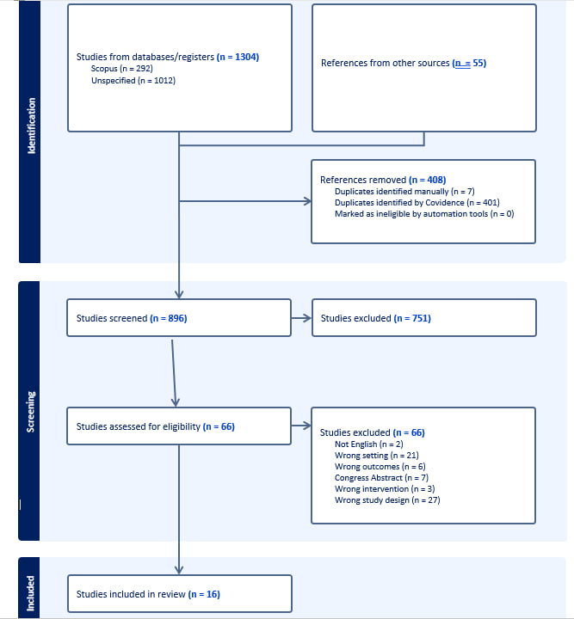
Study Selection Process
Mesh terms used: “Periprosthetic Fractures” AND bisphosphonate AND (knee replacement OR hip replacement)
16 articles were included in the final analysis

Slide 5

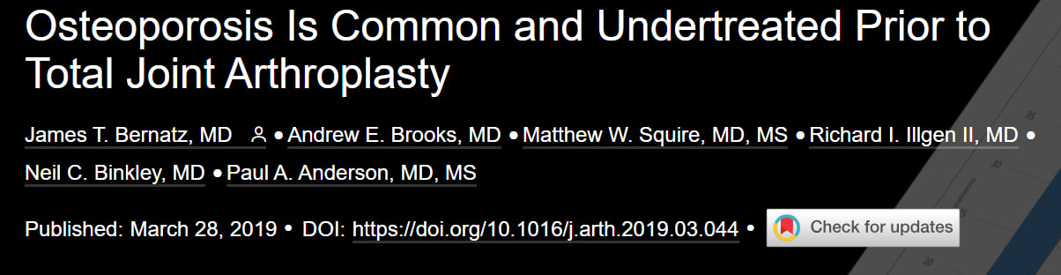
Findings from Literature
The incidence of PPFx tends to be higher in postmenopausal women and men over 50
the Bone Health and Osteoporosis Foundation (BHOF) recommends osteoporosis prevention, risk assessment, diagnosis, and treatment in postmenopausal women and men aged 50 years and older

Slide 6
Findings from Literature
Low T-score on DEXA scan and low bone density around the implant can predict the development of PPFx _{(2, 3)}
Bisphosphonates have been extensively studied and used for their effects on bone density _{(4,5)}
Bisphosphonates have shown promising results in improving bone density around implants _{(4,5)}
2. Jaroma AVJ, Soininvaara TA, Kröger H. Effect of one-year post-operative alendronate treatment on periprosthetic bone after total knee arthroplasty. BONE & JOINT JOURNAL. 2015;97B(3):337-45.
3. Muren O, Akbarian E, Salemyr M, Bodén H, Eisler T, Stark A, Sköldenberg O. No effect of risedronate on femoral periprosthetic bone loss following total hip arthroplasty A 4-year follow-up of 61 patients in a double-blind, randomized placebo-controlled trial. ACTA ORTHOPAEDICA. 2015;86(5):569-74.
4. Arabmotlagh M, Pilz M, Warzecha J, Rauschmann M. Changes of femoral periprosthetic bone mineral density 6 years after treatment with alendronate following total hip arthroplasty. J Orthop Res. 2009;27(2):183-8.
5. Shi M, Chen L, Xin Z, Wang Y, Wang W, Yan S. Bisphosphonates for the preservation of periprosthetic bone mineral density after total joint arthroplasty: a meta-analysis of 25 randomized controlled trials. Osteoporos Int. 2018;29(7):1525-37.

Slide 7
Question
Could Prophylactic Bisphosphonate Use Decrease Periprosthetic Fracture Incidence Following Total Hip and Knee Arthroplasty in Patients Over 50?
(Bisphosphonate vs Control)

Slide 8
Rationale
We conducted a comprehensive review of the literature from 2000 onward and after a thorough screening, included 16 studies in the analysis
  8 RCT
  8 Cohorts
Larger cohorts (included information from smaller cohorts) were chosen for the final analysis to minimize data overlap
Four separate meta-analyses in subgroups

Slide 9
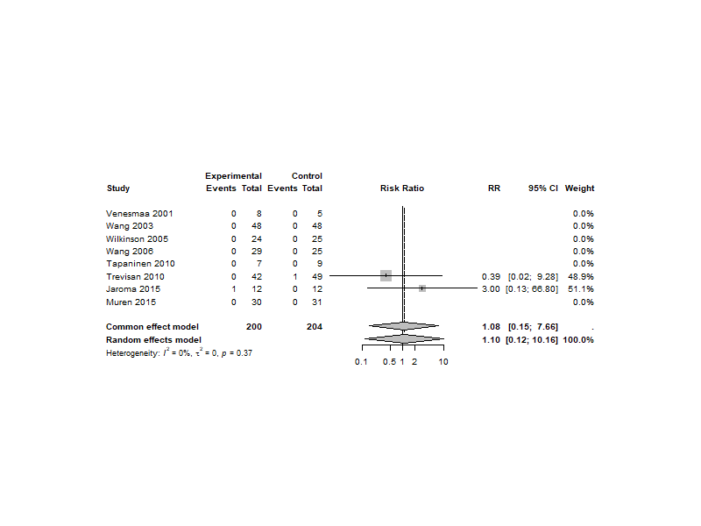
Study Design
RCTs
  Not significant
  RR = 1.08, CI: 95% [0.15; 7.66],
  P = 0.94

Slide 10
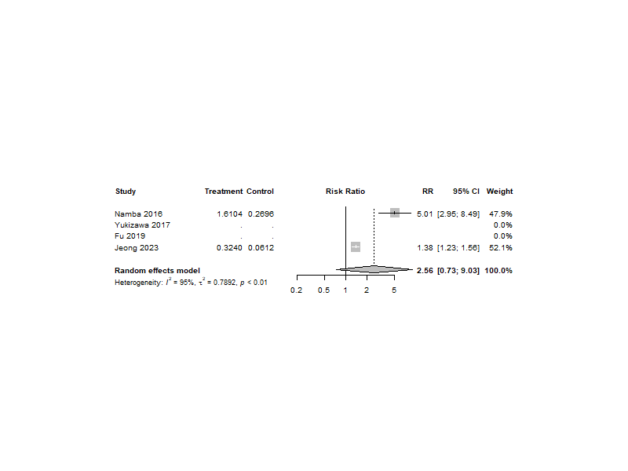
Study Design
Cohorts
  126,000 patients
  Higher PPFx in the BPs group compared to the control group,
    Not significant
    RR = 2.56, CI: 95% [0.73; 9.03]
    P = 0.14

Slide 11
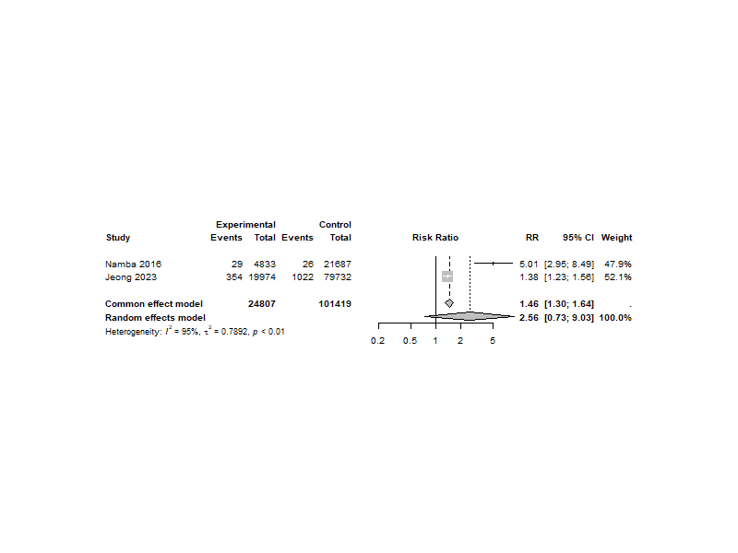
Prophylaxis
Pre-op:
  not significant
  RR = 2.56, CI: 95% [0.72; 9.03]
  P = 0.14

Slide 12
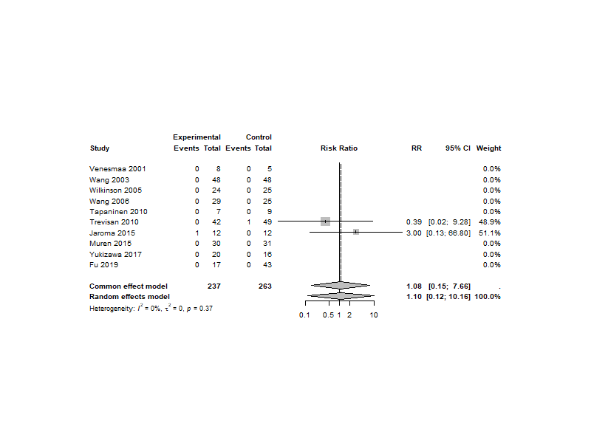
Prophylaxis
Post-ope
  not significant
  RR = 1.08, CI: 95% [0.15; 7.66]
  P = 0.94

Slide 13
Summary
The incidence of PPFx tends to be higher in postmenopausal women and men over 50, in whom osteoporosis may be more common and contribute to this complication
While bisphosphonates have been shown to improve bone mineral density, their positive impact on the incidence of PPFx is not proven.
Patients receiving prophylactic bisphosphonates appear to have a a similar rate of PPFx compared to those receiving no treatment of mere 500 mg of calcium supplements.
The available literature suggests that the rate of PPFx around the hip for certain, is influenced using uncemented components

Slide 14
Question
Should patients with periprosthetic fracture around the hip or knee be screened, and treated, for osteoporosis?
Although it is a known fact that patients with osteopenia or osteoporosis are at an increased risk of developing periprosthetic fracture (PPFx) around the hip or knee, there is no definitive literature demonstrating that screening these patients and treating them for underlying bone disease makes a difference in the rate of PPFx.
Level of Evidence: moderate
response

