Slide 1
Is there a role for resurfacing hip arthroplasty for patients with arthritis of the hip?
Hakan KOCAOĞLU
Ankara University Faculty of Medicine
Ankara
TURKEY

Slide 2
Crawford, R. Parvizi, J. Powell, J. Smailys, A. Yakub, S

Slide 3
Significance
Resurfacing Hip Arthroplasty (RHA)
Total Hip Arthroplasty (THA)
vs
Similar indications
RHA primarily intended for young cohort
Bone preservation
Conversion to THA

Slide 4
Do we still need Resurfacing Hip Arthroplasty (RHA)??

Slide 5
Literature Review/Process
“RHA” “RHA vs THA” on PubMed
National Registry Results
RHA working group
33 papers

Slide 6
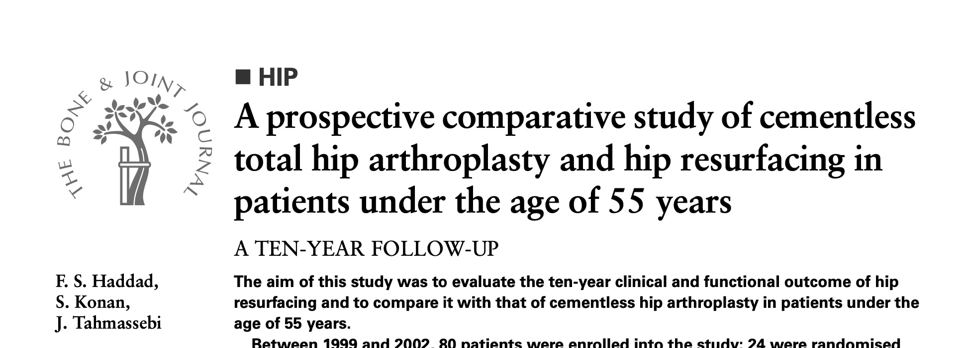
Functional Scores
Similar or better function at young patients

Slide 7
Survivorship
JBJS 2018
2024
Comparable at selected series
Notes:
Fong: Comparable results with 10-year survival more than 87%
French registry almost 100% survival at 5-year But use of RHA is strictly controlled
American experience is around the same with an experiencede surgeon

Slide 8
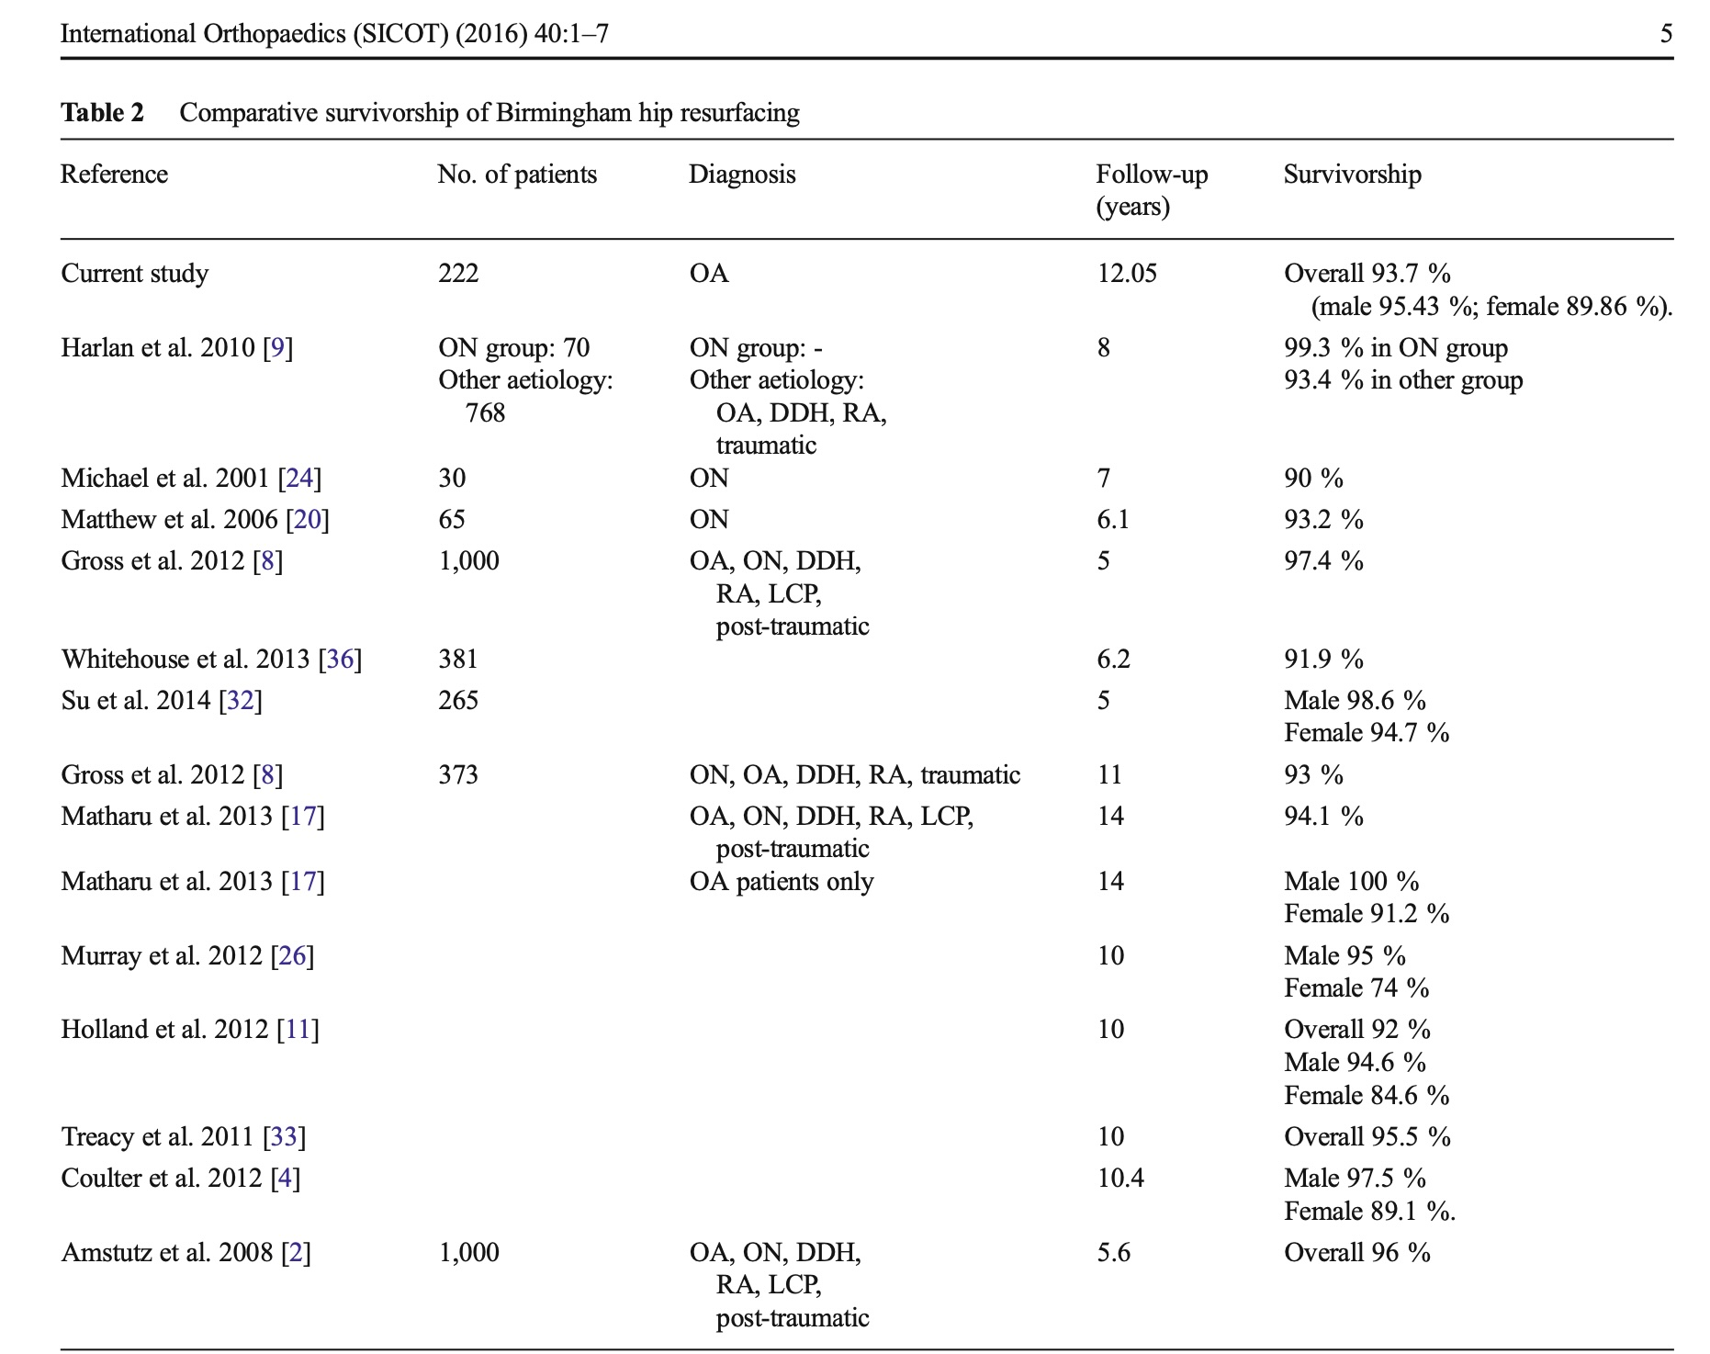
Female patients had significantly worse results

Slide 9
Concerns/Problems
Metal ions
ALTR

Slide 10
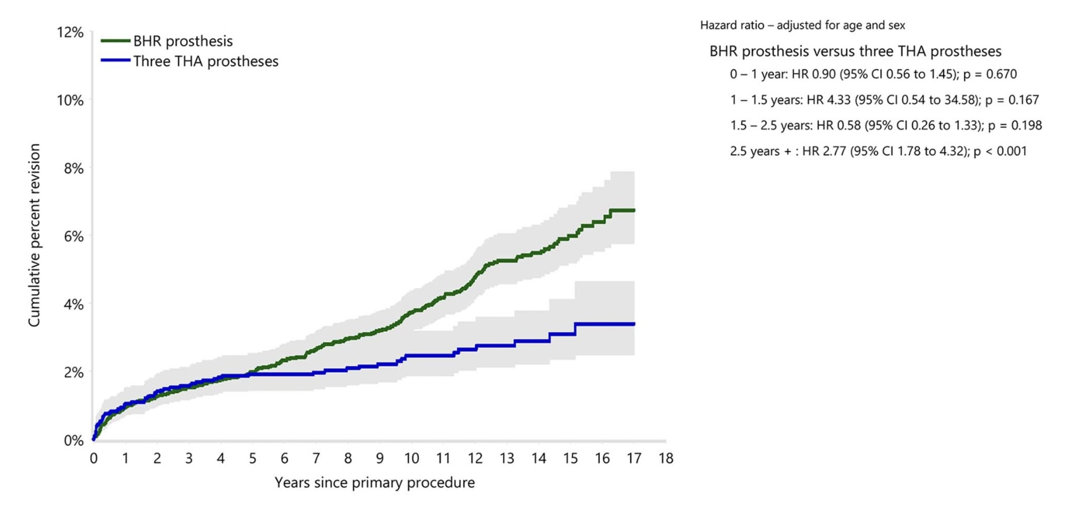
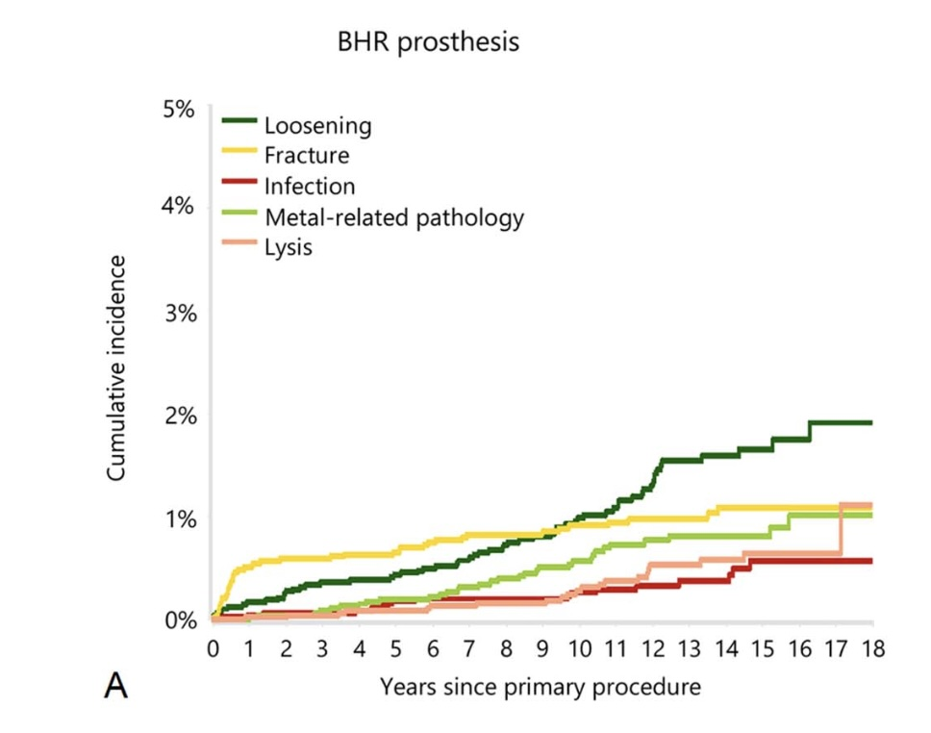

Slide 11
Question:
Is there a role for resurfacing hip arthroplasty for patients with arthritis of the hip?

Slide 12
Rationale:
RHA is not superior to modern THA
RHA is a technically challenging surgery
Future tech??? (Ceramic, oxinium)

Slide 13
Rationale:
If utilized it should be done in high volume centers /surgeons with great experience
Ideal candidate:
Young patients (<65 years)
Male
Hip arthritis
No significant deformity

Slide 14
Question:
Is there a role for resurfacing hip arthroplasty for patients with arthritis of the hip?
Response:
There is minimal role for the routine use of metal-on-metal RHA for patients with arthritis of the hip

