Slide 1
Is there a difference in outcomes between hemiarthroplasty and total hip arthroplasty for patients with displaced femoral neck fractures?
Seper Ekhtiari MD MSc FRCSC
Assistant Professor
McMaster University

Slide 2
Geert Meermans
Darko Talevski
Pēteris Studers
Emre Togrul
Mazhar Tokgözoglu
G Ruslan Nazaruddin Simanjuntak
Kamolsak Sukhonthamarn
Mark Phillips
Seper Ekhtiari

Slide 3
Why is this topic Important
1
Hip Fracture Statistics (2019) ²:
Annual global incidence: 14.2 million
Global prevalence: 23.6 million
12-month healthcare cost for a hip fracture:
43,669 USD
¹United Nations
²GBD 2019 Fracture Collaborators

Slide 4
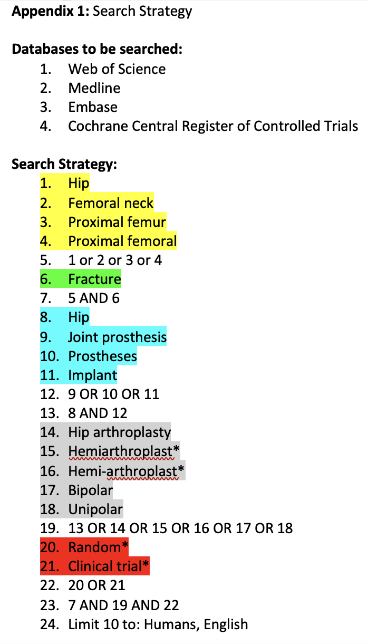
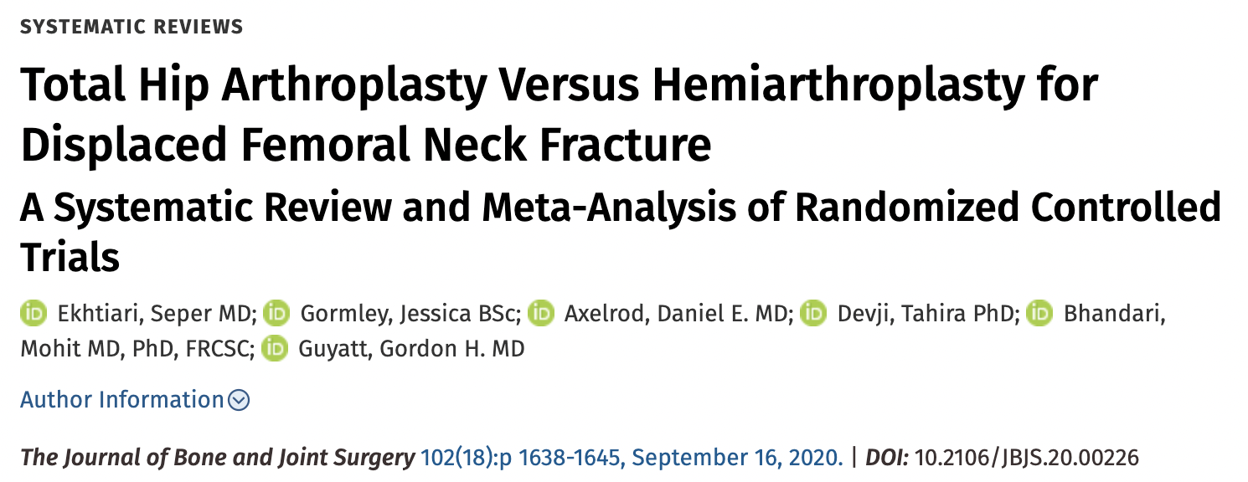
Literature Review/Process

Slide 5
2019
2024
IDENTIFICATION
N = 1,656
Duplicates removed: 515
N = 1,583
Duplicates removed: 573
SCREENING
N = 1,141
N = 1,010
ELIGIBLITY
N = 29
N = 27
INCLUDED
N = 16
N = 8
*1 update
* 3 secondary analyses
Notes:
In total we had 20 unique RCTs and 3 secondary analyses

Slide 6
THA PATIENTS, COMPARED TO HA PATIENTS HAD:
Significantly better function
4.6 points on HHS
95%CI: 1.7-7.5
MCID: 8 points
Significantly better HRQoL
0.05 on EQ-5D
95%CI: 0.02-0.08
MCID: 0.145
THA PATIENTS, COMPARED TO HA PATIENTS HAD:
Significantly longer operative time
MD: 29.7 mins
(95%CI: 18.0-41.5)
Significantly higher estimated blood loss
MD: 133 mL
(95%CI: 96-170mL)
AT UP TO 5 YEARS POST-OP, NO SIGNIFICANT DIFFERENCE BETWEEN THA AND HA IN RATES OF:
Revision surgery
Dislocation
Mortality Periprosthetic fracture

Slide 7
Question:
Is there a difference in outcomes between hemiarthroplasty and total hip arthroplasty for patients with displaced femoral neck fractures?

Slide 8
Rationale:
Meta-analysis of 20 unique RCTs and 3 secondary analyses of RCTs
There is some signal for small benefits in function and HRQoL that are likely not clinically meaningful
Total hip arthroplasty is associated with significantly longer operative times (~30mins) and blood loss (<150mL)
No significant difference in revision, complication, or mortality rates

Slide 9
Question
Is there a difference in outcomes between hemiarthroplasty and total hip arthroplasty for patients with displaced femoral neck fractures?
Response:
Based on randomized controlled trials (RCT), at up to 5 years follow up, there appears to be no important difference between hemiarthroplasty (HA) and total hip arthroplasty (THA) performed for patients with displaced femoral neck fracture. The use of THA is associated with better health-related quality of life (HRQoL) and function. Estimated blood loss and operative time are both significantly lower in hemiarthroplasty compared to THA.

