Slide 1
Q47 Should spinopelvic relationship be taken into account when performing routine primary THA?
SMJ Mortazavi
Joint Reconstruction Research Center,
Tehran University of Medical Sciences, Tehran, Iran

Slide 2
Mortazavi SMJ, Antoci V, Crestani M, Delgado A, Dimartino A, Murylev V, Poursalehian M, Qi X, Zhou Y.

Slide 3
Introduction
Alteration in spinopelvic(SP) motion may increase THA complications
Dislocation
Aseptic loosening
Wear of components
Onggo et al. JOA 2019
SP evaluation
Require additional x-rays in different positions
Notes:
Alteration in spinopelvic motion can affect The orientation of the acetabulum and implant positioning

Slide 4
Introduction
Not all patients undergoing THA are at risk for impaired SP mobility
THA prevalence in pts with SP fusion 4.6%
SP fusion in primary THA 0.1%
Bedard et al. 2016
SP evaluation in routine primary THA
Not const effective
Unnecessary x-ray exams
Notes:
Therefore, it is not recommended to conduct spino-pelvic evaluation in all patients

Slide 5
Literature Review/Process
Mesh Terms: Spinopelvic AND ((hip AND arthroplasty) OR “hip replacement” OR THA OR THR)
247 articles retrieved
73 articles were full text reviewed
21 articles were included in the review

Slide 6
Literature Review/Process
We tried to conduct a systematic review
Limited studies
The nature of question being wide
We conducted a narrative literature review
Scoping Review

Slide 7
Literature Review/Process
Studies tried to find the factors associated with impaired SP mobility in two groups:
Demographics, PMH, P/E, and AP X ray of pelvis
Lateral lumbosacral x-ray

Slide 8
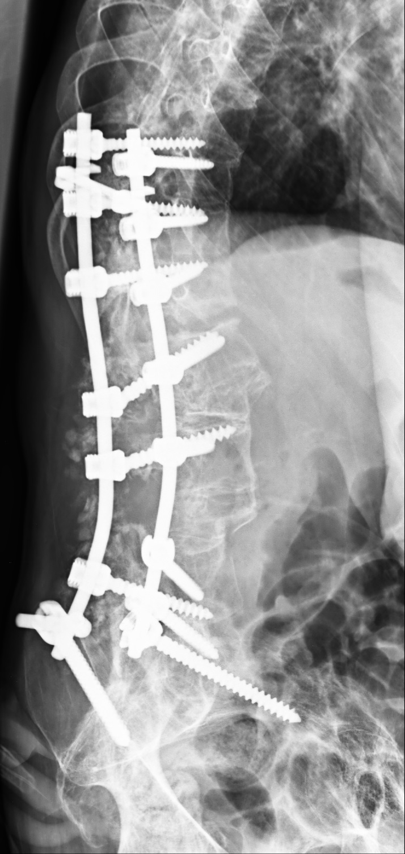
Patients Hx
Older Age >65y/o
Innmann M JOA 2024
Heckmann N JBJS 2018
Spinal fusion [5-8]
Surgical
Non-surgical
Stefl M BJJ 2023
Yang DS JOA 2023
Carender CN JOA 2022
Lumbar degenerative disc disease [17-20]
Berliner JL BJJ 2018
Klemt C BJJ 2023
Vigdorchik JM, JOA 2020

Slide 9
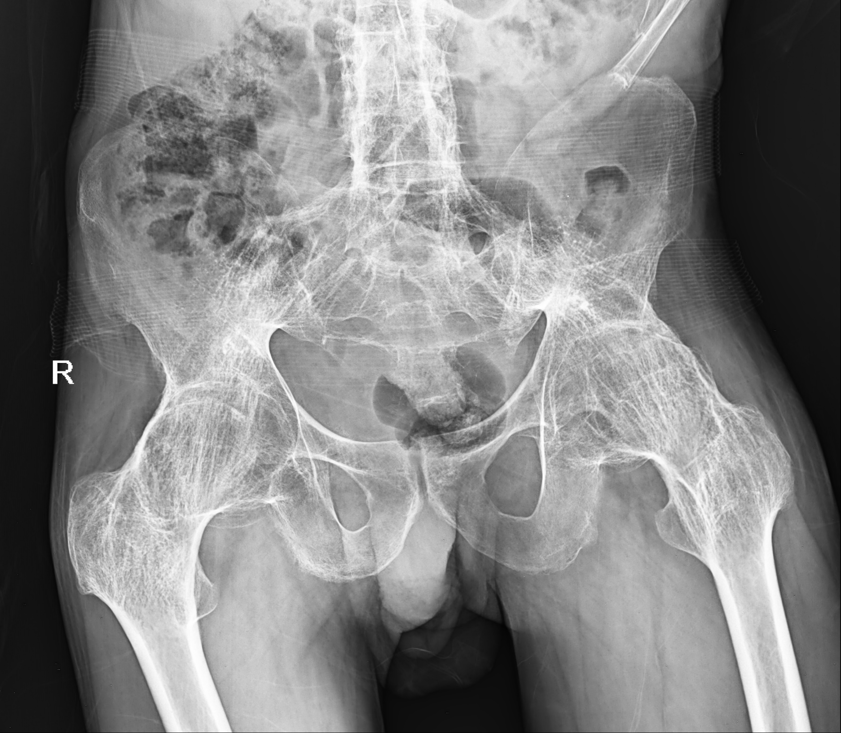
Patient’s P/E
Obvious Spinal Column Deformity [12-14]
Flat back
hyper-lordosis
Scoliosis
Homma Y IO 2020
Buckland AJ JOA 2019
Kleeman-Forsthuber L BJJ2022
Limited hip range of motion [1, 15]
Flexion<88
Innmann MM BJJ 2019
Ouchida J Eur Spine J 2022

Slide 10
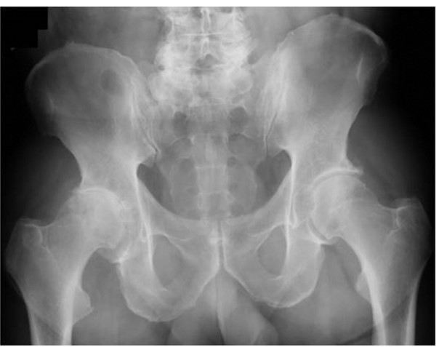
Pelvic X-ray
Contralateral hip [12, 15, 16]
Degenerative joint disease or
THA
Homma Y IO 2020
Ouchida J Eur Spine J 2022
Muellner M JOSR 2022
Overlap of the sacrococcygeal junction/pubic symphysis in AP radiograph [8, 21]
Carender CN JOA2022
Rainer WG JOA 2021

Slide 11
Standing Lateral Lumbar Xray
Pelvic tilt >19/13/10
Innmann MM BJJ 2019
Sacral slope >42 [1, 11, 12]
Homma Y IO 2020
Pelvic incidence-lumbar lordosis (PI-LL) mismatch >20
Vigdorchik JM, JOA 2021
Lumbar lordosis <45
Innmann M JOA 2023

Slide 12
Limitations
Limited number of articles
No cost-efficacy study
No study compared all factors together
No protocol

Slide 13
Question
Should spinopelvic relationship be taken into account when performing routine primary THA?
Recommendation
No. Current literature suggests that SP mobility evaluation is not necessary for all patients undergoing routine primary THA. A screening protocol should be developed.

