Slide 1
Q48What is the Best Position (High Hip vs. Anatomic) for the acetabular component in patients with severe DDH?
SMJ Mortazavi
Joint Reconstruction Research Center,
Tehran University of Medical Sciences,Tehran, Iran

Slide 2






Mortazavi SMJ, Atilla B, Bilgen OF, Cheng-Fong C, Gahramanov A, Hosseini-Monfared P, Kreuzer S, Razzaghof M, Shubnyakov I, Zagra

Slide 3
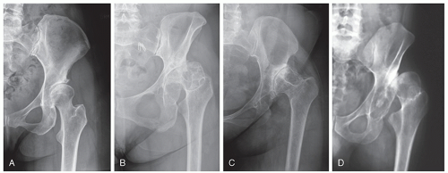
Total hip arthroplasty (THA) in severe DDH is challenging.
  Anatomical deformities
  Limited bone stock
Qu et al, AOTS, 2011.
Ranawat et al, JBJS Am, 1980
Notes:
X. Qu, X. Huang, and K. Dai, “Metal-on-metal or metal-onpolyethylene for total hip arthroplasty: a meta-analysis of prospective randomized studies,” Archives of Orthopaedic and Trauma Surgery, vol. 131, no. 11, pp. 1573–1583, 2011
Ranawat CS, Dorr LD, Inglis AE. Total hip arthroplasty in protrusio acetabuli of rheumatoid arthritis. J Bone Joint Surg Am.
1980;62:1059-1065.

Slide 4
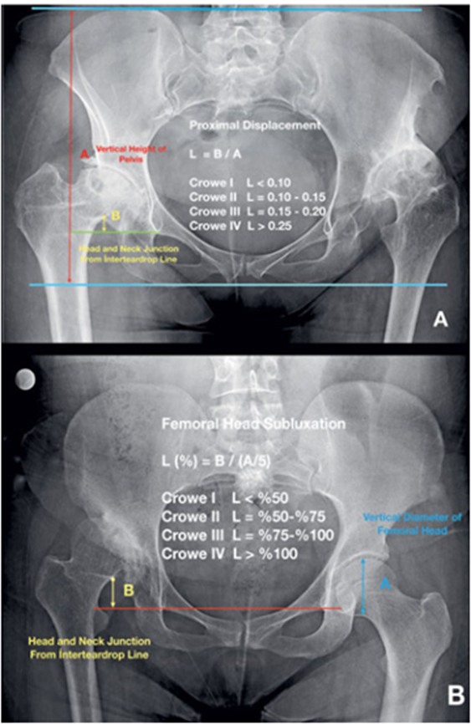
Crowe classification

Slide 5
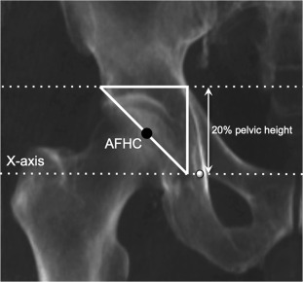
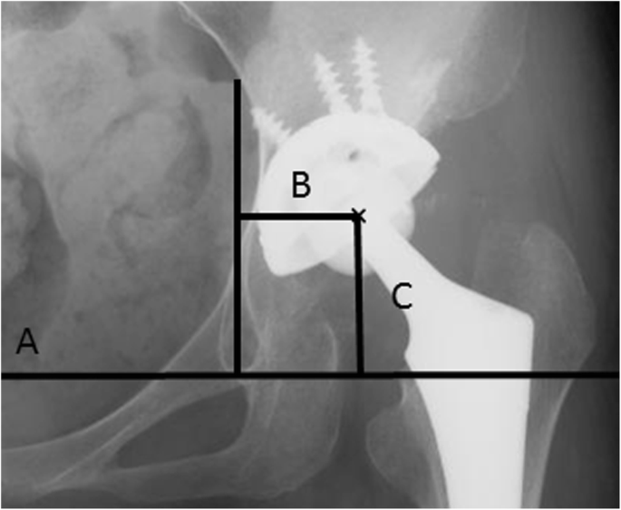
Hip Center
Ranawat method
Inter-teardrop line method

Slide 6
Anatomic hip center (AHC)
Advantage
  Restore joint reaction forces
  Restore hip biomechanics
  Restore normal gait
Potential issues
  Lesser bone stock
  Difficult reduction
  Risk of nerve injury
  Need for adjuvant procedures:
    femoral shortening
    Acetabular bone graft
1. Bicanic et al, IO, 2009 3. Marangoz et al, Hip Int, 2010
2. Dapuzzo et al, Orthop Clin North Am, 2012 4. Nie at al, IO, 2009
Notes:
Bicanic G, Delimar D, Delimar M, Pecina M. Influence of the acetabular cup position on hip load during arthroplasty in hip
dysplasia. Int Orthop. 2009;33:397-402.
Dapuzzo MR, Sierra RJ. Acetabular considerations during total hip arthroplasty for hip dysplasia. Orthop Clin North Am. 2012;
43:369-375
Marangoz S, Atilla B, Gok H, et al. Gait analysis in adults with severe hip dysplasia before and after total hip arthroplasty. Hip
Int. 2010;20:466-472
Nie Y, Ning N, Pei F, Shen B, Zhou Z, Li Z. Gait kinematic deviations in patients with developmental dysplasia of the hip
treated with total hip arthroplasty. Orthopedics. 2017;40: e425-e431

Slide 7
High hip center (HHC)
Advantages
  Higher bone stock
  Easier reduction
  Less need for adjuvant procedures:
    femoral shortening
    Acetabular bone graft
  lower risk of nerve injury
Potential issues
  Increased joint reaction forces
  Accelerated poly wear
  Aseptic loosening
  Dislocation
  Limb shortening
  Abductor failure
1. Delp et al, CORR, 1996. 4. Qu et al, AOTS, 2011
2. Jerosch et al, AOTS, 1997 5. Smith et al, Lancet, 2012
3. Kiyama et al, JOA, 2009 6.Hao et al, Chinese journal of joint surgery, 2007
Notes:
S. L. Delp, R. L. Wixson, A. V. Komattu, and J. H. Kocmond, “How superior placement of the joint center in hip arthroplasty affects the abductor muscles,” Clinical Orthopaedics and Related Research, vol. 328, pp. 137–146, 1996.
J. Jerosch, J. Steinbeck, J. Stechmann, and V. Güth, “Influence of a high hip center on abductor muscle function,” Archives of
Orthopaedic and Trauma Surgery, vol. 116, no. 6-7, pp. 385– 389, 1997.
T. Kiyama, M. Naito, H. Shitama, and A. Maeyama, “Effect of superior placement of the hip center on abductor muscle
strength in total hip arthroplasty,” The Journal of Arthroplasty, vol. 24, no. 2, pp. 240–245, 2009.
X. Qu, X. Huang, and K. Dai, “Metal-on-metal or metal-onpolyethylene for total hip arthroplasty: a meta-analysis of prospective randomized studies,” Archives of Orthopaedic and Trauma Surgery, vol. 131, no. 11, pp. 1573–1583, 2011
A. J. Smith, P. Dieppe, K. Vernon, M. Porter, A. W. Blom, and National Joint Registry of England and Wales, “Failure rates of stemmed metal-on-metal hip replacements: analysis of data from the National Joint Registry of England and Wales,” Lancet (London, England), vol. 379, no. 9822, pp. 1199–1204, 2012
Y. F. Hao, J. Y. Sun, P. Y. Yang, and L. B. Ma, “The deduction of a mathematical model of limited high hip center,” Chinese
Journal of Joint Surgery (Electronic Version), vol. 1, no. 3, pp. 161–167, 2007.

Slide 8
Literature Review/Process
MeSH terms:
  “Total Hip Arthroplasty” AND “Developmental Dysplasia of the Hip” AND (“High hip center” OR “Anatomic Hip Center” )

Slide 9
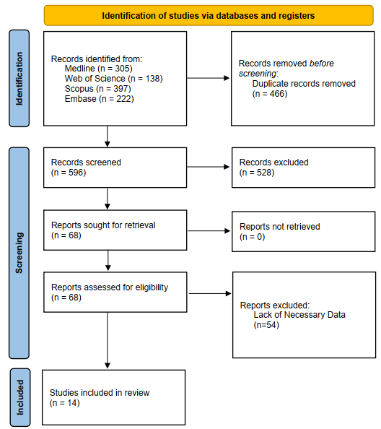
Literature Review/Process
Number of retrieved articles : 596
Final articles: 14
  11 retrospective
  3 prospective

Slide 10
Study | Study Design | Number of Patients | Dysplasia Classification | High Hip Position Definition | Reference Landmark
Demirel,2022[3] | Retrospective | 57 patients / 57 hips | Crowe type-II, type-III | Vertical distance of 15 mm from AHC | Anatomic Head Centers
Christodoulou, 2010 [4] | Retrospective | 88 patients / 104 hips | Hartofilakidis classification | >35 mm from the inter-teardrop line, >15 mm from AFHC | Inter-teardrop line
Dogra, 2023 [5] | Prospective | 30 patients / 30 hips | Crowe type-II, type-III | >15 mm from AHC | Inter-teardrop line
Fukui, 2013 [6] | Prospective | 200 patients / 200 hips | Crowe type I, II, III | >22 mm from the inter-teardrop line | Inter-teardrop line
Karaismailoglu 2019-1 [1] | Retrospective | 20 patients / 20 hips | Crowe III/IV | >15 mm superior to AHC | approximate femoral head center
Karaismailoglu 2019-2 [2] | Retrospective | 10 patients / 20 hips | Crowe III/IV | >15 mm superior to AHC | approximate femoral head center
Murayama, 2012 [7] | Retrospective | 43 patients / 43 hips | Crowe I-III | >24.5 mm above inter-teardrop line | Inter-teardrop line
Nawabi 2013 [8] | Retrospective | 46 patients / 51 hips | Crowe I-III | >10 mm superior to AFHC | Inter-teardrop line, (Ranawat method)
Shen, 2021 [9] | Retrospective | 42 patients / 42 hips | Crowe II–III and IV | >22 mm above inter-teardrop line | Inter-teardrop line
Traina, 2008 [10] | Retrospective | 67 patients / 88 hips | Crowe I-IV | ≥30 mm above inter-teardrop line | Inter-teardrop line
Wang, 2017 [11] | Retrospective | 68 patients / 86 hips | Hartofilakidis classification | >35 mm above inter-teardrop line | Inter-teardrop line
Watts, 2018 [12] | Retrospective | 88 patients / 88 hips | Crowe II-III | >1 cm superior and >1 cm lateral to AFHC | Inter-teardrop line, (Pagnano and Ranawat method)
Yang, 2017 [13] | Retrospective | 21 patients / 21 hips | Crowe III-IV | Superior displacement | Inter-teardrop line (Pierchon method)
Zhang, 2017 [14] | Prospective | 40 patients / 42 hips | Crowe I-III | Upward placement of 5-20 mm | Inter-teardrop line

Slide 11
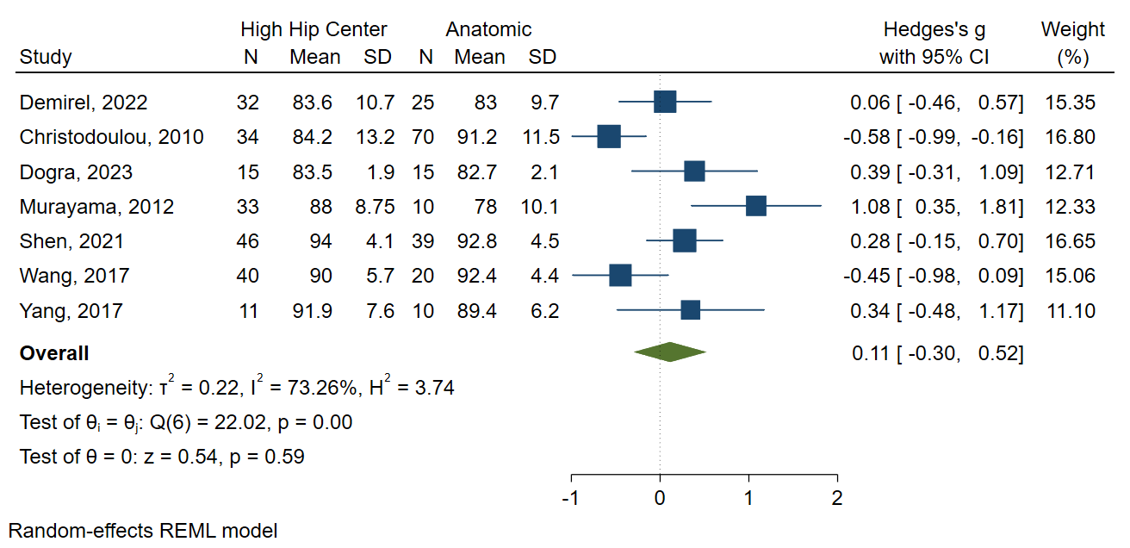
HHS score
  7 studies
  No difference (P=0.59)
HHS scores

Slide 12
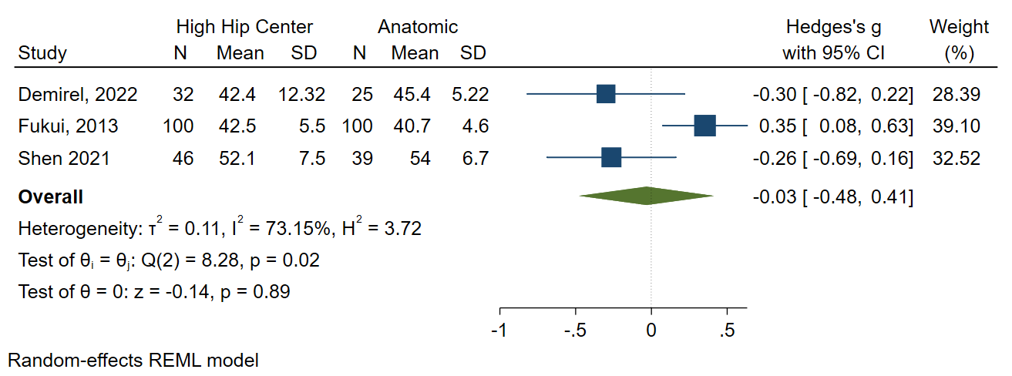
Abductor lever arm
  3 studies
  No difference (P=0.89)
Abductor Lever Arm

Slide 13
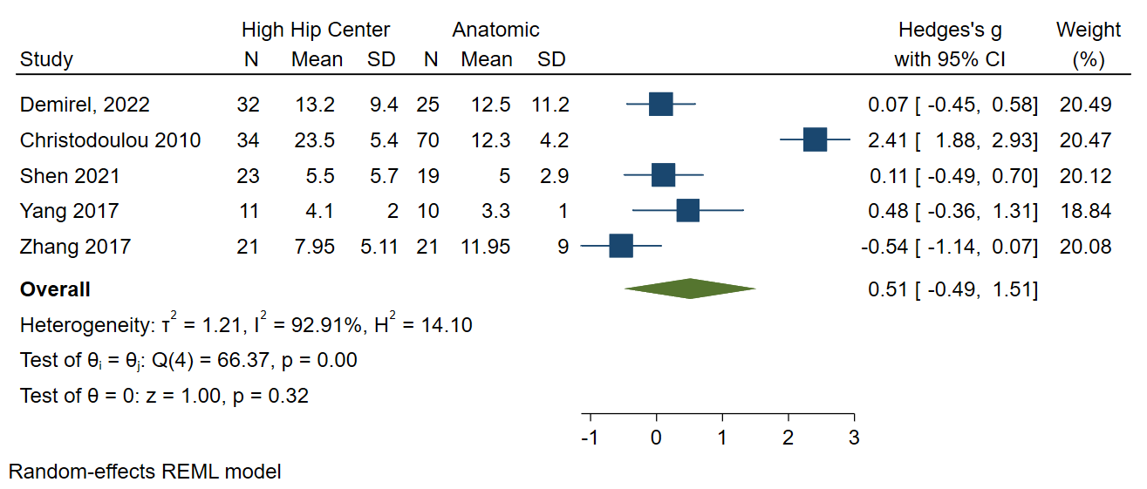
Limb Leg Difference
  5 studies
  No difference (P=0.32)
Figure 4. Limb Leg Difference (mm)

Slide 14
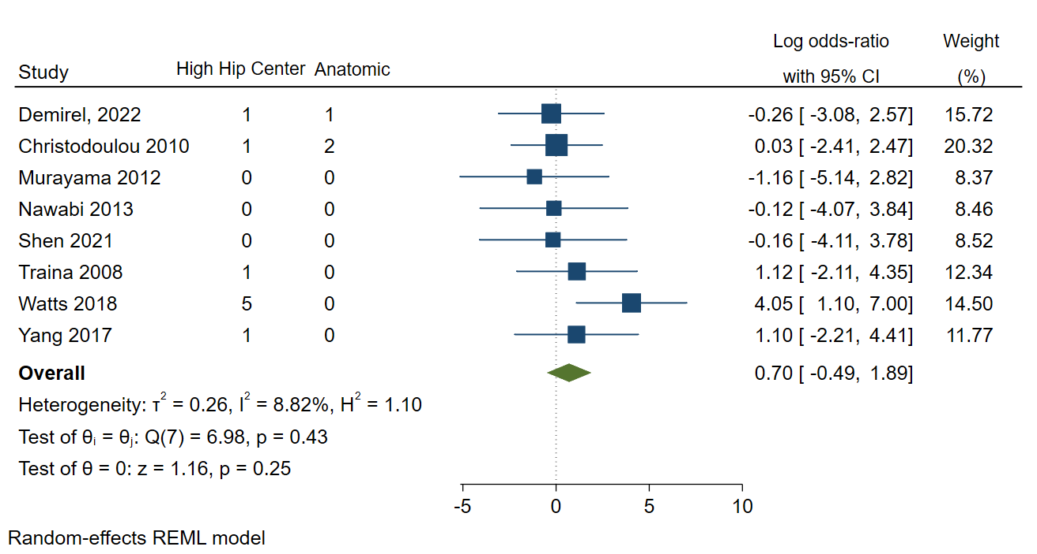
Acetabular Cup Revisions
  8 studies
  No difference (P=0.25)
Acetabular Cup Revisions

Slide 15
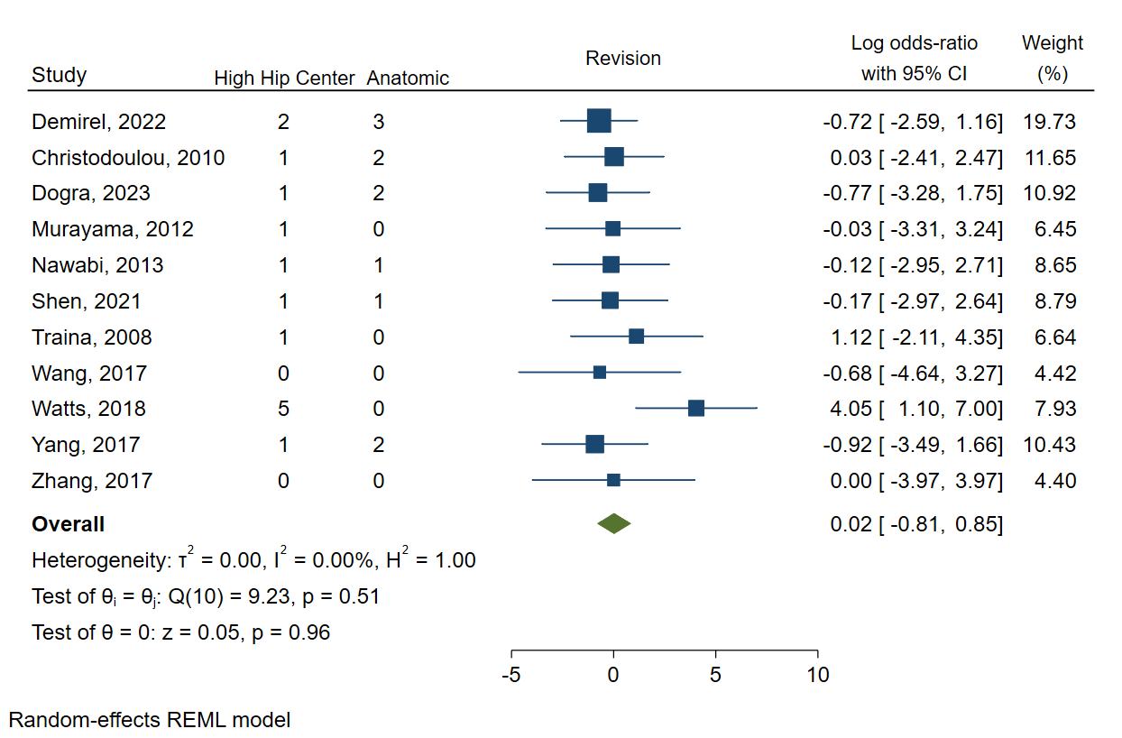
Any Cause Revisions
  11 studies
  No difference (P=0.96)
Any Cause Revisions

Slide 16
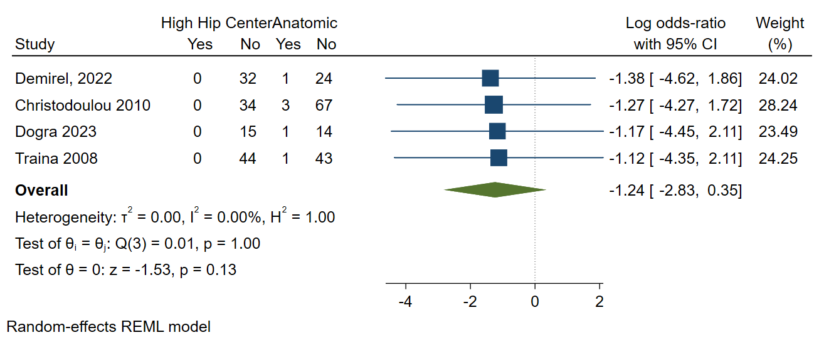
Nerve injury
  4 studies
  No difference (P=0.13)
Nerve Injury

Slide 17
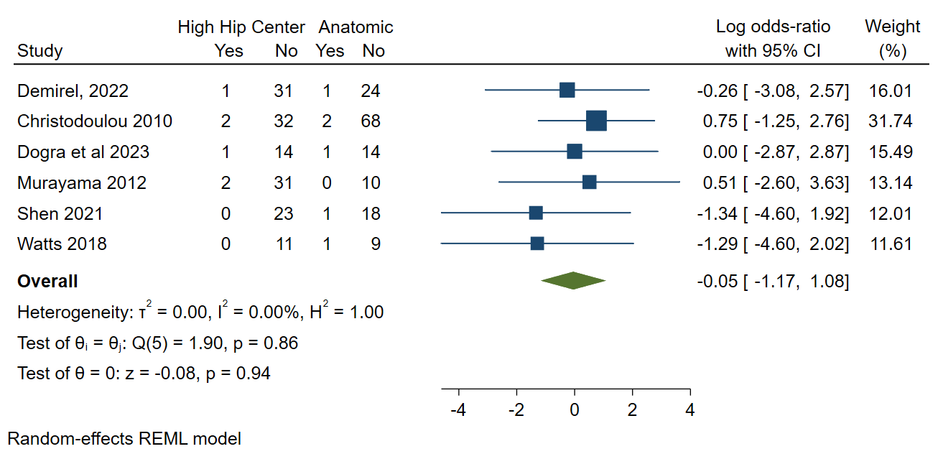
Dislocation rate
  6 studies
  No difference (P=0.94)
Dislocation Rate

Slide 18
Question:
What is the Best Position (High Hip vs. Anatomic) for the acetabular component in patients with severe DDH?

Slide 19
Question:
What is the Best Position (High Hip vs. Anatomic) for the acetabular component in patients with severe DDH?
Recommendation:
The findings of the previous studies demonstrate that the functional outcomes, revision rates, and nerve injury rates were not significantly different between the high hip or anatomic center groups for patients with developmental dysplasia of the hip.

