Slide 1
What are the indications for
tibial and femoral osteotomies around the knee?
Bozkurt M¹, Randelli P², Tetsworth K³, Manzary M⁴, Seon JK⁵, Salzmann G⁶,
Haghpanah B⁷, Kim KI⁸, Petersen W⁹, Walker J³, Landreau P¹⁰, Pulatkan A¹¹
¹ Acibadem Ankara Hospital, Department of Orthopedics and Traumatology, Istanbul, Turkey
² Clinica Ortopedica, ASST Gaetano Pini, Milano, Italy
³ Department of Orthopaedic Surgery, Royal Brisbane and Women's Hospital, Herston, Queensland, Australia
⁴ Department of Orthopedics, Johns Hopkins University School of Medicine, Dhahran, Saudi Arabia
⁵ Department of Orthopaedic Surgery, Chonnam National University Medical School and Hospital, Chonnam, Republic of Korea.
⁶ Department of Orthopaedic and Trauma Surgery, University Medical Center, Albert-Ludwigs University Freiburg, Freiburg, Germany
⁷ Department of Orthopedic Surgery, Kashan University of Medical Sciences, Kashan, Iran
⁸ Department of Orthopaedic Surgery, School of Medicine, Kyung Hee University, Seoul, Korea.
⁹ Department for Orthopaedics and Trauma Surgery, Martin Luther Hospital, Berlin, Germany.
¹⁰ Orthocure & Mediclinic, Dubai, United Arab Emirates
¹¹ Diakonie-Klinikum Hospital, Department of Orthopedics and Traumatology, Stuttgart, Germany

Slide 2



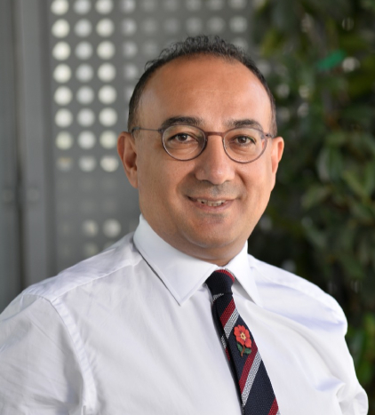







Slide 3
What are the indications for
tibial and femoral osteotomies around the knee?
OAK are primarily used to correct biomechanical abnormalities and malalignment
HTO,DFO and DLO offer a viable option for patients with early-OA symptoms, especially for younger, active individuals
Based on principle of unloading affected compartment and ↑ load to opposite compartment
Numerous patient demographic factors that may influence results
In patients with a JLO>3° where deformity is corrected with HTO alone→ ☹ functional results
Current literature discussion on correct indication of OAK
Appropriate patient selection and detailed preoperative planning have a direct impact on results

Slide 4
Pubmed search for “High tibial osteotomy“ or “Proximal tibial osteotomy“ or
“distal femoral osteotomy“ and
“indication“ (n=404) studies
189 of records excluded (not focused or not relevant on the topic)
101 excluded after title review
88 excluded after abstract review
215 records reviewed and screened
196 of records excluded after full text review (not focused or not relevant on the topic)
19 articles assessed for eligiblity
Total included references (n=19)

Slide 5
HTO Indications | DFO Indications | PTS Ostetomy Indications
Tibial malalignment (MPTA: 87 ± 3⁰) | Femoral malalignment (mLDFA: 87 ± 3) | PTS>12° and anterior tibial translation >10 mm in ACL failure
Chronic ligamentous instability | HTO → JLO >3° | In extreme cases of PTS (>16-20°)
Meniscal deficiency | PFI or maltracking | multiple ACL reconstruction insufficiency in the contralateral knee
Focal compartmental chondral defects | Asymmetric unloading of tibial plateau
Failed ACL reconstruction + PTS >12° and >10 mm anterior tibial translation
PCL or PLC instability
OAK Contraindications
Tricompartmental OA
Severe unicompartmental OA
Flexion contracture >10ᵒ
ROM < 120ᵒ
Tobacco use
Inflammatory arthritis

Slide 6
Addition of a DFO to MOW-HTO
Preoperative mLDFA > 90° combined with MPTA<87°
MPTA>94° after HTO
JLCA>6°
Total preop. tibial plateau inclination (PI) > -10° and
Lateral tibial PI>5°

Slide 7
Findings from OAK Literature-I
There is no strict age limit for OAK (Cut off ?) Similar functional outcomes between patients >50y and <40 y
→Indication should be based on the patient's preoperative activity and motivation)
OAK is not recommended patients with a BMI >30
↑ BMI → ↑ nonunion, ☹ functional outcomes?, ↑ conversion to TKA?
Ahlback or Kellgren-Lawrence grade 3≤ survival rate ↓, ☹ functional outcomes
Mild OA (ICRS grade 1-2) in the opposite compartment does not cause any decrease in clinical outcomes
No systematic review has established superiority of either the closing or opening wedge technique
(Selection: LLD and patellar height)
MOW-HT → Patellar height ↓, and PFJ-OA ↑; LCW-HTO → Patellar height →
Rutin preoperative arthroscopy → ☺ functional outcomes?

Slide 8
Findings from OAK Literature-II
The preop. status of ACL do not influence the outcomes following MOWHTO
MMPRT + varus deformity → HTO + MMPRT repair has similar results
Lateral tibial spine is a simple and reproducible bone point in valgus-producing osteotomies
Patellar infra or PFJ-OA, requiring greater corrections (>15°) → descending biplane osteotomy or LCW-HTO
Use of grafts for high-risk patients (obese, smoker or corrections >10-12mm)
No superiority of autograft, allograft or no graft. Synthetic grafts are contradictory → delayed union
Under- or overcorrection patients → long-term ☹ functional outcomes and ↑ failures
Postop MPTA >95° → ☹ functional outcomes ?
JLO >3° → ☹ functional outcomes and ↓ survival rate
JLCA >3° → significant soft tissue laxity and is predictive of outliers after HTO
☺ functional outcomes and similar complication rate with DLO at both bone deformities

Slide 9
Question
What are the indications for tibial and femoral osteotomies around the knee?
Recommendation
Indications for tibial and femoral osteotomies around the knee is compartmental mechanical overloading up to K-L grade II in young and active patients with ROM at least 10-120°

