Slide 1
What is the optimal fixation method for stems in revision TKA?
Jon Goosen
Sint Maartenskliniek
Nijmegen, The Netherlands

Slide 2
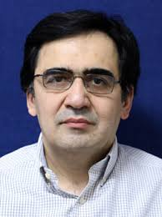
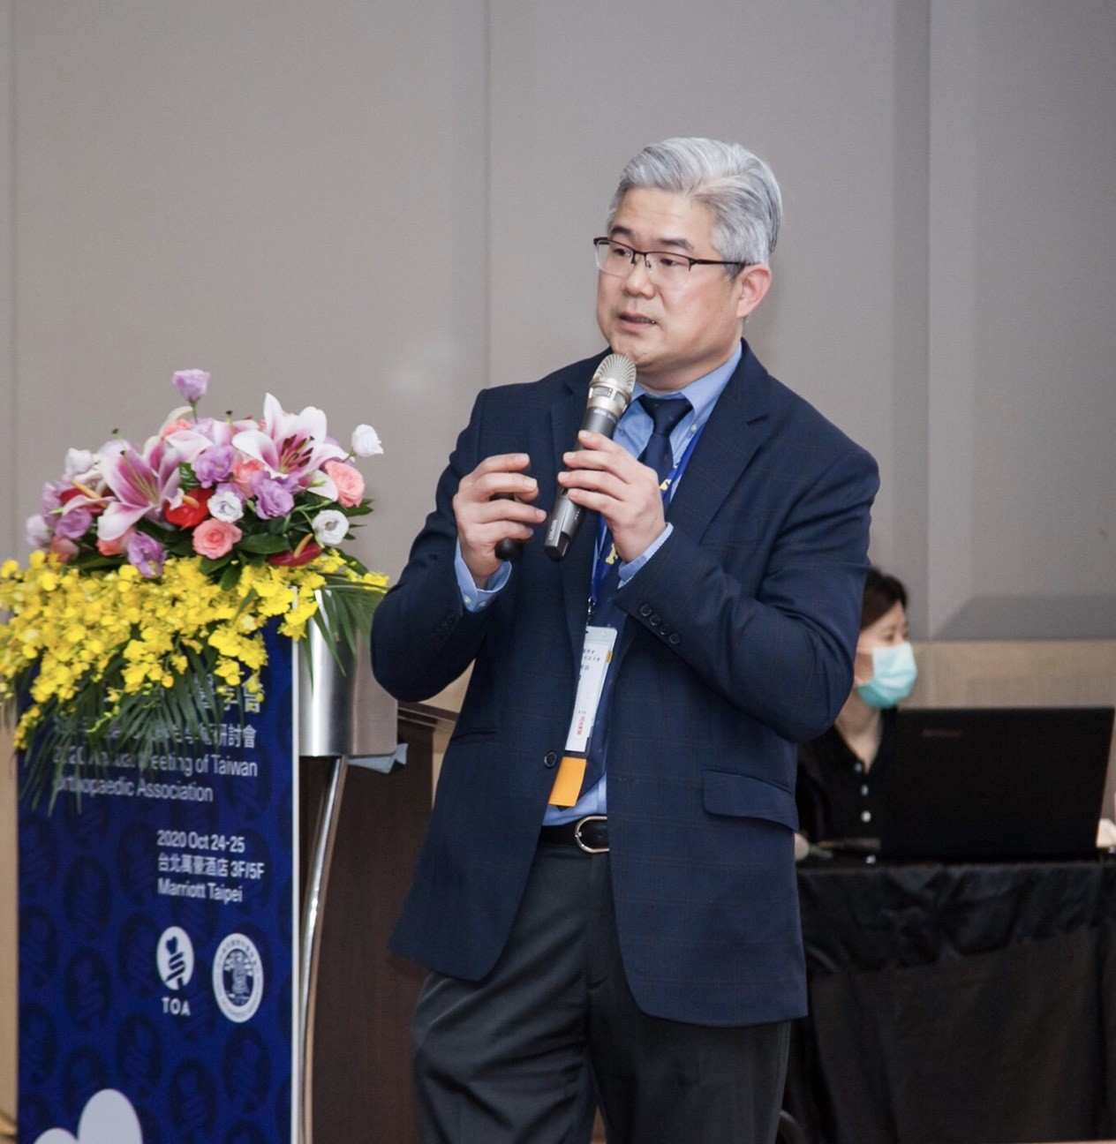
Mortazavi SMJ, Sousa R, Goosen J, Oldenrijk J, Kocaoğlu H, Xu P, Chen FC, Bezwada H, Saheb M, Porsalehian M

Slide 3
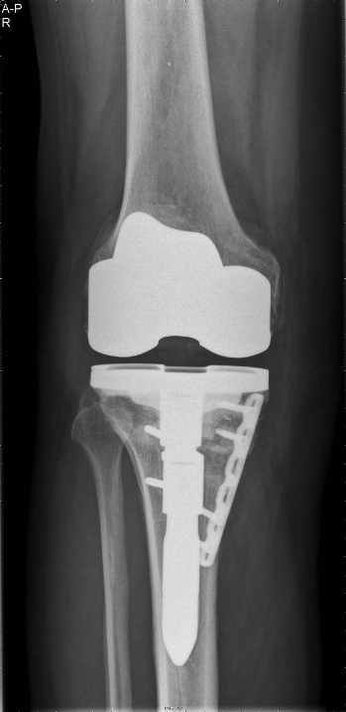
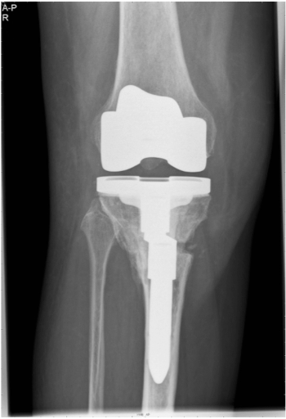
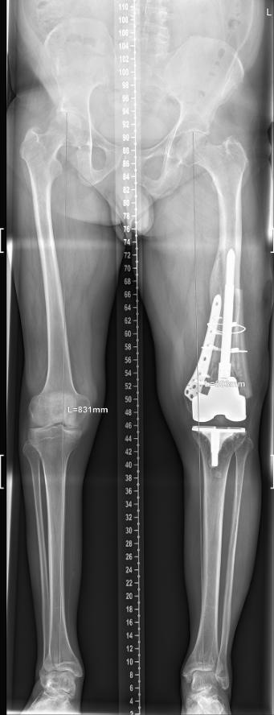
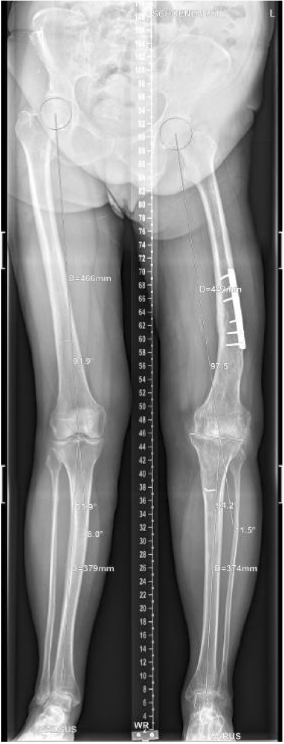
Specific reasons to decide stem-length / type of fixation:
Anatomy
Offset issues
Sleeves/cones
Extra-articular deformity
Canal sizing
Fracture etc

Slide 4
Can we individually choose between a cemented or an uncemented stem regardless of :
Overall failure rate
Overall revision rate
Diffence in aseptic loosing
Infection rate
Radiological and clinical performance

Slide 5
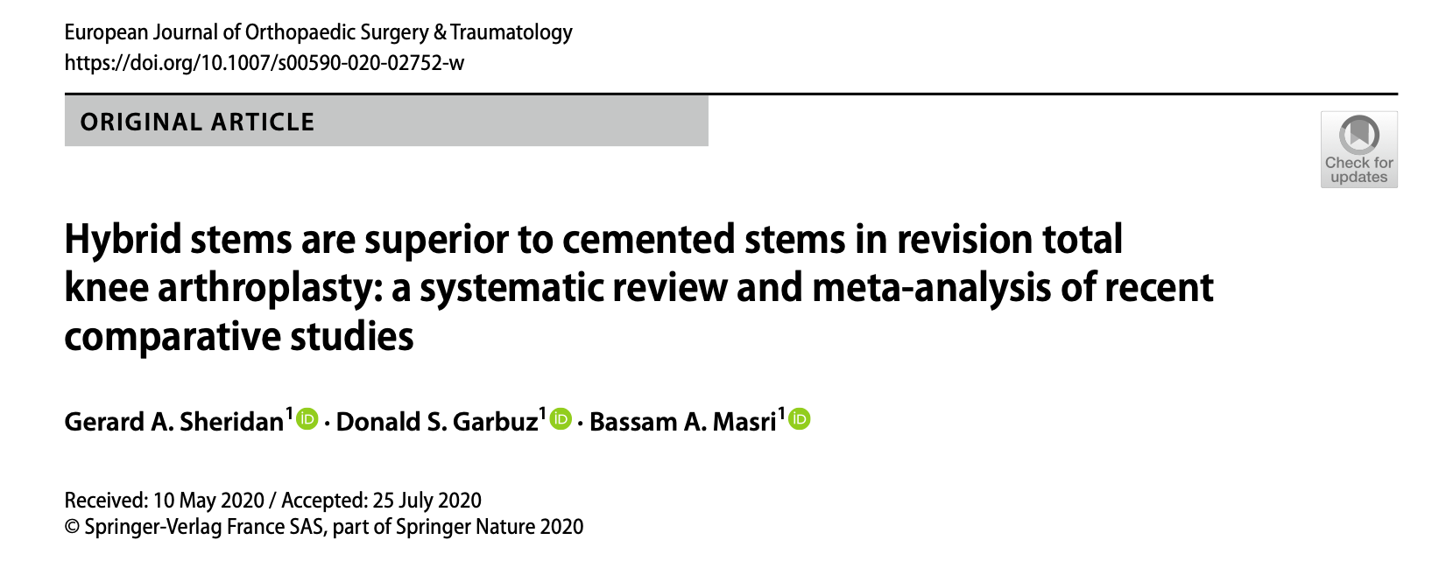
“Based on the current literature, no final statement can be drawn regarding the optimal fixation technique in revision TKA”
“trend favoring hybrids stems
for all outcome variables”

Slide 6
Literature Review/Process
Mesh terms used:"stem*"[Title/Abstract] AND ("revisi*"[Title/Abstract] OR "reoperation"[MeSH Terms]) AND ("knee"[Title/Abstract] OR "total knee replac*"[Title/Abstract] OR "total knee arthro*"[Title/Abstract] OR "TKA"[Title/Abstract] OR "TKR"[Title/Abstract] OR "rTKR"[Title/Abstract] OR "rTKA"[Title/Abstract] OR "arthroplasty, replacement, knee"[MeSH Terms])
Number of articles retrieved: 838 (Pubmed, Scopus, WOS, Ebrace)

Slide 7
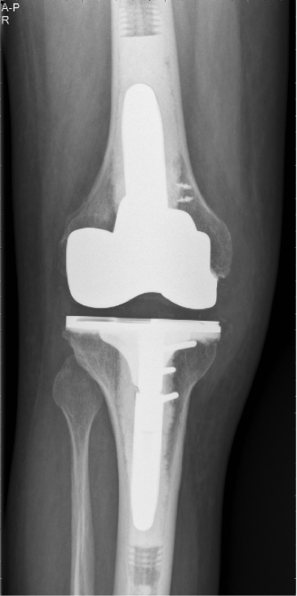
Literature Review/Process
Screening
1. Comparing 2 interventional groups; Cemented vs. Cementless (hybrid fixation with press-fit smooth stem)
2. Follow-up of at least 24 months
3. Publication date after 2010
Final number of publications: 13

Slide 8
Literature Review/Process
Investigated outcomes in the meta-analysis:
Overall failure rate
Overall revision rate
Revision due to aseptic loosening
Revision due to periprosthetic joint infection
Radiolucent lines
Knee Society Score clinical/functional
WOMAC Osteoarthritis Index
Visual Analogue Scale

Slide 9
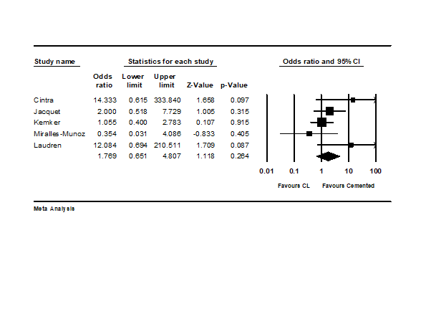
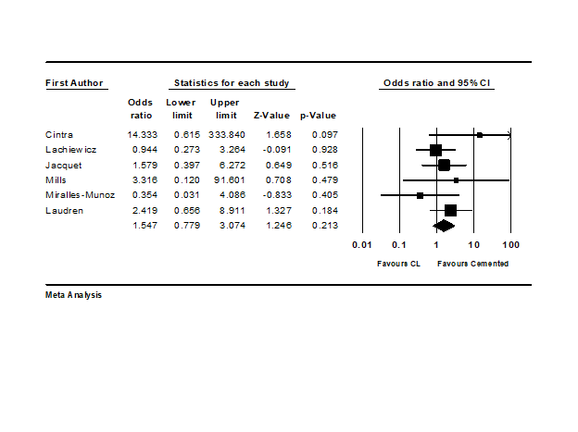
Overall failure rate
Overall revision rate

Slide 10
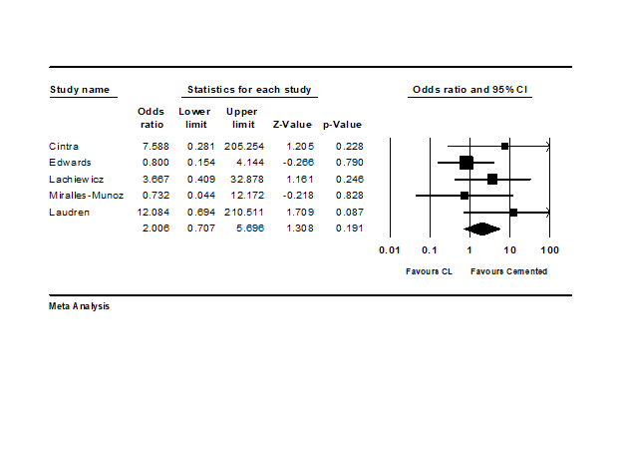
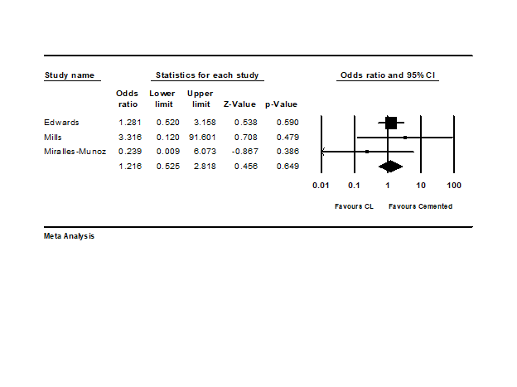
Revision rate due to aseptic loosing
Revision rate due to PJI

Slide 11
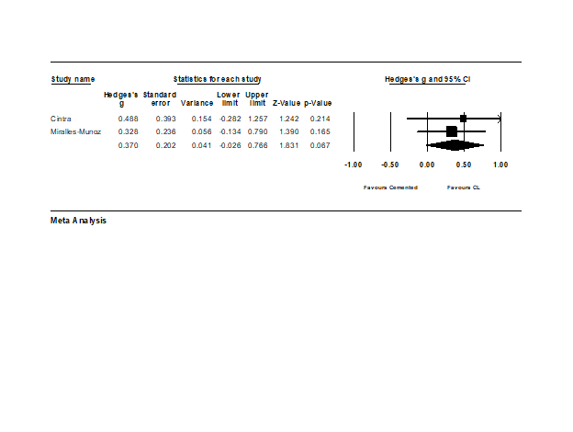
KSS clinical
KSS funcional
WOMAC
VAS

Slide 12
Findings from Literature
NO DIFFERENCE:
Overall failure rate (p= 0.264)
Overall revision rate (p = 0.213)
Revision due to aseptic loosening (p = 0.191)
Revision due to periprosthetic joint infection (0.649)
Radiolucent lines (p = 0.659)
Knee Society Score clinical (p = 0.102) and functional (p = 0.431)
WOMAC Osteoarthritis Index (p = 0.067)
Visual Analogue Scale (p = 0.672)

Slide 13
Limitations
Limited number of studies and sample size
Most of studies were retrospective cohorts with limited follow-ups and significant confounding factors.
Most of the studies reported tibial stem and femoral stem together.
Different bone qualities were noted in the existing literature.
Different constrain level were used.
Studies used different stem lengths and diameters in each technique.

Slide 14
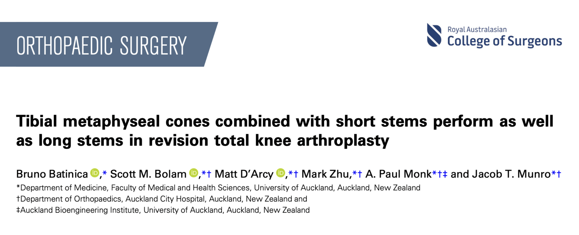
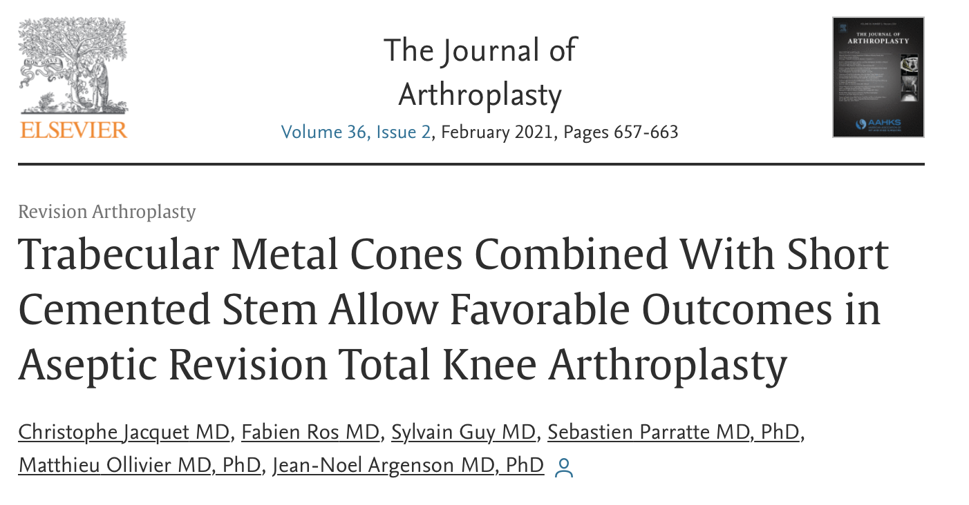
Summary:
No difference between uncemented and cemented stems in current analysis
Choice based on specific individual reasons
Be kind for your re-revision surgeon!
->size does matter!

Slide 15
Voting Question:
What is the optimal fixation method for stems used during revision TKA?

Slide 16
Question
What is the optimal fixation method for stems used during revision TKA?
Recommendation
The current literature indicates no significant superiority of using a specific stem fixation method for revision total knee arthroplasty (rTKA) regarding various postoperative outcomes.
Therefore, we recommend that cemented and cementless fixation methods could be utilized based on individual situations and surgeon preference.

