Slide 1
What are the indications for using sleeves and/or cones during revision total knee arthroplasty?
Andrew Fraval
St Vincent’s Hospital Melbourne Australia
Melbourne Orthopaedic Group

Slide 2

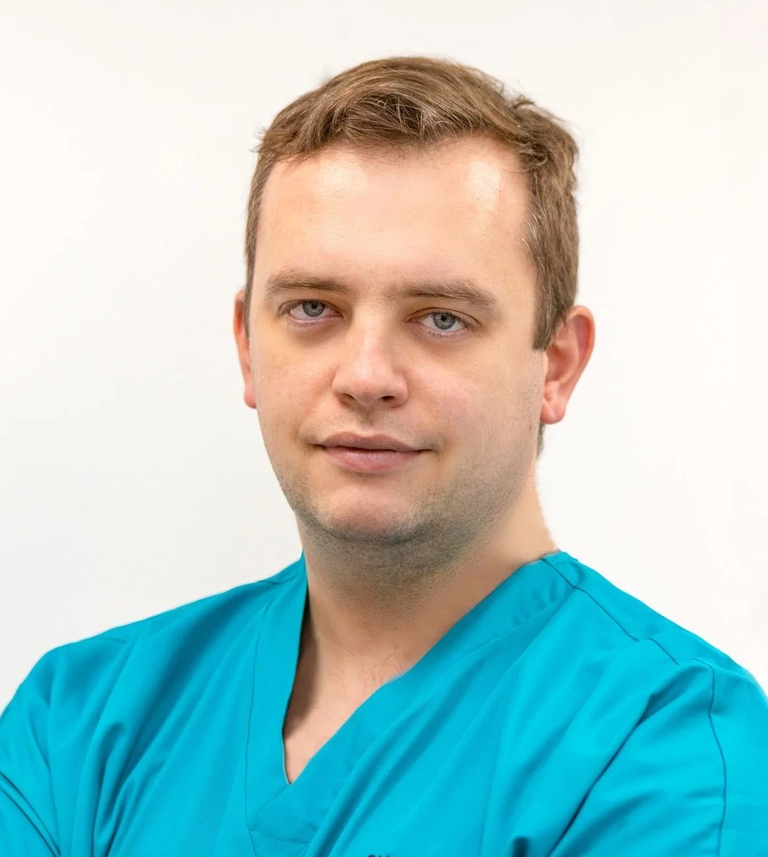





Dr Jose Baeza
Dr Pawel Bartosz
Dr. Job Diego Velázquez Moreno
Dr. Andrew Fraval
Dr Robert Hube
Dr. Ashok Rajgopal
Dr. Pablo San Ruiz

Slide 3
Why is this topic Important
One important aspect of revision knee arthroplasty is to achieve durably well-fixed implants
Morgan-Jones et al introduced the concept of zonal fixation (epiphysis, metaphysis and diaphysis), and advocated for a minimum of 2 zones of solid fixation to obtain a durably well fixed revision prosthesis
  A cemented or cementless stem can be used to obtain fixation in the diaphysis.
Porous-coated sleeves or cones have been used to obtain fixation in the metaphyseal zone.
  The strategy of gaining metaphyseal fixation has a growing body of evidence with porous metaphyseal metal implants at 10 year follow up reported
Notes:
The long-term goal of revision knee arthroplasty is to achieve durably well-fixed implants that restore the joint line, restore alignment and provide stability through a functional range. It is common for revision total knee arthroplasty (rTKA) to present the challenge of bone loss.

Slide 4
Literature Review/Process
Mesh terms used
"cone*" [ti] AND "revision total knee arthroplasty"[ti]
"cone*"[tiab] AND "revision total knee arthroplasty"[tiab]
"sleeve*" [ti] AND "revision total knee arthroplasty"[ti]
"sleeve*"[tiab] AND "revision total knee arthroplasty"[tiab]
"Femoral metaphyseal defect*" [ti] AND "revision total knee arthroplasty"[ti]
"Femoral metaphyseal defect*"[tiab] AND "revision total knee arthroplasty"[tiab]
"Tibial metaphyseal defect*" [ti] AND "revision total knee arthroplasty"[ti]
"Tibial metaphyseal defect*"[tiab] AND "revision total knee arthroplasty"[tiab]
"implant fixation*" [ti] AND "revision total knee arthroplasty"[ti]
"implant fixation*"[tiab] AND "revision total knee arthroplasty"[tiab]

Slide 5
Literature Review/Process
Mesh terms used
Number of articles retrieved - 223
Screening - 98
Final number of publications - 22

Slide 6
Findings from Literature
Over the past decade in rTKA there has been a shift towards obtaining fixation in the metaphysis
Both cones and sleeves can theoretically provide biologic fixation through ongrowth in the metaphyseal region in addition to an initial press fit which provides immediate rigid stability
Cones or sleeves have been described as being indicated in AORI type IIB and III defects
Outcomes of sleeves and cones provide similar findings, with no superiority of one construct over the other
Few studies have compared porous metal metaphyseal implants (cones or sleeves) with earlier graft options (bulk allograft or autograft)

Slide 7
Question:
What are the indications for using sleeves and/or cones during revision total knee arthroplasty?

Slide 8
Rationale:
We did an umbrella study on this question. The evidence base is limited to retrospective, uncontrolled studies. The majority of the literature reported outcomes associated with the use of cones or sleeves with AORI type IIB and III defects. In some reports, both cones and sleeves were routinely utilized in revisions with AORI I and IIA-type bone loss. A recent meta-analysis comparing outcomes of sleeves to cones evaluated the results of 43 included studies and 3008 rTKA (1911 cases in the sleeve group and 1097 cases the cone group). All papers included were level III (retrospective cohort studies, case–control studies) and IV (case series) studies. The analysis showed no significant difference in relation to prosthesis survival. Aseptic loosening occurred at a rate of 0.4% in the sleeve group and 4.1% in the cone group (> 5 yr follow up) (p = 0.09). 9 further case series published since this meta-analysis were also analyzed which showed similar findings, with no superiority of one construct over the other. Few studies have compared porous metal metaphyseal implants (cones or sleeves) with earlier graft options (bulk allograft or autograft).

Slide 9
Question:
What are the indications for using sleeves and/or cones during revision total knee arthroplasty?
Response:
Yes – Moderate recommendation
In AORI type II or III bone defects of the knee, metaphyseal fixation using sleeves and cones is associated with acceptably low rates of aseptic loosening.
Metaphyseal sleeves and cones provide similar outcomes in terms of prosthesis survival due to aseptic loosening.

