Slide 1
What are the Indications for Hinged Implants in Revision Total Knee Arthroplasty
Hantouly AT, Muthu S, Shahab M, Sarungi M, Unnanuntana A, Debeaubien B,
Jordaan K,Gehrke T, Parvizi J, Citak M

Slide 2










Slide 3
Why is this topic Important
Hinged implants are increasingly being considered for rTKA in complex scenarios. These scenarios can be complicated by instability, bone loss, infections, arthrofibrosis, etc. which compromise the performance and longevity of standard implant designs.
Thus, a comprehensive literature review was conducted to analyse the existing literature for the indications of hinged implant rTKA

Slide 4
Literature Review/Process
PubMed, Web of Science and Scopus were search from inception till 27 March 2024 for original articles reporting the indication of using hinged implant designs in rTKA.
Eligibility criteria: Original articles reporting the indication of using hinged implant designs in rTKA. Exclusion criteria were non-English language, case reports, studies with sample size <10 patients, review articles, registry-based studies, studies with oncology cases, techniqal articles, non-human studies and studies not reporting implants use indications.

Slide 5
Literature Review/Process
TITLE-ABS-KEY ( ( "arthroplasty, replacement, knee" OR "TOTAL KNEE ARTHROPLASTY" OR "TOTAL KNEE REPLACEMENT" OR ( "Revision knee replacement" OR "Revision knee arthroplasty" OR "Knee replacement" OR "knee arthroplasty" OR "knee prosthesis" ) ) AND ( hinge* OR constrain* ) AND ( revise OR revised OR revisers OR revises OR revising OR revision OR revisions ) )
Search | Query | Number of results
#1 | (ALL=((("Arthroplasty, Replacement, Knee") OR ("TOTAL KNEE ARTHROPLASTY")) OR ("TOTAL KNEE REPLACEMENT"))) OR ALL=(("Revision knee replacement" OR "Revision knee arthroplasty" OR "Knee replacement" OR "knee arthroplasty" OR "knee prosthesis")) | 47890
#2 | ALL=(("Revision knee replacement" OR "Revision knee arthroplasty" OR "Knee replacement" OR "knee arthroplasty" OR "knee prosthesis")) | 47890
#3 | #2 OR #1 | 47890
#4 | ALL=("Hinge*") | 36931
#5 | ALL=("Constrain*") | 878094
#6 | #5 OR #4 | 913099
#7 | #6 AND #3 | 1229
#8 | ALL=(Revision) | 199389
#9 | #8 AND #7 | 656
Search | Query | Number of results
#7 AND #8 | ("arthroplasty, replacement, knee"[MeSH Terms] OR "TOTAL KNEE ARTHROPLASTY"[All Fields] OR "TOTAL KNEE REPLACEMENT"[All Fields] OR ("Revision knee replacement"[All Fields] OR "Revision knee arthroplasty"[All Fields] OR "Knee replacement"[All Fields] OR "knee arthroplasty"[All Fields] OR "knee prosthesis"[All Fields])) AND ("hinge*"[All Fields] OR "constrain*"[All Fields]) AND ("revise"[All Fields] OR "revised"[All Fields] OR "revisers"[All Fields] OR "revises"[All Fields] OR "revising"[All Fields] OR "revision"[All Fields] OR "revisions"[All Fields]) | 765
Revision | "revise"[All Fields] OR "revised"[All Fields] OR "revisers"[All Fields] OR "revises"[All Fields] OR "revising"[All Fields] OR "revision"[All Fields] OR "revisions"[All Fields] | 215,834
#3 AND #6 | ("arthroplasty, replacement, knee"[MeSH Terms] OR "TOTAL KNEE ARTHROPLASTY"[All Fields] OR "TOTAL KNEE REPLACEMENT"[All Fields] OR ("Revision knee replacement"[All Fields] OR "Revision knee arthroplasty"[All Fields] OR "Knee replacement"[All Fields] OR "knee arthroplasty"[All Fields] OR "knee prosthesis"[All Fields])) AND ("hinge*"[All Fields] OR "constrain*"[All Fields]) | 1,566
#4 OR #5 | "hinge*"[All Fields] OR "constrain*"[All Fields] | 207,827
"Constrain*" | "constrain*"[All Fields] | 190,366
"Hinge*" | "hinge*"[All Fields] | 18,145
#1 OR #2 | "arthroplasty, replacement, knee"[MeSH Terms] OR "TOTAL KNEE ARTHROPLASTY"[All Fields] OR "TOTAL KNEE REPLACEMENT"[All Fields] OR "Revision knee replacement"[All Fields] OR "Revision knee arthroplasty"[All Fields] OR "Knee replacement"[All Fields] OR "knee arthroplasty"[All Fields] OR "knee prosthesis"[All Fields] | 50,841
("Revision knee replacement" OR "Revision knee arthroplasty" OR "Knee replacement" OR "knee arthroplasty" OR "knee prosthesis") | "Revision knee replacement"[All Fields] OR "Revision knee arthroplasty"[All Fields] OR "Knee replacement"[All Fields] OR "knee arthroplasty"[All Fields] OR "knee prosthesis"[All Fields] | 50,841
(("Arthroplasty, Replacement, Knee"[Mesh]) OR ("TOTAL KNEE ARTHROPLASTY")) OR ("TOTAL KNEE REPLACEMENT") | "arthroplasty, replacement, knee"[MeSH Terms] OR "TOTAL KNEE ARTHROPLASTY"[All Fields] OR "TOTAL KNEE REPLACEMENT"[All Fields] | 43,415
Notes:
Broad terms were used to ensure the inclusion of all eligible articles

Slide 6
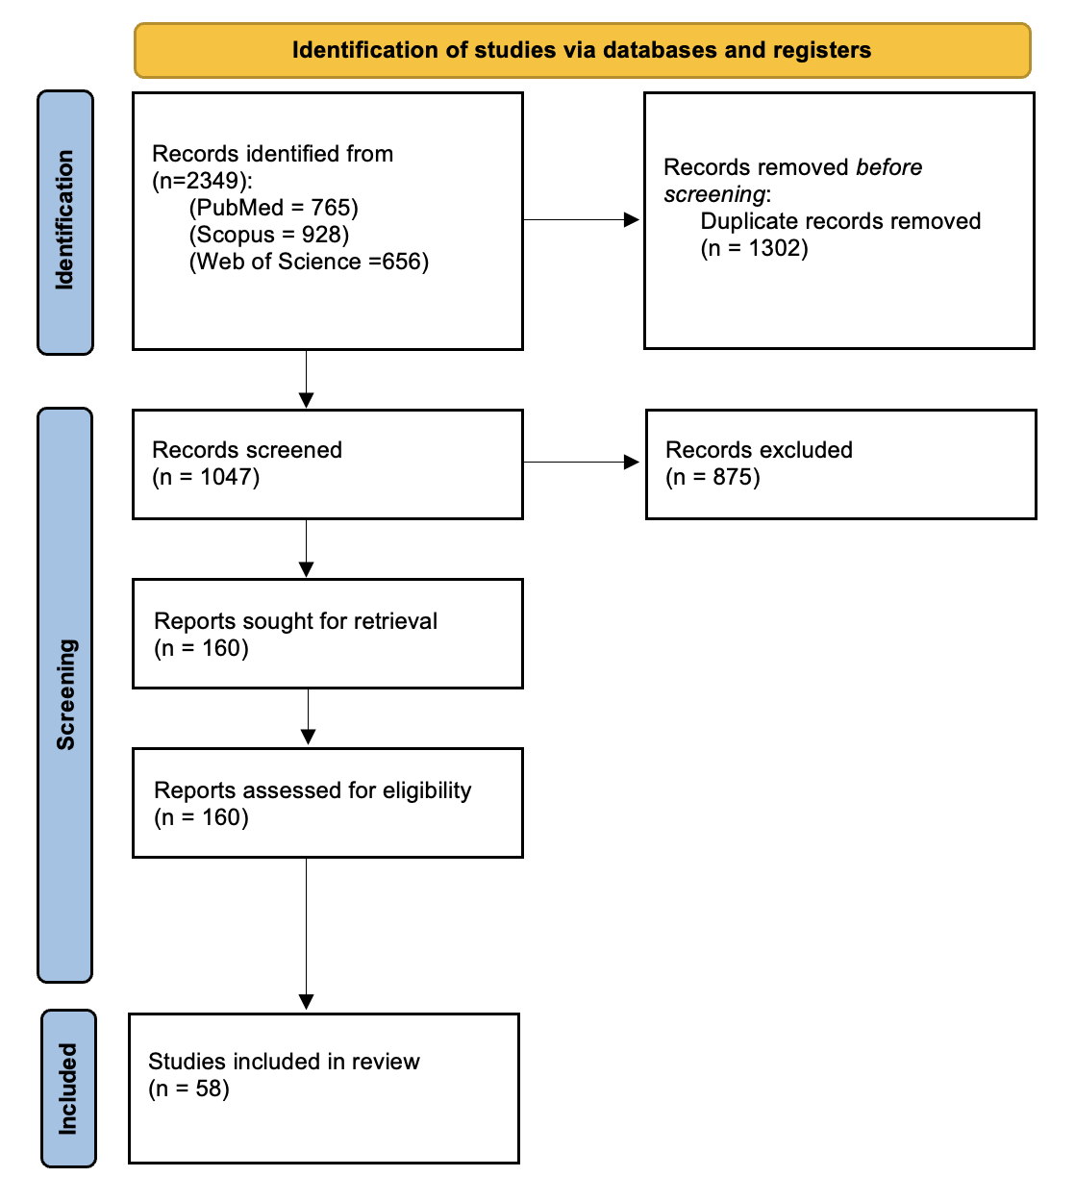
Literature Review/Process
Number of Articles Retrieved: 2349 articles
Screening: 160 studies selected for full-text review
Final number of publications: 58 studies included
Notes:
Broad terms were used to ensure the inclusion of all eligible articles

Slide 7
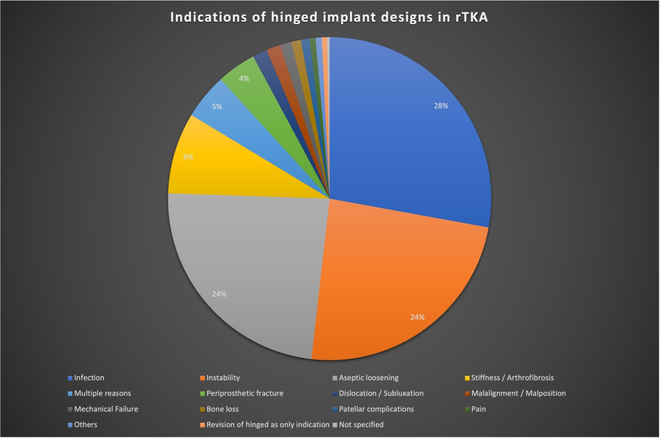
Findings from Literature
A total of 2803 revision TKAs were included in this review
n=781
Multiple reasons as an indication was poorly reported in the studies
>75%
n=665
n=671

Slide 8
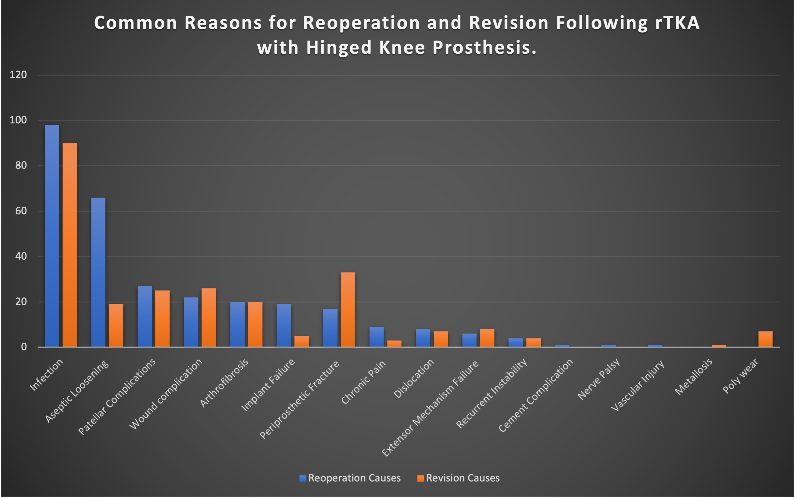
Findings from Literature
The overall reoperation and revision rates in the included studies were 13.9% and 14.2%, respectively
For reoperation: Infection and aseptic loosening made 55% of the cases
For revision: Infection and periprosthetic fracture made 50% of the cases

Slide 9
Rationale:
A comprehensive systematic review was conducted.
A total of 2349 articles were screened and 58 studies with 2803 revised TKAs were finally included.
The three most common indications for hinged implants in rTKA are infection, instability, and aseptic loosening. However, studies poorly reported “multiple reasons for revision” as an indication.
On a clinical perspective, the identified indications are rarely encountered in isolation, rather they present in a combined fashion thereby making hinged designs ideal.

Slide 10
Response:
The three most common indications for considering hinged-design implants in revision total knee arthroplasty are infection, instability, and aseptic loosening when severe bone loss and loss of integrity of collateral ligaments may be encountered.

Slide 11
Limitations
Heterogeneity among the included studies
Inconsistency in reporting outcomes, such as radiological assessments, mortality rates, pre- and postoperative outcomes restricted the ability to conduct robust meta-analyses, often limiting making qualitative descriptions.
Some studies did not provide detailed information on patient demographics and comorbidities, which are important factors that could influence outcomes.
variations in the follow-up durations across studies could affect the long-term assessment of outcomes and mortality rates. Moreover, the diversity in implant designs affected the outcomes.

Slide 12
Question
    What are the Indications for Hinged Implants in Revision Total Knee Arthroplasty?
Recommendation:
    The three most common indications for hinged-design implants in revision TKA are infection, instability, and aseptic loosening. However, in practice, these are rarely isolated indications; rather, they typically occur in combination with other factors such as pain, stiffness/arthrofibrosis, periprosthetic fracture, dislocation/subluxation, malalignment/malposition, bone loss, patellar complications, and the need for revision of a previously implanted hinged prosthesis.
What is the final recommendation
What will you put to a vote today

