Slide 1
How should periprosthetic fractures at the tip of cemented or uncemented femoral stem be treated?
Slullitel PA, Van Oldenrijk J, Tsai S, Bondarenko S, Rodriguez-Quintana D, Smith EL, Brown S, Merghani K, Smith EB, Wadhwa M, Goswami K

Slide 2
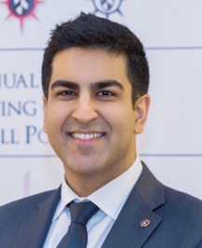
Pablo Slullitel
(Speaker)
Karan Goswami
(Liaison)
Jakob van Oldenrijk
Khalid Merghani
Stanislav Bondarenko
Shang-Wen Tsai
Scot Brown
Eric Smith
David Rodriguez-Quintana
Manuj Wadhwa

Slide 3
Nothing to disclose

Slide 4
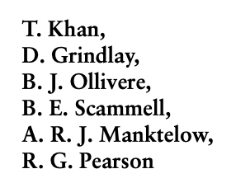
Reproducibility of the Vancouver System
3 questions
Consensus
B1: Fixed implant
B2: Loose implant
B3: Loose + Bone loss
ORIF
Revision
Complex revision
Is the Bed of the implant compromised?
Is the implant loose (B2)?
Is bone stock deficient (B3)?

Slide 5
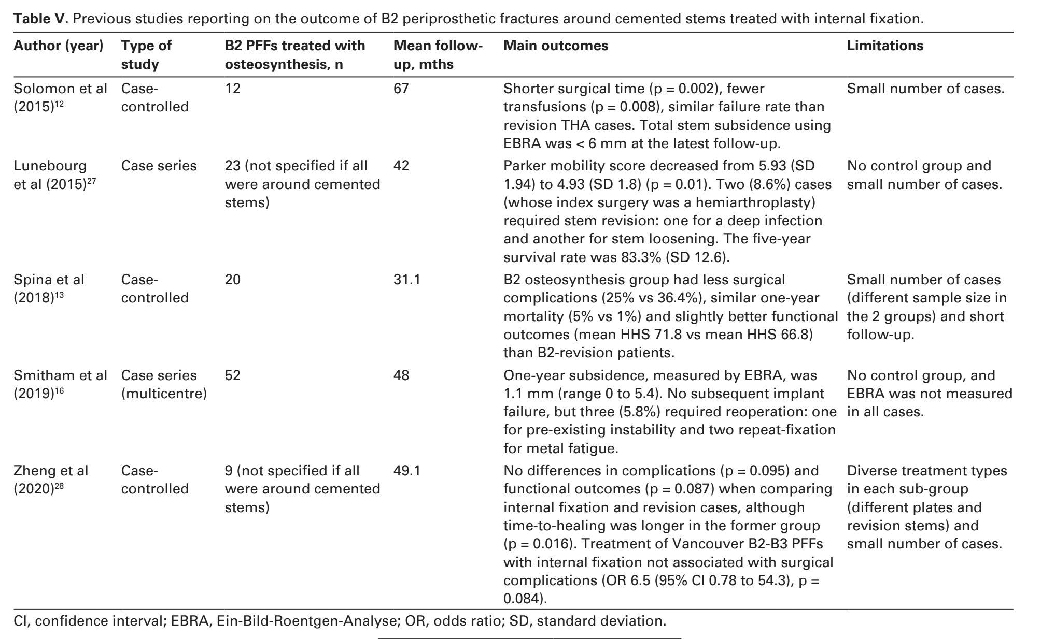
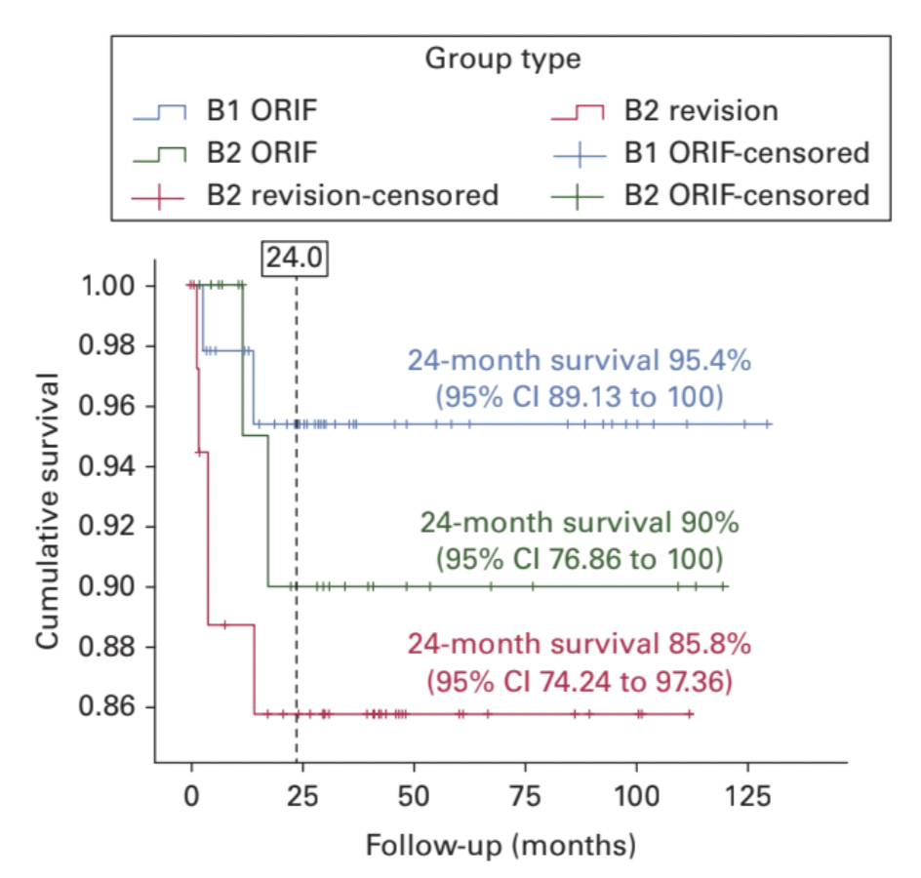
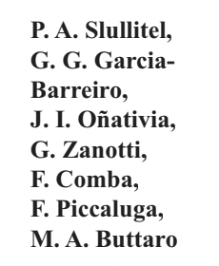
Some concerns with this algorithm
In up to 20% of unstable uncemented stems, pre-operative imaging is insufficient to make the distinction between stable and unstable (Brady et al, J Arthroplasty, 2000)
It largely depends on a reliable assessment of the implant (somehow subjective)
The binary approach of revising loose stems and fixing well-fixed ones has been called into question
Implant survival p=0.296

Slide 6
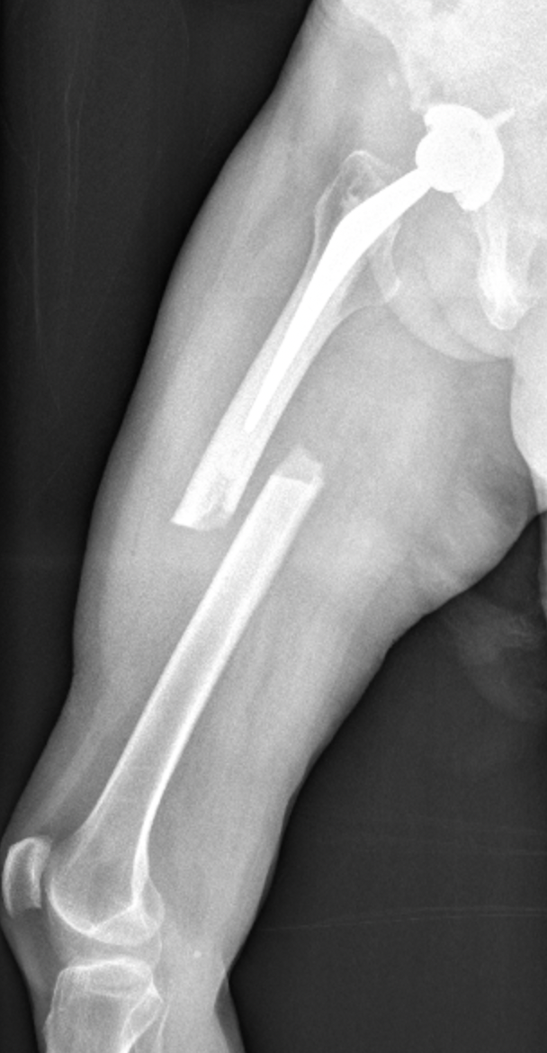
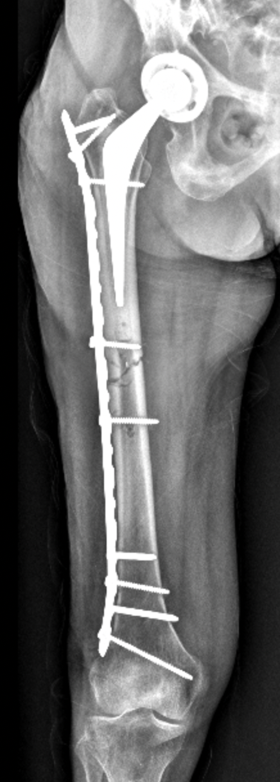
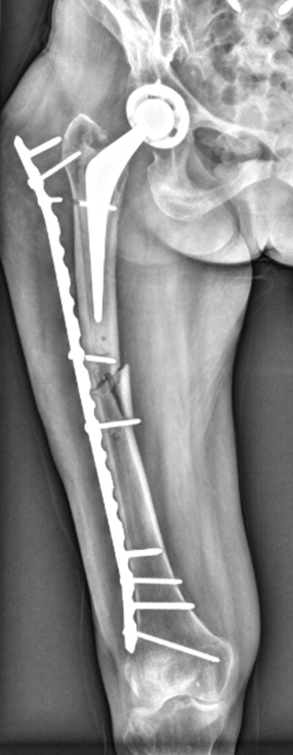
Controversial cases: B1s that behave as B2s

Slide 7
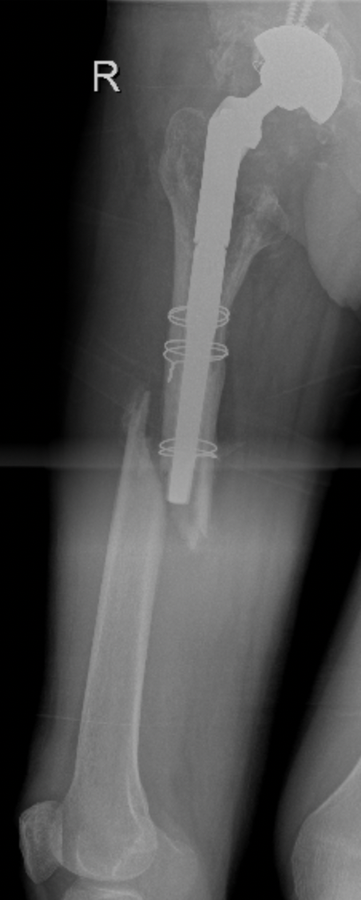
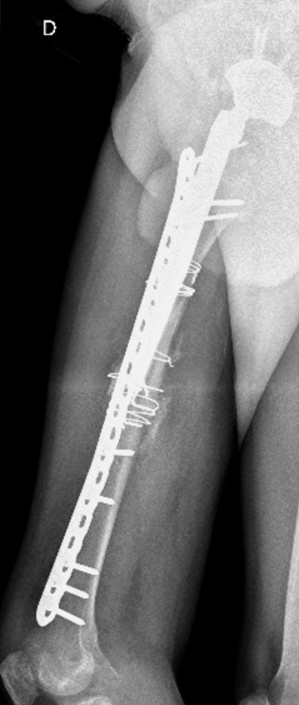
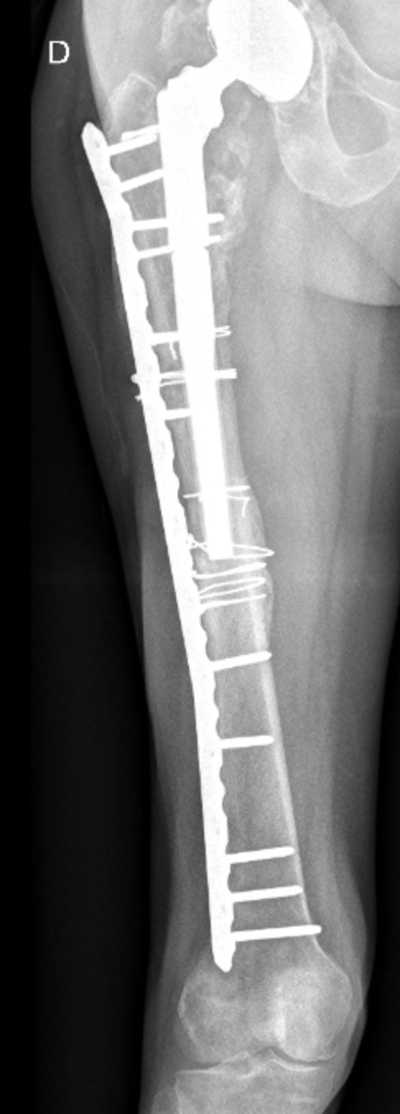
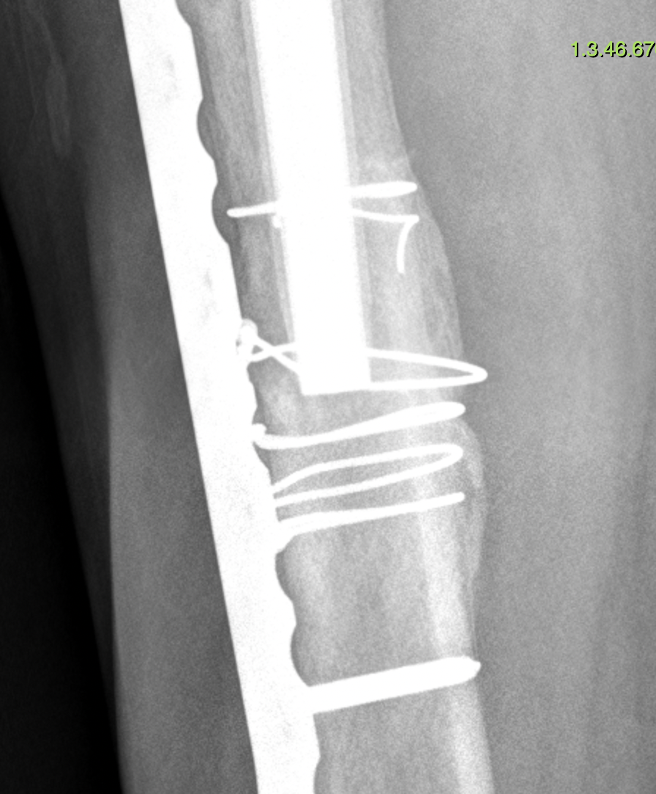
Fracture pattern (transverse or short oblique) and location

Slide 8
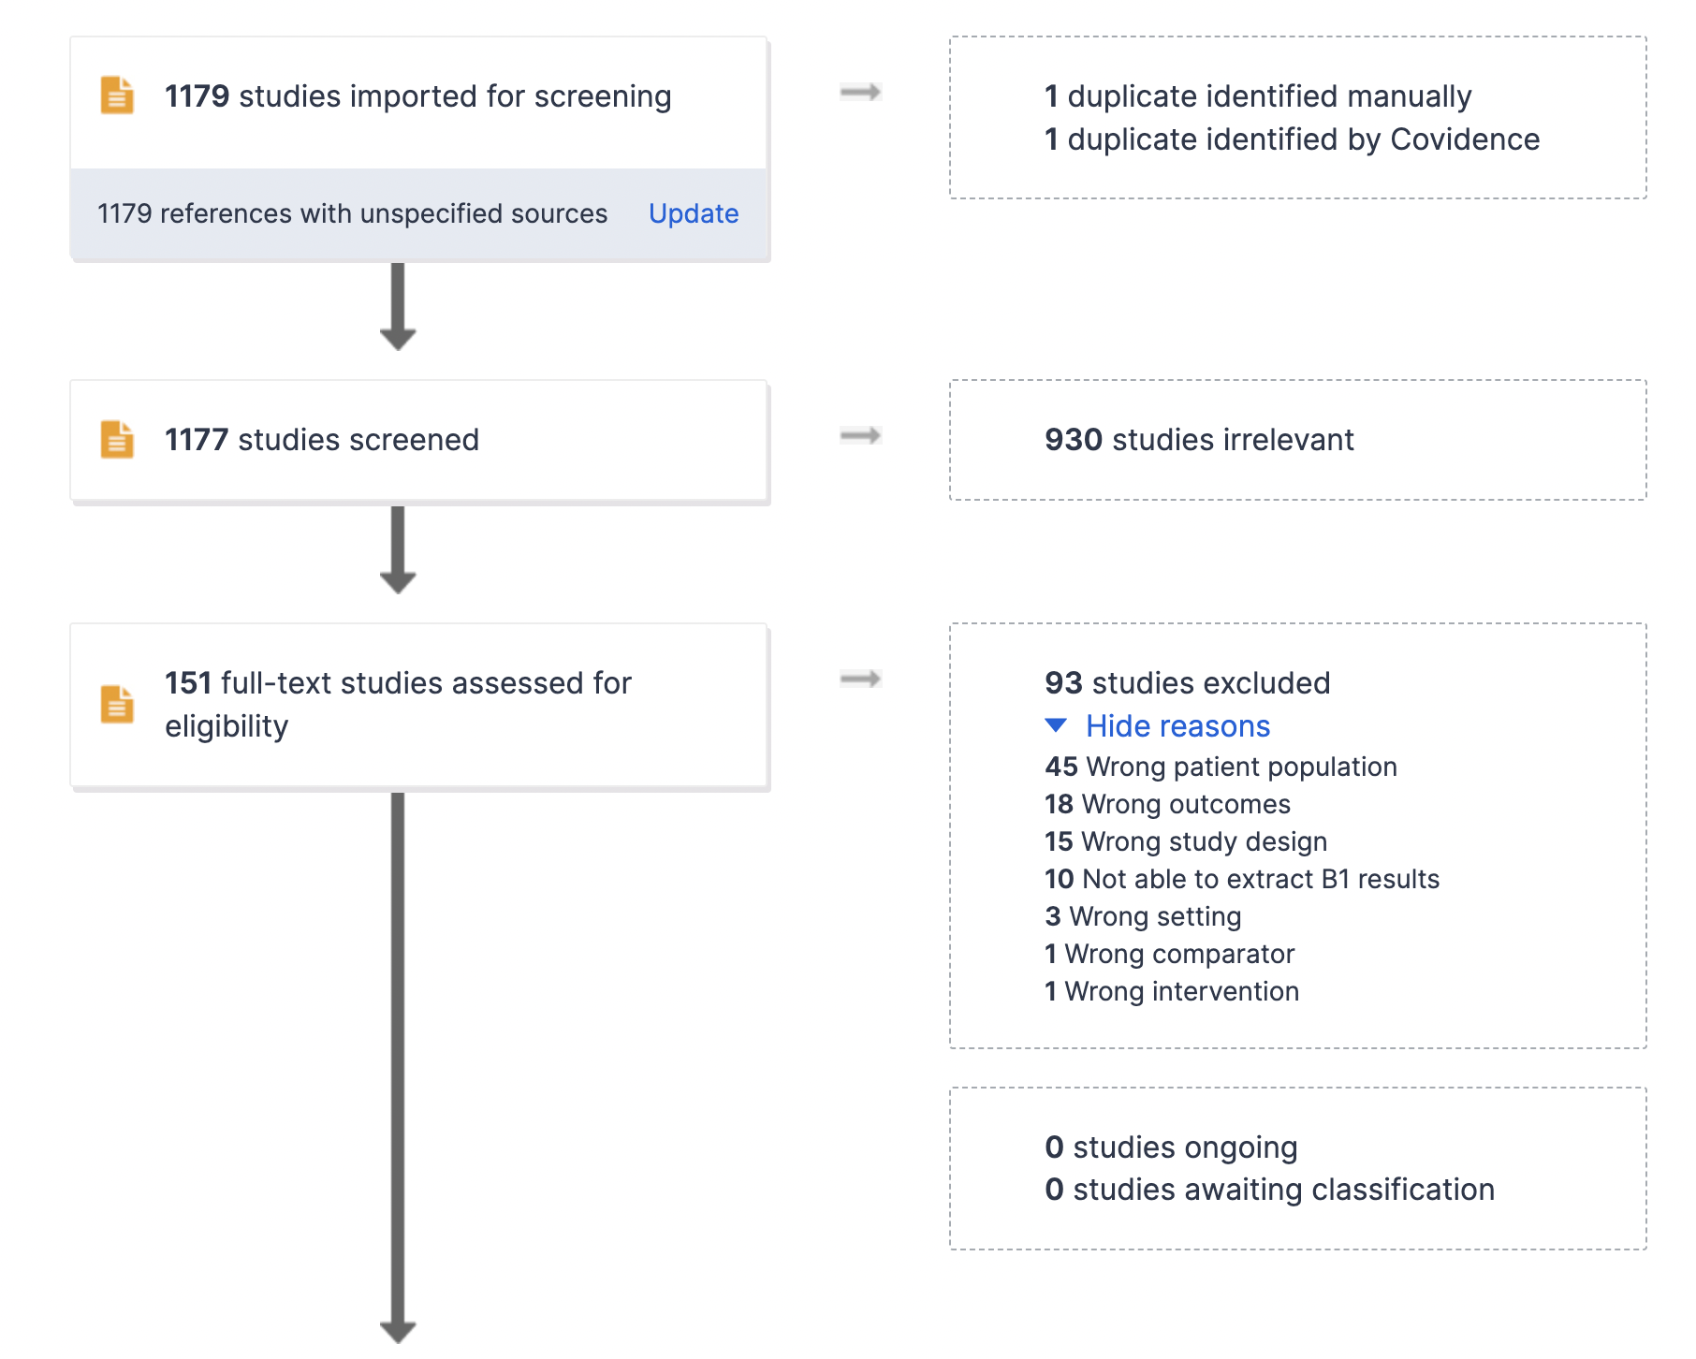
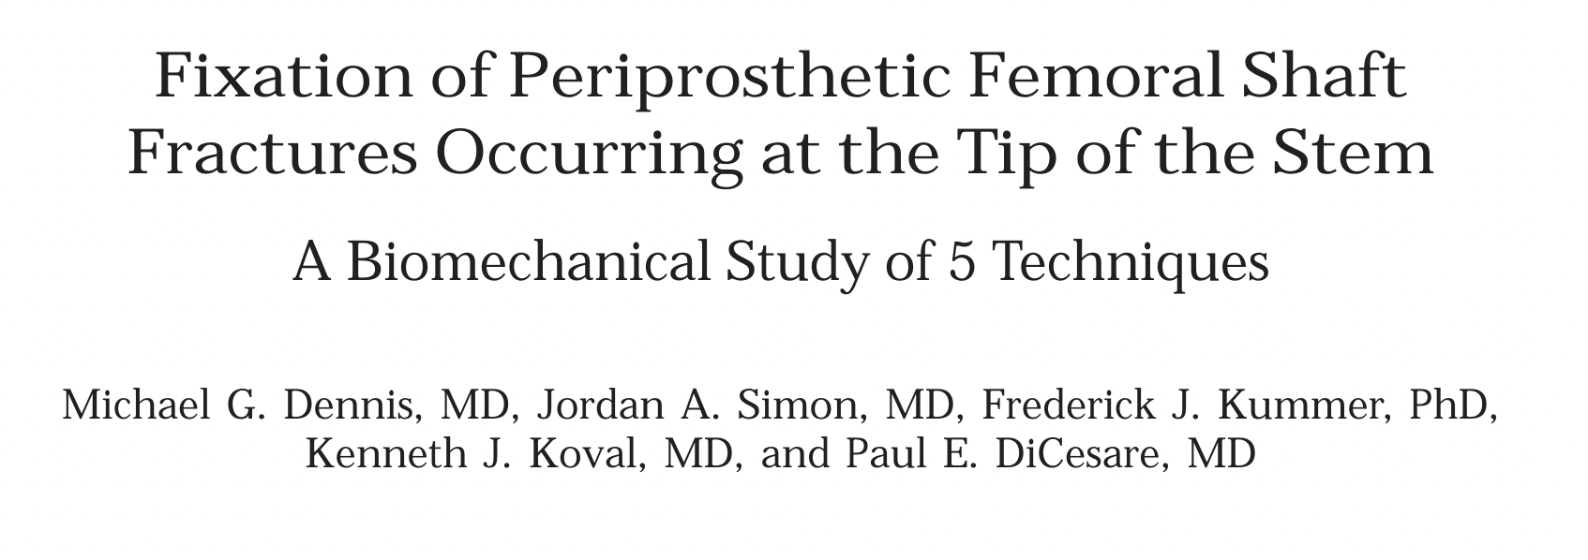
Exclusion criteria
biomechanical or cadaveric studies
editorials and commentaries
case reports
reviews
technique articles without patient data
articles not written in English language
Additional exclusion of 41 articles for including a very low number of cases
17 articles included

Slide 9
Studies without control group
Studies with control group
Against
Single plate (lateral)
(Powell–Bowns: OR 4.22; 95%CI: 1.63-10.9, p=0.008)
Recommendation:
2 orthogonal plates
Additional strut
Revision with distally-fixed stem
Tsiridis et al (Injury 2003)
Tsiridis et al (Acta Orthop 2005)
Buttaro et al (JBJS Am 2007)
Chakrabarti et al (Injury 2019)
Kang et al (Hip Pelvis 2019)
Min et al (J Clin Med Res 2020)
Powell-Bowns et al (Injury 2023)
Yeo et al (Int Orthop 2016)
Ciriello et al (Hip Int 2020)
Haddad et al (JBJS 2002)
Lindahl et al (JBJS 2006)
Pavlou et al (Hip Int 2011)
Gausden et al (J Arthroplasty 2021)
Peters et al (Orthopedics 2023)
Jain et al (BJJ 2023)
>failures with single plate vs revision
>failures with revision with cemented stems (no reaming?)
>failures with single plate vs plate + strut
>failures with single plate vs double-plating [20% (95%CI: 5%-59%) vs. 36% (95%CI: 15%-70%)]
In favour
Single plate (lateral)
All retrospective studies

Slide 10
Conservative treatment
Lee et al (J Arthroplasty 2017)
Mondanelli et al (Geriatr Orthop Surg Rehabil 2021)
No treatment: selected cases
The best treatment strategy should be adjusted for patient age and comorbidities
In many cases, damage control with a plate may be the standard of care in patients with a high risk of perioperative mortality
All retrospective studies

Slide 11
Question:
How should periprosthetic fractures at the tip of cemented or uncemented femoral stem be treated?
Response/Recommendation:
The literature supports the notion that transverse or short-oblique B1-periprosthetic femoral fractures at the level or just below the tip of the stem (either cementless or cemented) have poorer results when treated only with a single lateral plate osteosynthesis. We therefore recommend that either augmentation with an additional orthogonal plate/cortical strut allograft, or revision with a longer stem (preferably with a cementless, tapered fluted stem, with endosteal reaming during femoral preparation) bypassing the fracture level should be the gold standards for treatment.
Level of Evidence: Moderate

