Slide 1
Can cemented femoral stems be used during revision total hip arthroplasty?
Mustafa Citak, Erdem Aras Sezgin, Fabio Devito,
Amir Human Hoveidaei, Matthew Hubble, Nikolai S Nikolaev, Kasra Pirahesh, Pablo Sanz-Ruiz

Slide 2








Mustafa Citak
Erdem A Sezgin
Fabio Devito
Amir H Hoveidaei
Matthew Hubble
Nikolai S Nikolaev
Kasra Pirahesh
Pablo Sanz-Ruiz

Slide 3
Why is this topic Important?
Significant increase in number of revision total hip arthroplasty (THA) procedures and patients are younger
Uncemented stems can better preserve bone stock for potential future revisions; however, are prone to subsidence and may require longer stems for diaphyseal anchorage
Cemented stems are still a valid option especially in patients with bone defects; but, have an increased risk for aseptic loosening due to lack of biological fixation

Slide 4
Literature Review/Process
Mesh terms and keywords used
Femoral Head; Hip Dislocation; Femoral head; Liner; Isolated exchange; Hip instability*
Number of Articles Retrieved: 1409 (after duplicate removal)
Screening: 12 studies selected for full-text review
Final number of publications: 6 studies included in analysis

Slide 5
Findings from Literature
What did literature reveal
Cemented femoral stems have lower risk of dislocation
Cemented femoral stems have higher risk of aseptic loosening
Both stems have comparable infection rates
Cemented femoral stems have higher risk of periprosthetic fractures
What did your group determine to be the most important findings?
Cemented femoral stems can be used during revision THA especially in patients with capacious femoral canal and older patients with shorter life expectancies

Slide 6
What is the final recommendation
What will you put to a vote today
Voting Slide
Question:
Can cemented femoral stems be used during revision THA?
Recommendation:
Cemented femoral stems in revision THA can be used in selected patients with capacious femoral canal and older patients with shorter life expectancies.

Slide 7
Question:
Can cemented femoral stems be used during revision THA?

Slide 8
Rationale:
Studies included varied in study designs, patient numbers and follow-up durations
Cemented femoral stems were associated with lower risk of dislocation
Cemented femoral stems were associated with higher risk of aseptic loosening and periprosthetic fractures
Either femoral stems had comparable infection rates

Slide 9
Ref. Author | Country | Journal | Study Type | Centers | Number of stems | Patient Sex (M%) | Patient Age (SD) | Follow-up Duration
Iorio, 2008 | USA | The Journal of Arthroplasty | Prospective | Single | Cemented: 43, Uncemented: 43 | Cemented: 17 (40%), Uncemented: 27 (63%) | Cemented: 67.5, Uncemented: 71.2 | Cemented: 9 years, Uncemented: 7 years
Weiss, 2011 | Sweden | Acta Orthopaedica | Retrospective | Multiple | Cemented: 1073, Uncemented: 812 | Cemented: 544 (51%), Uncemented: 443 (55%) | Cemented: 76 (9), Uncemented: 72 (11) | Cemented: 4.2 years, Uncemented: 3.4 years
Wang, 2013 | China | Scientific Reports | Retrospective | Single | Cemented: 28, Uncemented: 23 | Cemented: 13 (46%), Uncemented: 16 (70%) | Cemented: 68, Uncemented: 64.3 | Cemented: 6.1 years, Uncemented: 5.5 years
Tyson, 2019 | Sweden | Acta Orthopaedica | Retrospective | Multiple | Cemented: 1,328, Uncemented: 1,668 | No. Females: Cemented: 748 (56.3) Uncemented: 955 (56.6) | Cemented: 74 (9), Uncemented: 72 (10) | Cemented: 7.5 years, Uncemented: 5.5 years
Van Dooren, 2023 | The Netherlands | Acta Orthopaedica | Retrospective | Multiple | Cemented: 555, Uncemented: 1324 | Cemented: 144 (26%), Uncemented: 419 (32%) | Not Reported | Mean: 4.1 years
Lara-Taranchenko, 2024 | Spain | European Journal of Orthopaedic Surgery & Traumatology | Retrospective | Single | Cemented: 17, Uncemented: 13 | Cemented: 8 (26,7%), Uncemented: 4 (13.3%) | Cemented: 82.8 (6.0), Uncemented: 78.4 (8.6) | Mean: 1 year
Table 1: Baseline Characteristics of the Reviewed Articles

Slide 10
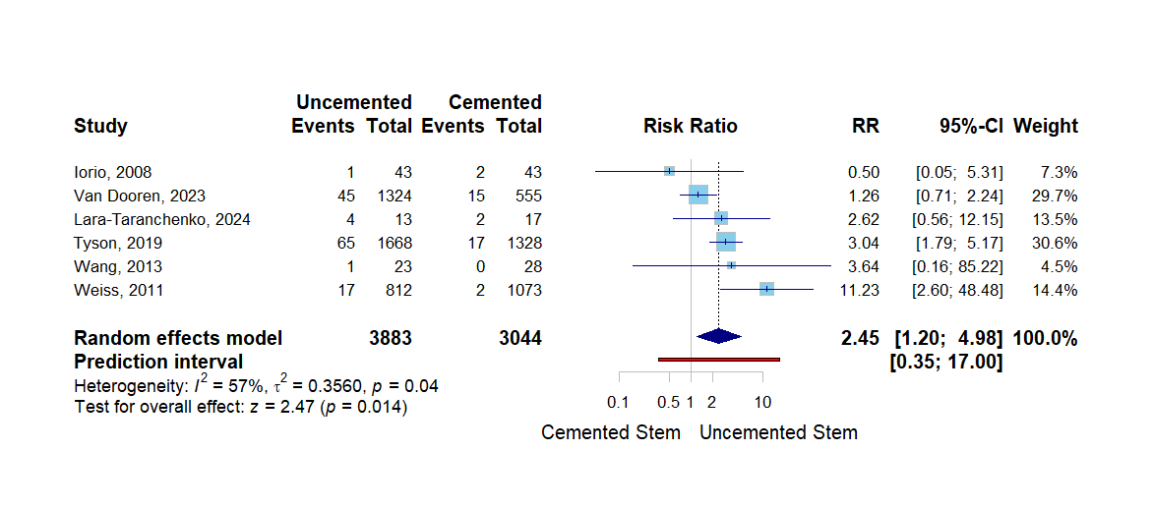
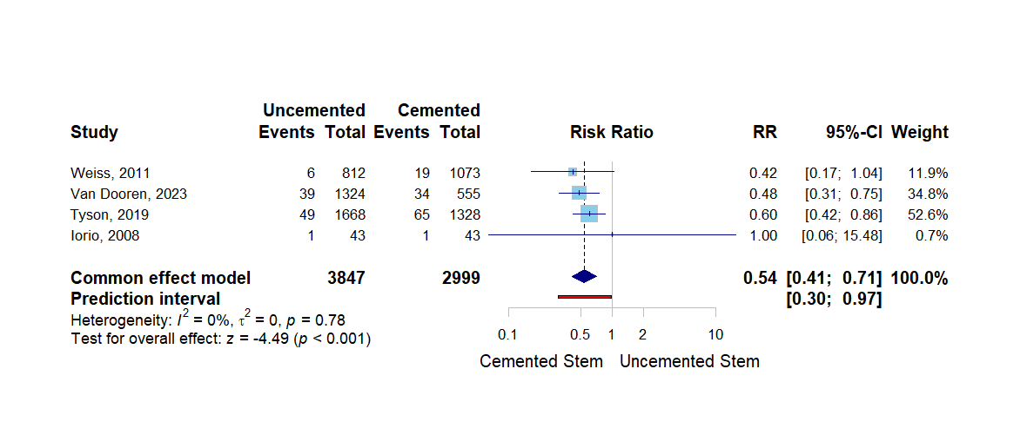
Figure 1: Dislocation rates between cemented and uncemented femoral stems in revision THA
Figure 2: Aseptic loosening rates between cemented and uncemented femoral stems in revision THA

Slide 11
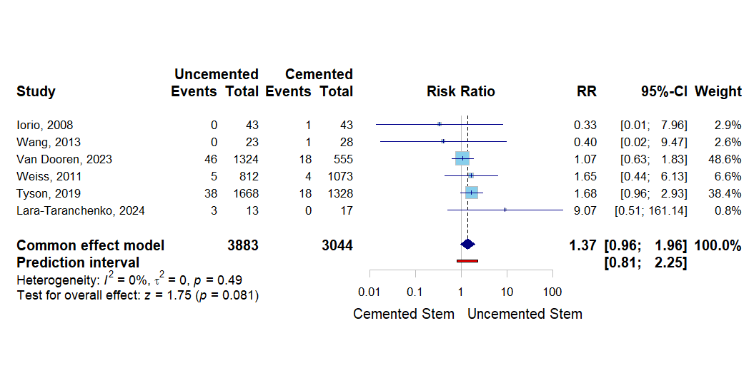
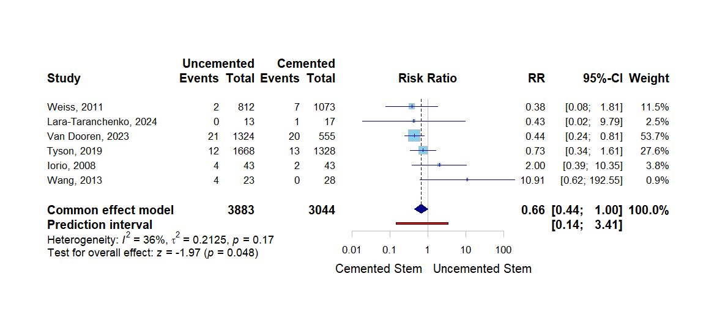
Figure 3: Infection rates between cemented and uncemented femoral stems in revision THA
Figure 4: Periprosthetic fracture rates between cemented and uncemented femoral stems in revision THA

Slide 12
Question:
Can cemented femoral stems be used during revision THA?
Response:
Yes.
Cemented femoral stems in revision THA can be used in selected patients with capacious femoral canal and older patients with shorter life expectancies.

