Slide 1
What is the Most Optimal Bearing Surface for Minimizing Instability After Revision Total Hip Arthroplasty?
Joshua S. Bingham MD
Saad Tarabichi MD
Mohamed ElKabbani MD
Jens T. Verhey MD
Ahmed H. Abdelazeem MD
Tim Petheram MD
Pieralberto Valpiana MD
Koos Jordan
Sulaiman Alazzawi MD
Liu Xian-Zhe MD
Wierd P. Zijlstra MD

Slide 2












Slide 3
Why is this topic important
Instability remains one of the leading causes of failure following revision total hip arthroplasty (THA). Despite recent advancements in implant design, the optimal bearing surface to prevent instability and dislocation after revision THA remains unclear.

Slide 4
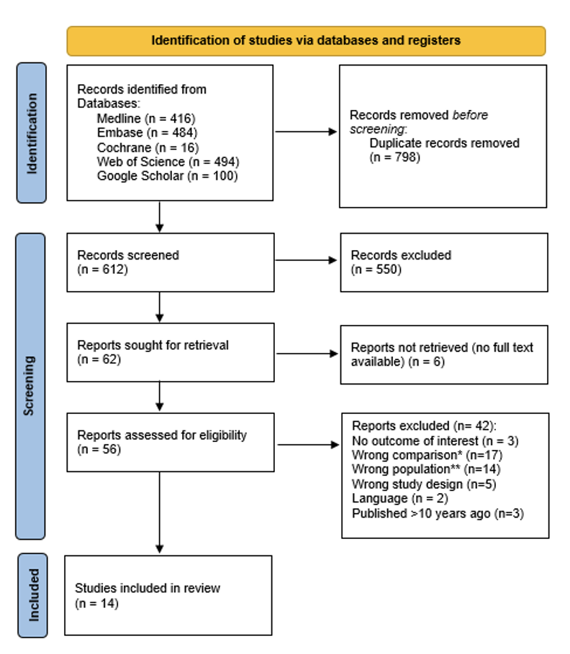
Literature Review/Process
Mesh terms used
((revision* OR revised) ADJ3 (hip arthroplast* OR hip replacement* OR hip total arthroplast* OR hip total joint replacement* OR hip total replacement* OR THA) AND ((constrain* adj3 (liner* OR cup* OR device* OR implant* OR component* OR bearing* OR socket* OR construct* OR insert* OR THA OR arthroplast*)) OR ((big OR bigger OR large) adj3 (head* OR bearing*)) OR 36mm OR 36 mm OR 40mm OR 40 mm OR 42mm OR 42 mm OR 44mm OR 44 mm OR dual mobility OR double mobility OR mobile bearing OR dualmobility OR dual-mobility OR mobile-bearing OR DMC

Slide 5
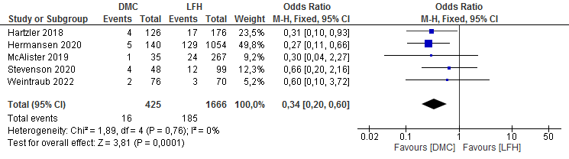
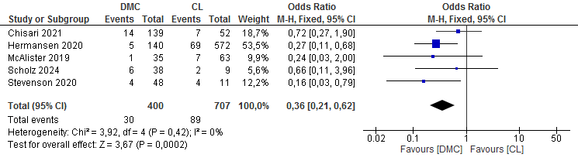
Findings from Meta-Analysis

Slide 6
Question:
What is the Most Optimal Bearing Surface for Minimizing Instability After Revision Total Hip Arthroplasty?

Slide 7
Rationale:
DM implants (odds ratio [OR] 0.34 [95% CI 0.20 to 0.60]; p<0.001) were associated with a significant reduction in the risk of dislocation when compared to LFH.
DM implants (OR, 0.36 [95% CI 0.21 to 0.62]; p<0.001) were also found to be protective against dislocation when compared to CL.
There was no difference in the dislocation rate between patients that received LFH and those that received CL (p=0.56).

Slide 8
Question
What is the Most Optimal Bearing Surface for Minimizing Instability After Revision Total Hip Arthroplasty?
Response:
Based on the results of our metanalysis, dual mobility implants appear to have the most efficacy in preventing the risk of instability in high risk patients undergoing revision THA, when compared to those that received large femoral heads and constrained liners.

