Slide 1
What is the most optimal surgical treatment for patients with a chronic pelvic discontinuity?
Dr Rajeev K Sharma
Moolchand Medcity
New Delhi, INDIA

Slide 2




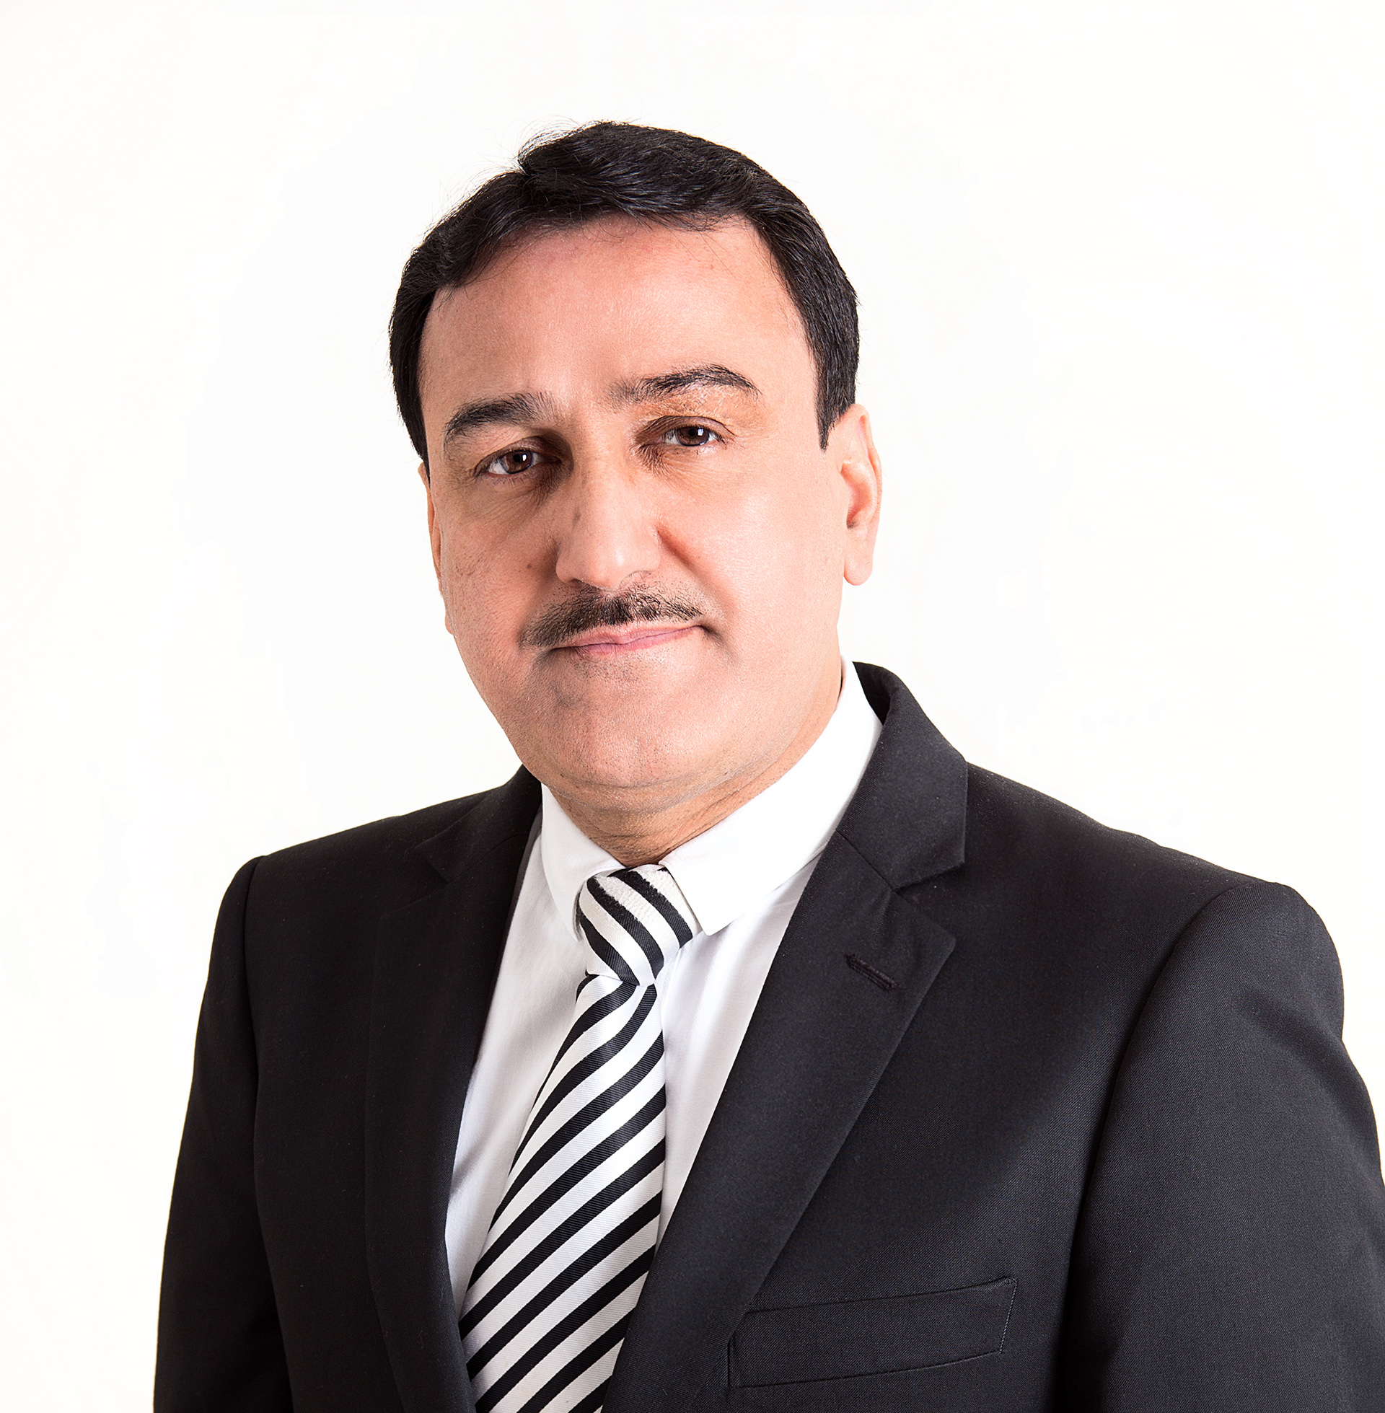
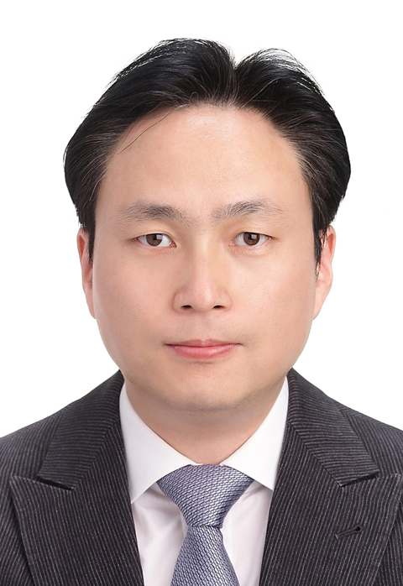

Abdullah Hammad
Joris Ploegmakers
Li Cao
Neil P. Sheth
Rajeev K. Sharma
Seung-Hoon Baek
Wenbo Mu

Slide 3
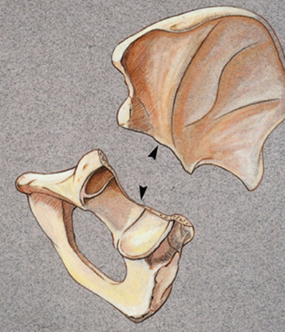
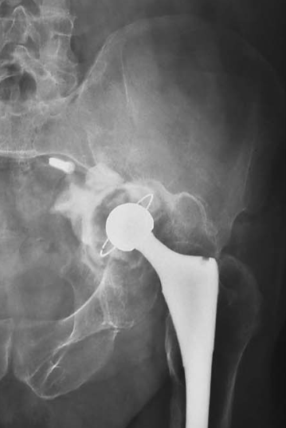
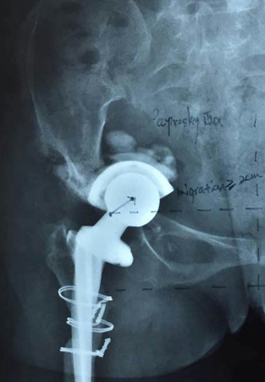
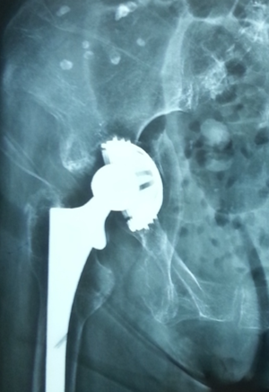
Patient Outcomes: | Effective surgical treatment for chronic PD can significantly reduce pain, restore mobility, and enhance overall functional outcomes, thereby improving patient quality of life and long-term prognosis.
Surgical Challenges: | PD's severe bone loss and instability pose substantial technical challenges, requiring surgeons to navigate complex anatomy and ensure stable, durable reconstructions with effective techniques and materials for successful outcomes.
Restoration of Biomechanics: | Proper surgical intervention aims to restore hip and pelvis biomechanics, crucial for implant stability, preventing complications, and enabling patients to perform daily activities and maintain an active lifestyle.
Advancements in Techniques: | Reviewing and determining optimal treatments for PD integrates the latest advancements in orthopedic surgery, enhancing patient care and outcomes.
Economic Considerations: | Optimizing PD surgery protocols reduces healthcare costs by minimizing revisions and hospital stays, leading to quicker recoveries and less burden on healthcare systems.
Professional Consensus: | A consensus among orthopedic experts on optimal PD treatments ensures a standardized approach, facilitating global dissemination and consistent training for new surgeons, thereby improving patient care across regions.

Slide 4
"Pelvic Discontinuity" [MeSH Terms]
("pelvic" [All Fields] OR "acetabular" [All Fields]) AND ("discontinuity" [All Fields] OR "disassociation" [All Fields])
"Surgical Procedures, Operative" [MeSH Terms] OR "surgical treatment" [All Fields]
1 OR 2 AND 3
("clinical trial" [Publication Type] OR "observational study" [MeSH Terms] OR "case report" [MeSH Terms] OR "cohort study" [MeSH Terms] OR "cross-sectional study" [MeSH Terms] OR "case-control study" [MeSH Terms] OR "comparative study" [MeSH Terms])
4 AND 5
"humans" [MeSH Terms] NOT "animals" [MeSH Terms]
6 AND 7

Slide 5
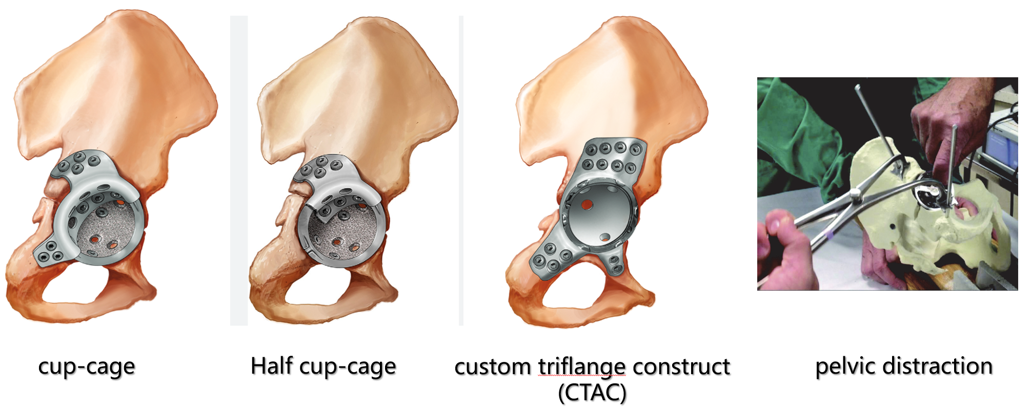
Cup-Cage
Half Cup-Cage
Custom Triflange
Construct (CTAC)
Pelvic Distraction

Slide 6
1. Cup-Cage Construct
  Survivorship: 66.7-100% at follow-up of 2.9 to 9.6 years.
  Harris Hip Score improvement: From 29-39 to 72-76 points.
  Complication rate: overall 7-29 %: dislocation (7-10%), nerve injury (3%), and infection (8%)
2. Custom Triflange Acetabular Components (CTAC)
  Survivorship: 89-95% over 2 to 15.2 years
  Infection Rate: 5.7% - 12.2%.
  Reoperation Rate: 6.1% - 37.5%.
  Overall Complication Rate: Up to 49%
3. Acetabular Distraction Technique
  Survivorship: 90% - 100% over 2 to 4.8 years.
  Complication Rate: 8% - 29%
4. Cage-Related Methods
  Survivorship:
    Ilioischial cages: 66.7% at 2.9 to 13.5 years.
    Non-ilioischial cages: 60.6% at 4.5 to 6.2 years.
    Pelvic plating with a hemispherical shell: 72.7%.
  Complication Rates:
5. Acetabular Component with Stem
  Survivorship: 91% at 5 years.
  Harris Hip Score Improvement: From 41 to 79 points.
  Complication Rate: 28.6%, including periprosthetic infection (8%) and hip dislocation (12%)
What is the final recommendation
What will you put to a vote today
 | Aseptic loosening | Dislocation | PJI
Ilioischial cages | 18.4 % | 7.9 % | 6.1 %
Non-ilioischial cages | 39.4 % | 15.2 % | 9.1 %
Pelvic plating with hemispherical shell | 10.6 % | 9.1 % | 7.6 %

Slide 7
Question :
What is the most optimal surgical treatment for patients with a Chronic Pelvic Discontinuity?

Slide 8
Rationale:
Cup-cage and custom triflange acetabular components (CTACs) show good short- to mid-term outcomes but with high complication rates.
Acetabular distraction technique has lower complication rates, however with limited long-term data.
Asymmetric acetabular component with iliac fixation offers encouraging mid-term results and may be suitable for complex cases with associated chronic pelvic discontinuity.
Ongoing research and patient-specific considerations are crucial for optimizing treatment strategies.

Slide 9
Question
What is the most optimal surgical treatment for patients with a chronic pelvic discontinuity?
Response
Cup-cage construct and CTACs (Custom Triflange Acetabular Components) prove to be most reliable methods with mid-to-long outcomes.

