Slide 1
Should patients be weightbearing when obtaining preoperative radiographs of the hip and knee?
Graham S. Goh, MD
Boston University

Slide 2








Graham Goh
USA
Chahine Assi
Lebanon
Jesse Kuiper
Netherlands
Tarek El Khadrawe
Egypt
Paul Jutte
Netherlands
Lyes Aitelhadj
Algeria
Fahri Erdogan
Turkey
Harmen Ettema
Netherlands

Slide 3
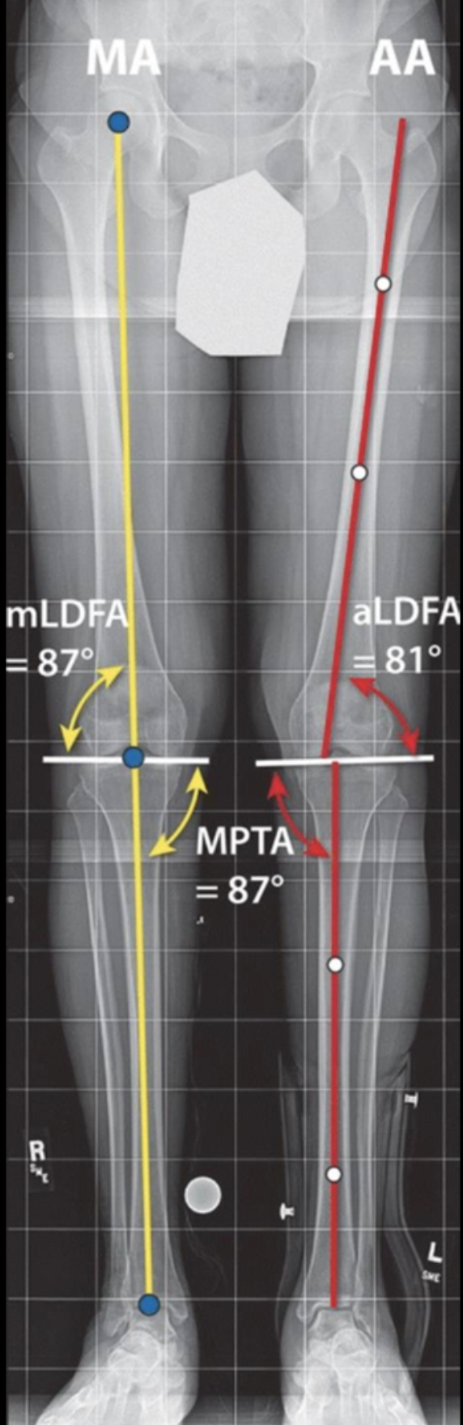
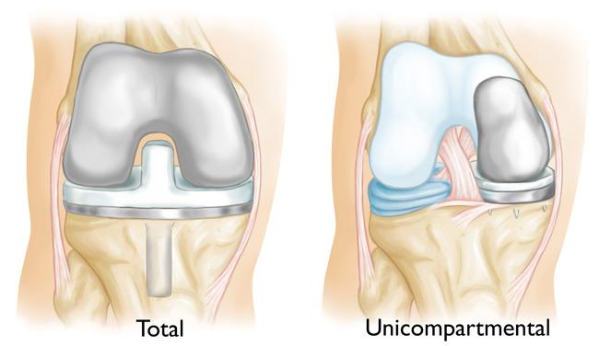
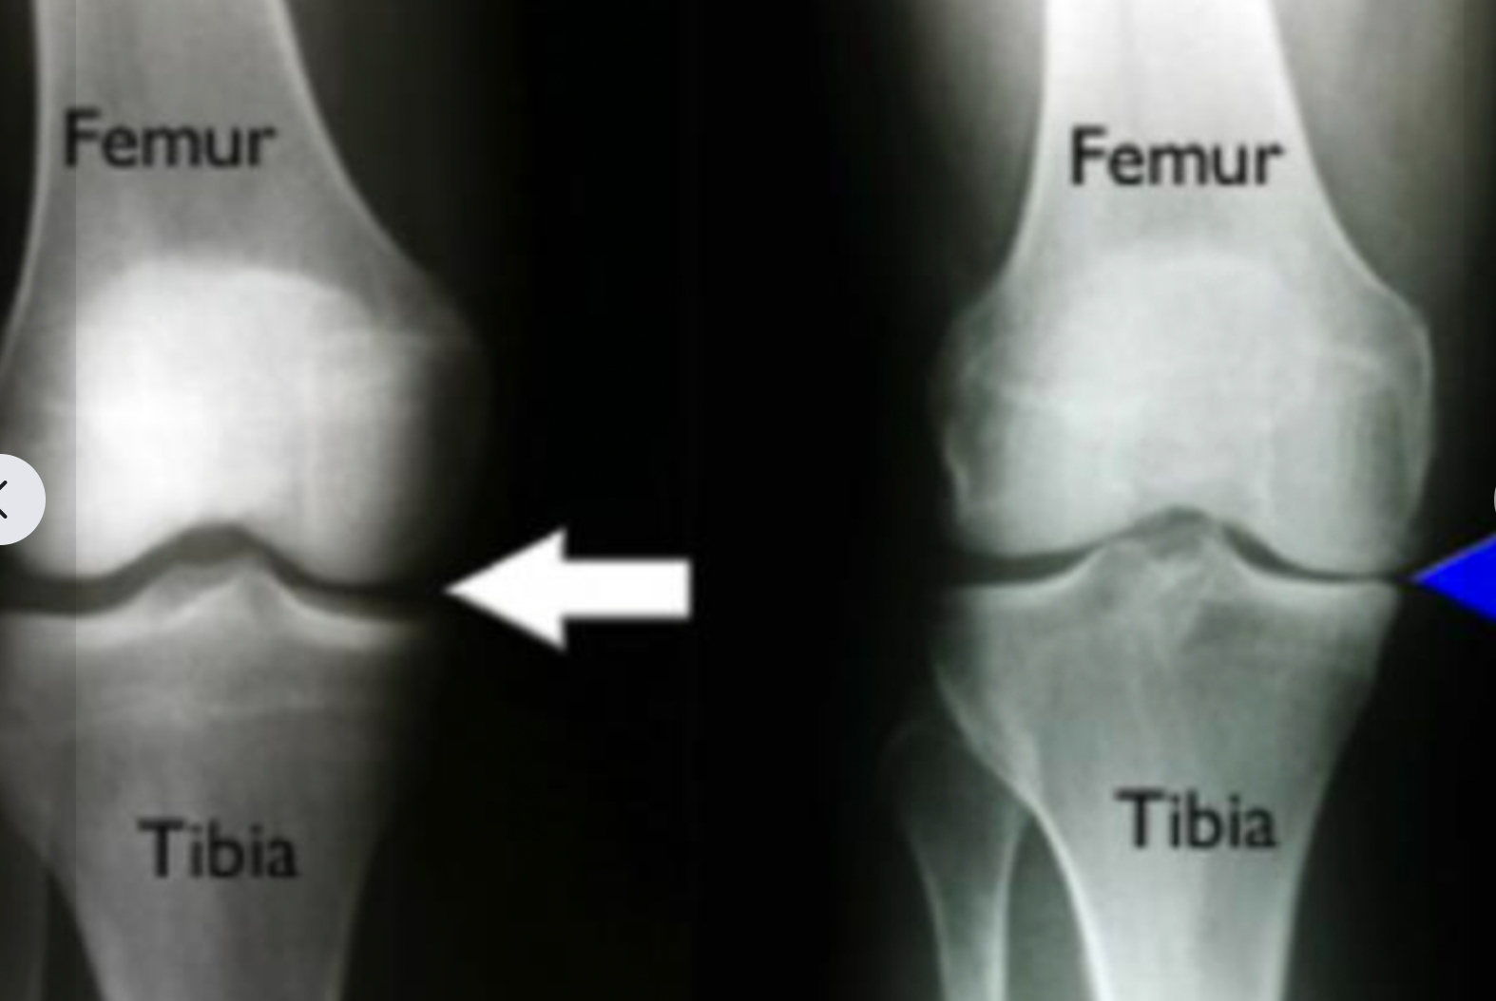
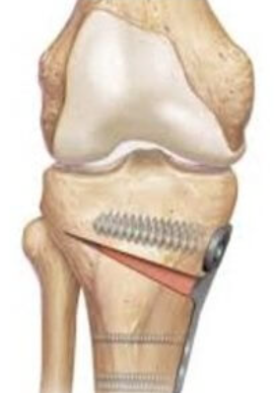
Why is this topic Important
Preop radiographs → decision-making + preop planning
KNEE
Notes:
Joint space narrowing (JSN)
→ Compartments

Slide 4
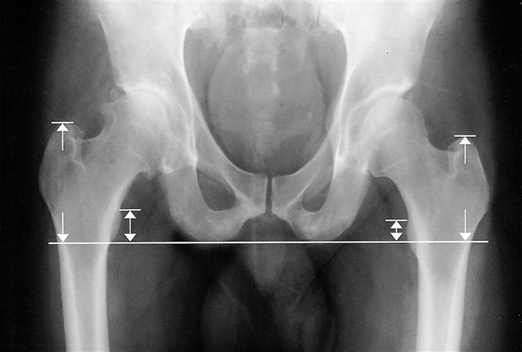
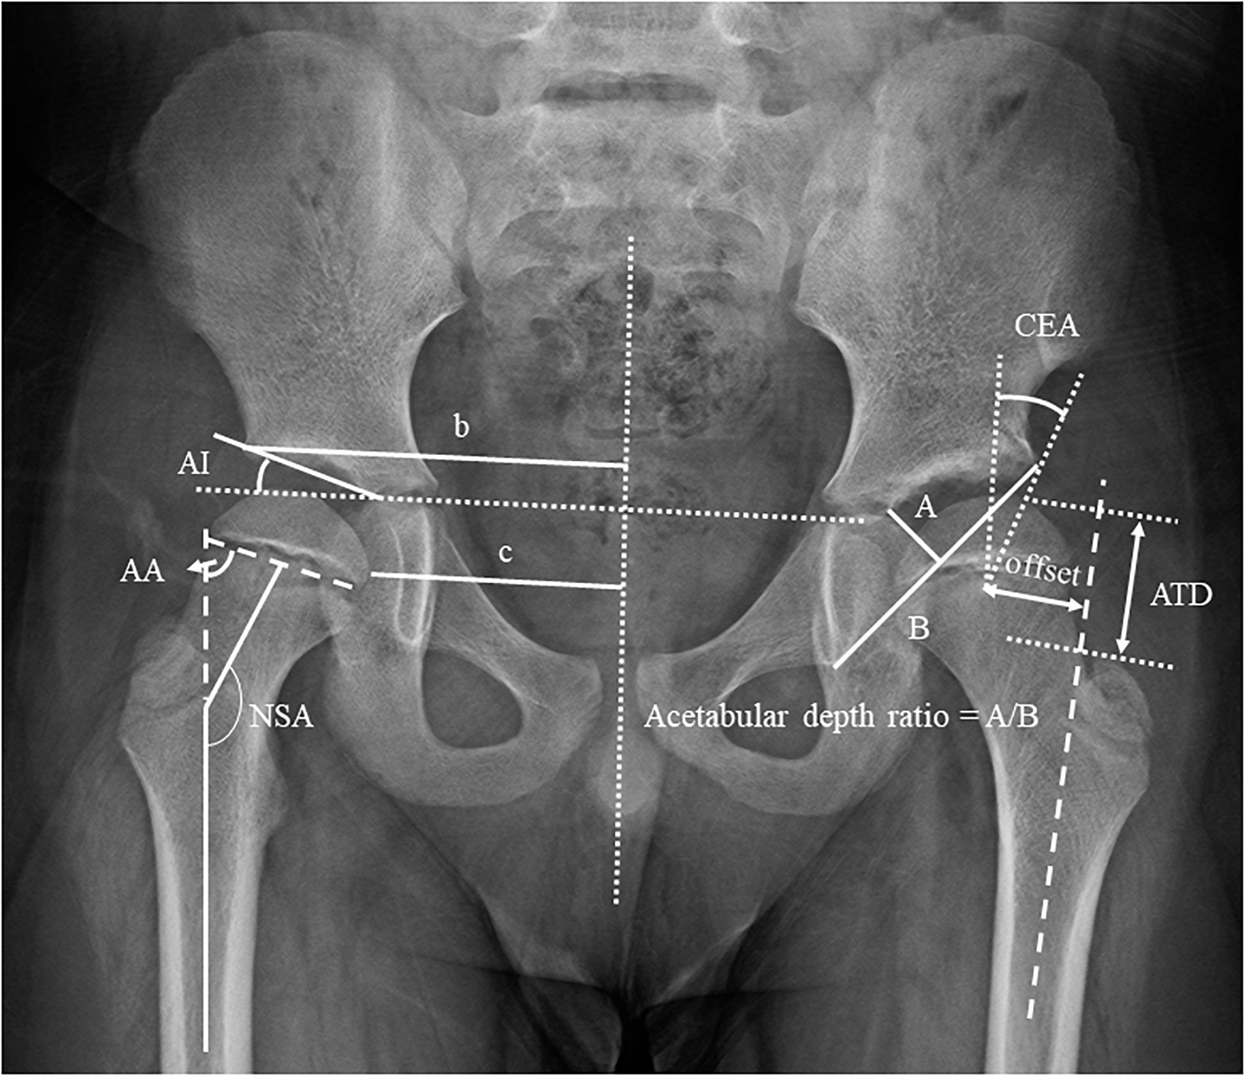
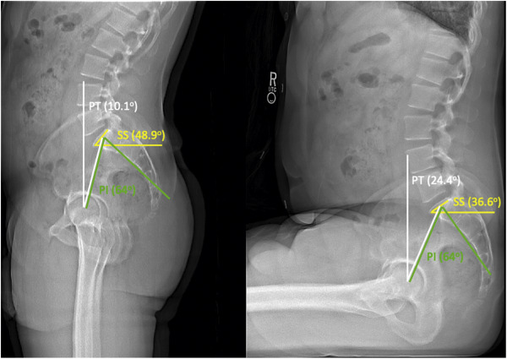
Why is this topic Important
Preop radiographs → decision-making + preop planning
HIP

Slide 5


Literature Review
MeSH Terms
Radiograph
X-ray
Weightbearing
Preoperative
Hip
Knee
789 articles screened
48 full-texts reviewed

Slide 6
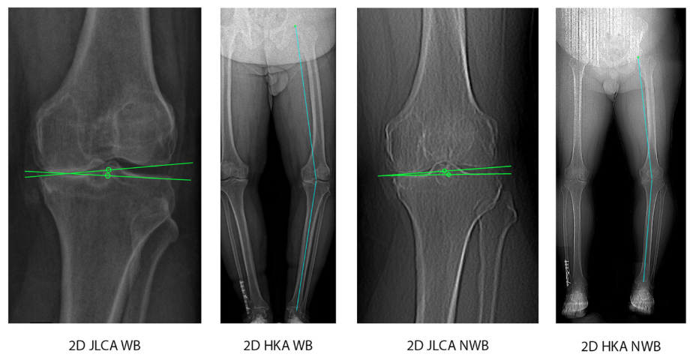
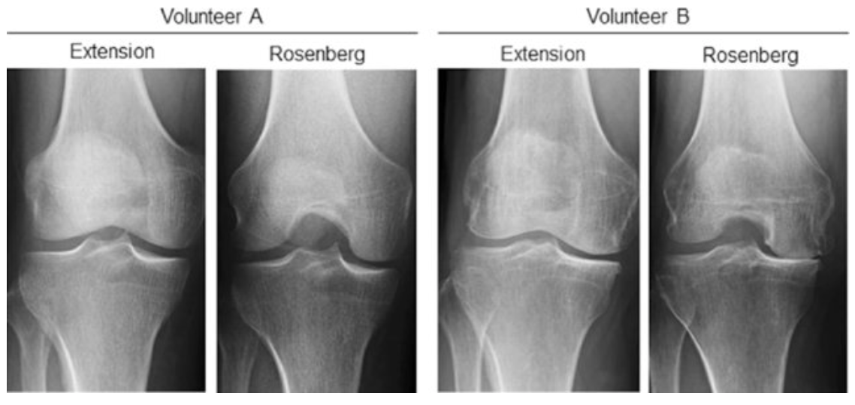
Literature Review
KNEE
45° PA flexion view was more sensitive to joint space
-- especially for lateral wear
-- not for early disease
Mechanical axis can differ up to 2°
-- depends on tissue laxity
Notes:
underestimation in patients with medial arthrosis was small and acceptable. However, in patients with lateral arthrosis, more pronounced discrepancies were found
45 deg PA flexion view was more sensitive to joint space narrowing than standing anteroposterior (AP) projections.
This assertion was subsequently supported by biomechanical data demonstrating that peak articular stresses at the femorotibial articulation occurred at 28° flexion because of diminished contact area
Using a minimum difference of 2 mm in joint space width between the medial and lateral compartments as a criterion for predicting articular cartilage ulceration or erosion on arthroscopy, they found a greater sensitivity with the 45° PA projection (80–85%) compared to standing AP radiographs (25–30%) and there were no false positives for either the medial or lateral compartments in their study
Dervin et al. found that the 45° PA was superior for detecting lateral compartment wear, but offered no advantage on the medial side
The lateral joint space height averaged 1 .0 ± 1.7 mm on the 45° PA radiograph compared to 2.7 ± 1.1 mm on the 3-foot standing AP view. Using a cut-point of 2 mm or less to predict Grade IV chondral changes, the 45° PA view was more sensitive than the standing AP view (83% versus 42%) at correctly detecting the most severe chondropathy.
mechanical axis angle measured on weightbearing radiographs can differ up to 2.0° from radiographs in the supine position [4,5]. Positioning a patient supine eliminates the ground reaction force on the knee, which can underestimate alignment deformity. The knee adduction moment, which forces the knee into varus during weightbearing, is not captured in the supine position.
Several factors may affect the extent of an alignment discrepancy between supine and standing radiographs, which include severe soft tissue laxity around the knee joint [5,21] as well as the difference in joint attrition [22,23]. In patients with increased ligamentous laxity, the difference in HKA measured on standing and supine whole-leg radiographs may be even more pronounced [24]. In contrast, when the soft tissues are balanced after TKA, the postoperative difference in HKA measured on weightbearing and non-weightbearing radiographs decreases [25].

Slide 7
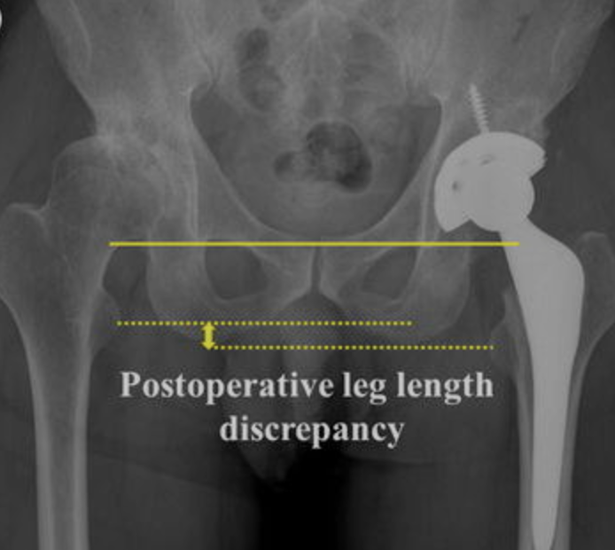
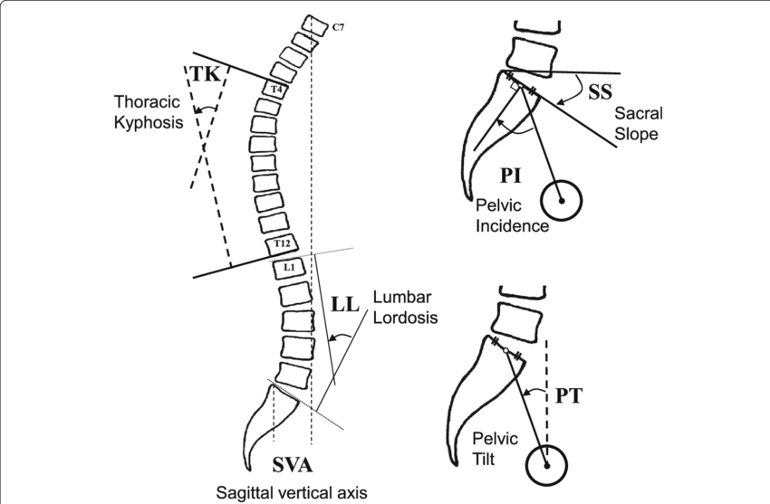
Literature Review
HIP
(1) supine AP pelvis, (2) standing AP pelvis, (3) standing lateral pelvis, (4) seated lateral pelvis
LLD: no cases varied by >1 cm
Variation in PT is well established
Small decrease in AC was found in several reports
Variations in LCEA and SA remain contentious
Notes:
Hip-Spine Workgroup therefore advocates that four static radiographs be obtained for preoperative planning prior to THA: a supine AP pelvis, a standing AP pelvis, a standing lateral pelvis, and a seated lateral pelvis [29]. These images should be ideally obtained on 36-inch radiographic cassettes or by stereoradiography (EOS Imaging,
sagittal spinopelvic alignment parameters have been described: lumbar lordosis (LL), pelvic incidence (PI), spinopelvic tilt (SPT), and sacral slope (SS)
By comparing the standing and seated lateral radiographs, the hip surgeon will be able to assess the change in pelvic tilt, as measured by the AP pelvic tilt, SPT, or SS. Changes to these values that are <20 degrees from standing to sitting implies a stiff spine that will be unable to tilt posteriorly in a sitting position, increasing the risk of femoroacetabular impingement and resultant instability or premature component wear.
not only influences alignment targets, but also influences the bearing choice at times, as some surgeons advocate for the use of a dual-mobility liners in at-risk patients in an effort to maximize stability
Bhanushali et al. analyzed the anterior coverage (AC), posterior coverage (PC), lateral centre-edge angle (LCEA), acetabular inclination (AI), sharp angle (SA), pelvic tilt (PT), retroversion index (RI), femoroepiphyseal acetabular roof (FEAR) index, femoroepiphyseal horizontal angle (FEHA), leg length discrepancy (LLD), and pelvic obliquity (PO)

Slide 8
Question:
Should patients be weightbearing when obtaining preoperative radiographs of the hip and knee?

Slide 9
Rationale:
Despite the limitations of conventional radiographs, they remain the most practical and readily available imaging tools for preoperative planning in patients with hip and knee arthritis. It is the consensus of this panel that weightbearing radiographs should be obtained whenever possible as they provide additional information on joint space narrowing, lower extremity alignment, the spinopelvic relationship, limb length discrepancy and other radiographic parameters. This also provides additional information on the affected joint in functional positions. Technological advancements such as the EOS imaging system could enhance the accuracy and comprehensiveness of these assessments, supporting the use of weightbearing radiographs as standard practice.

Slide 10
Question:
Should patients be weightbearing when obtaining preoperative radiographs of the hip and knee?
Response:
Current literature supports the use of weightbearing radiographs in the preoperative evaluation of patients undergoing hip and knee arthroplasty.
This approach not only provides a more accurate representation of anatomical considerations such the degree of joint space narrowing, lower extremity alignment and other radiographic parameters, but also provides additional information on the affected joint in functional positions.

